Slide 1
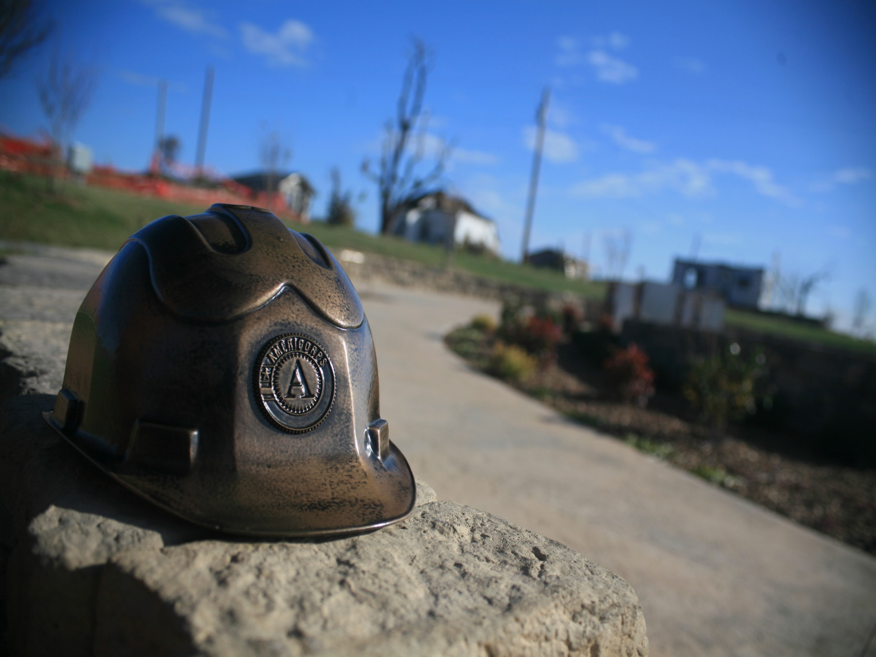
Volunteer Management
AmeriCorps St. Louis
www.ACSTL.org

Slide 2
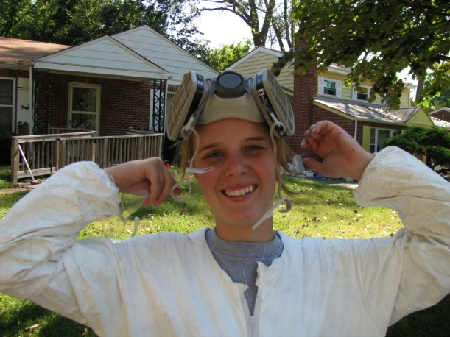
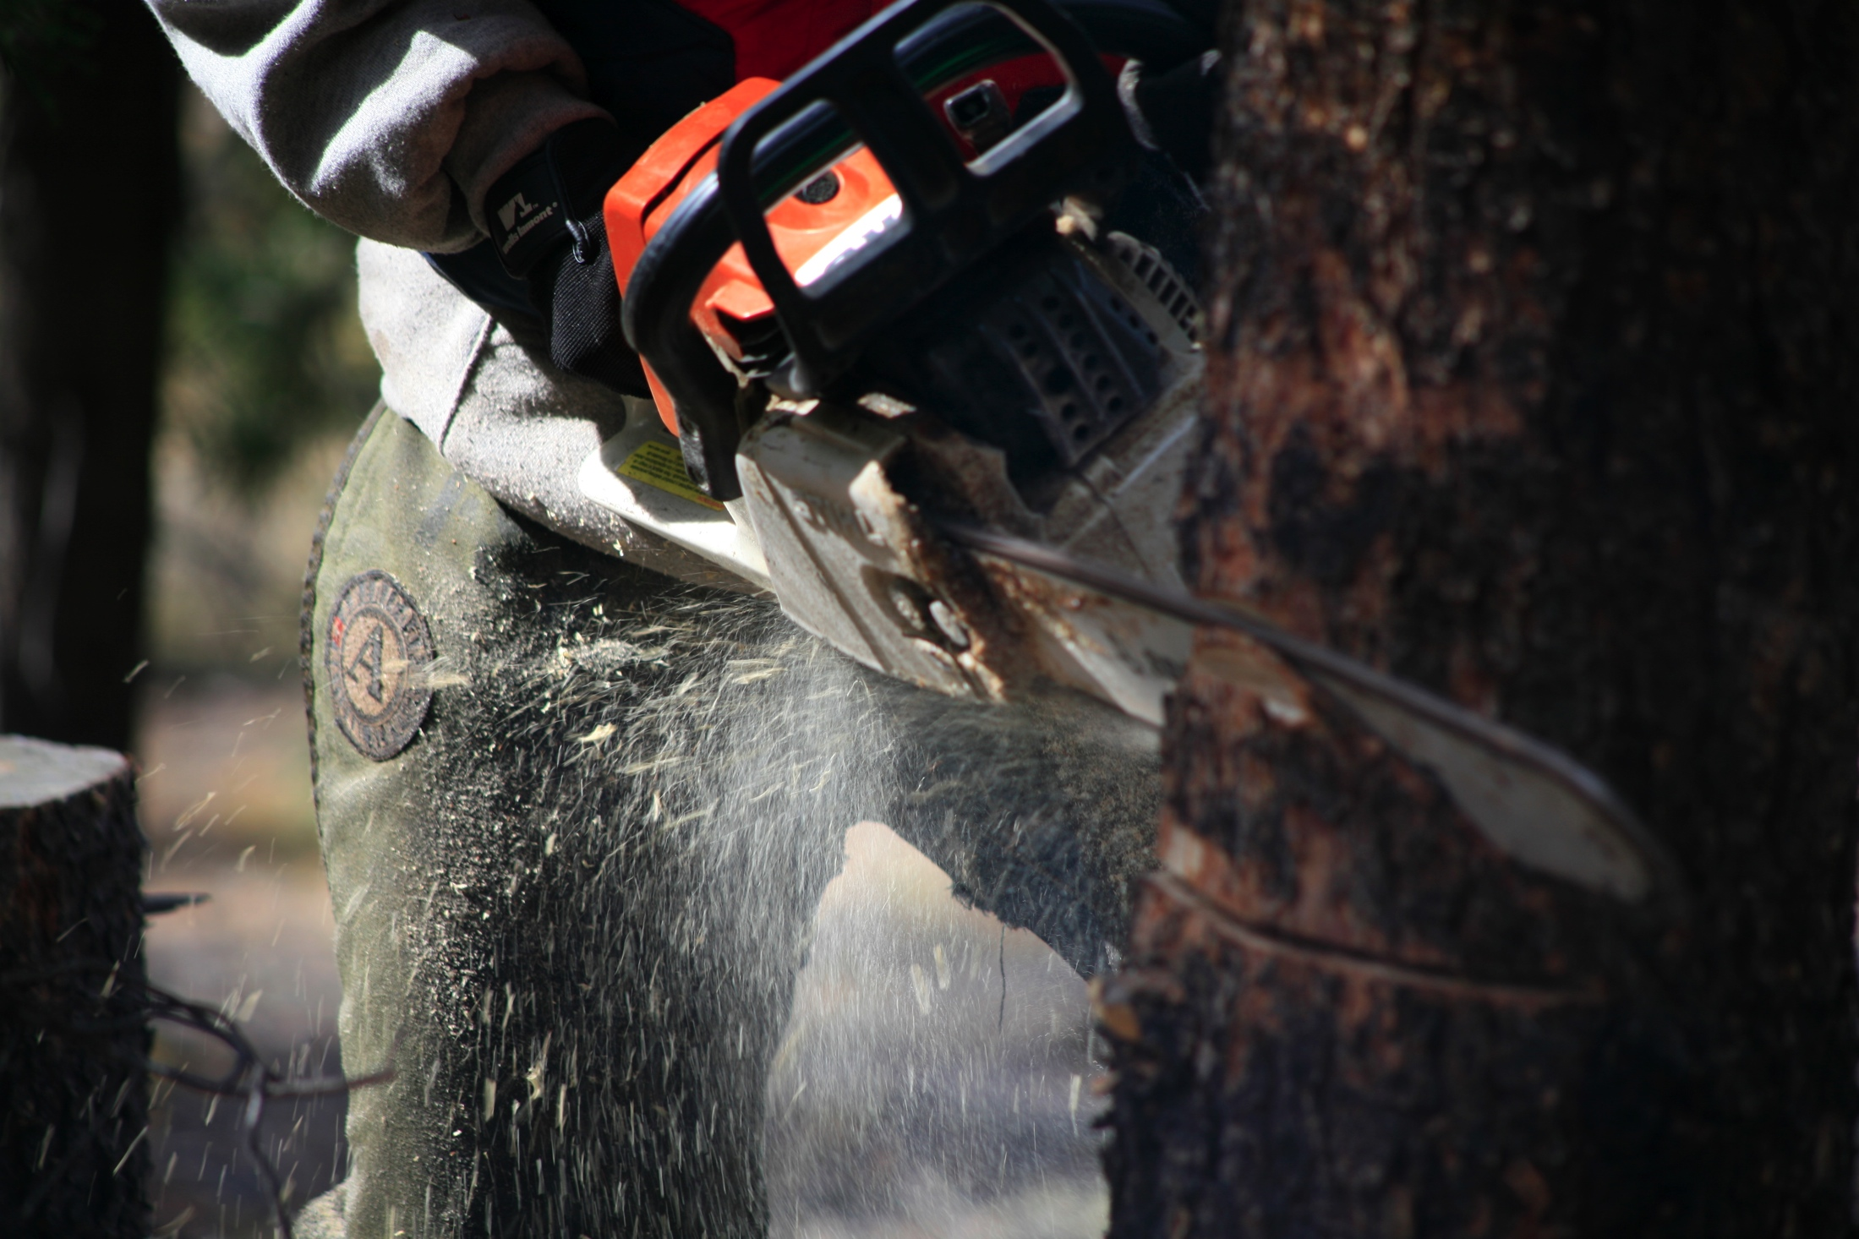

AmeriCorps St. Louis
Getting Things
Done
WWW.ACSTL.ORG
Filling unmet needs in education, disaster response, land stewardship
and volunteer coordination

Slide 3
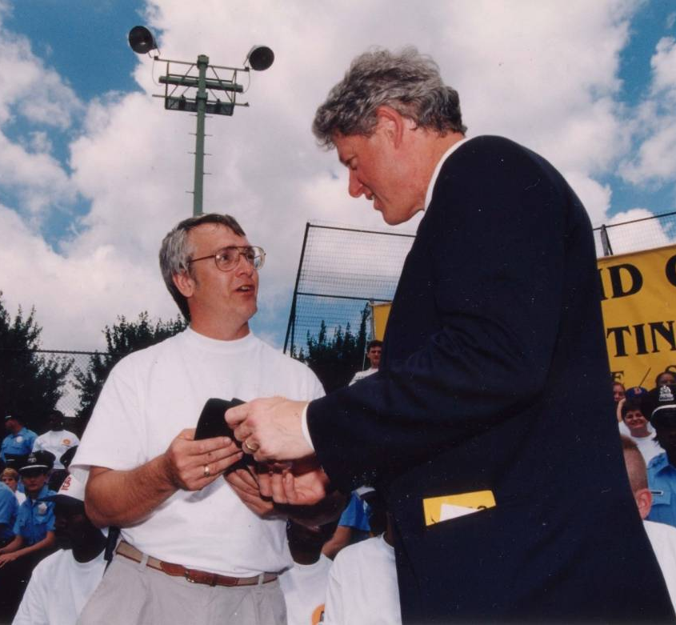
AmeriCorps History
Getting Things
Done
Based on the work of the CCC in the 1930’s
1960’s
  Peace Corps- Kennedy
  VISTA – Johnson
1990 CNCS Created Bush Administration
1993 – State /National Programs

Slide 4
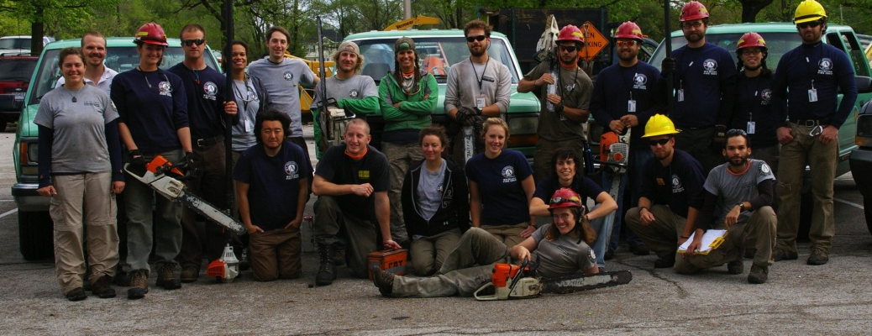
At a Glance
AmeriCorps
St. Louis
          Began as a pilot program 1994
          501(c)3 Non Profit Organization
          Currently in our 18th year of service
      Over 2.4 million hours of service
      Disaster Responses in over 30 states and 60 Missouri Counties
85 current members
  Education Corps
    City Wide Service Team
  Safety Service Corps (ERT)
    Joplin Recovery Project
www.ACSTL.org

Slide 5
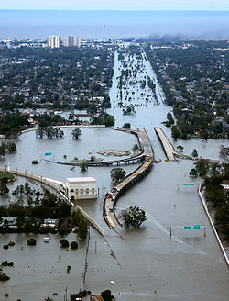
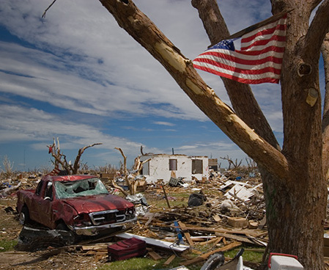
AmeriCorps St. Louis
Disaster Responses
Oklahoma City Bombing
9/11
Hurricane Katrina
Greensburg Tornado
Clarksville Floods
Springfield Ice Storms
Neosho Tornado
Joplin Tornado

Slide 6
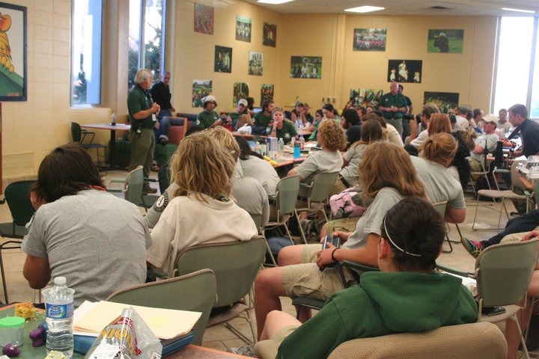
Written into the State Emergency Plan for Volunteer and Donations Management
Work in Partnership with other National Service organizations to enhance local capacity to respond to and recover from disasters

Slide 7
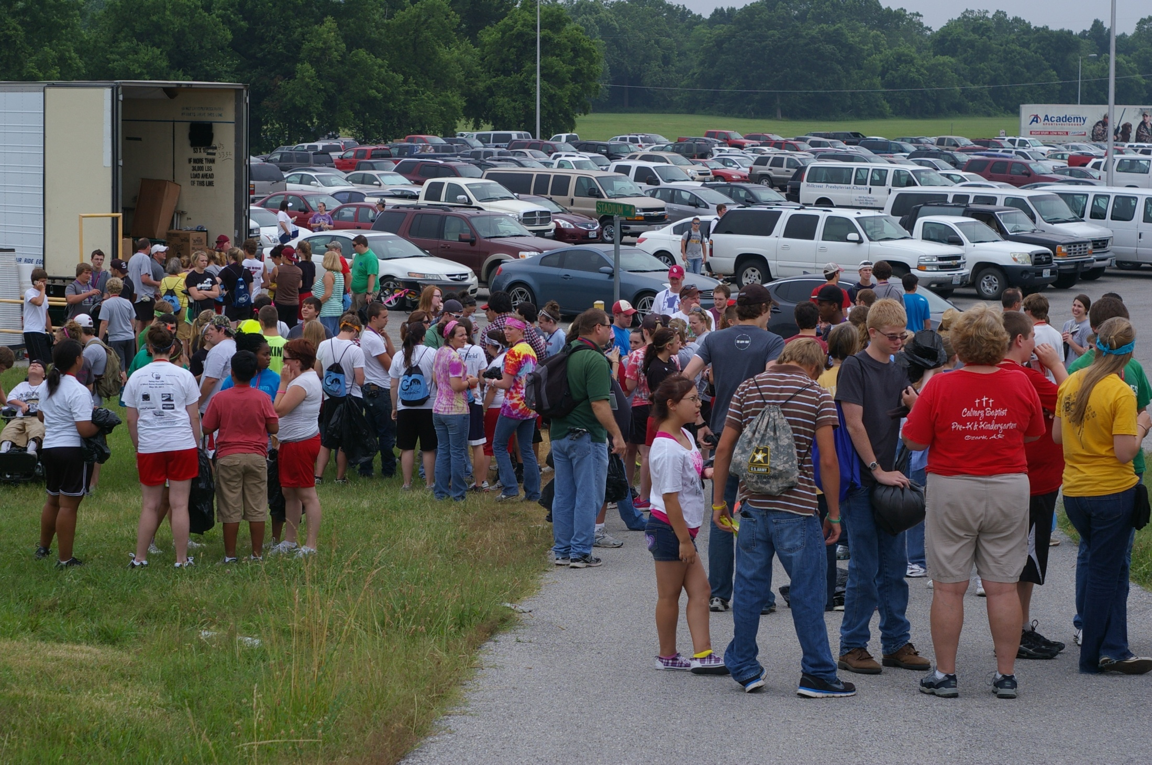
Pre Planning and Preparing for Volunteers
How to run a Volunteer Reception Center
Volunteers…They will Come…

Slide 8
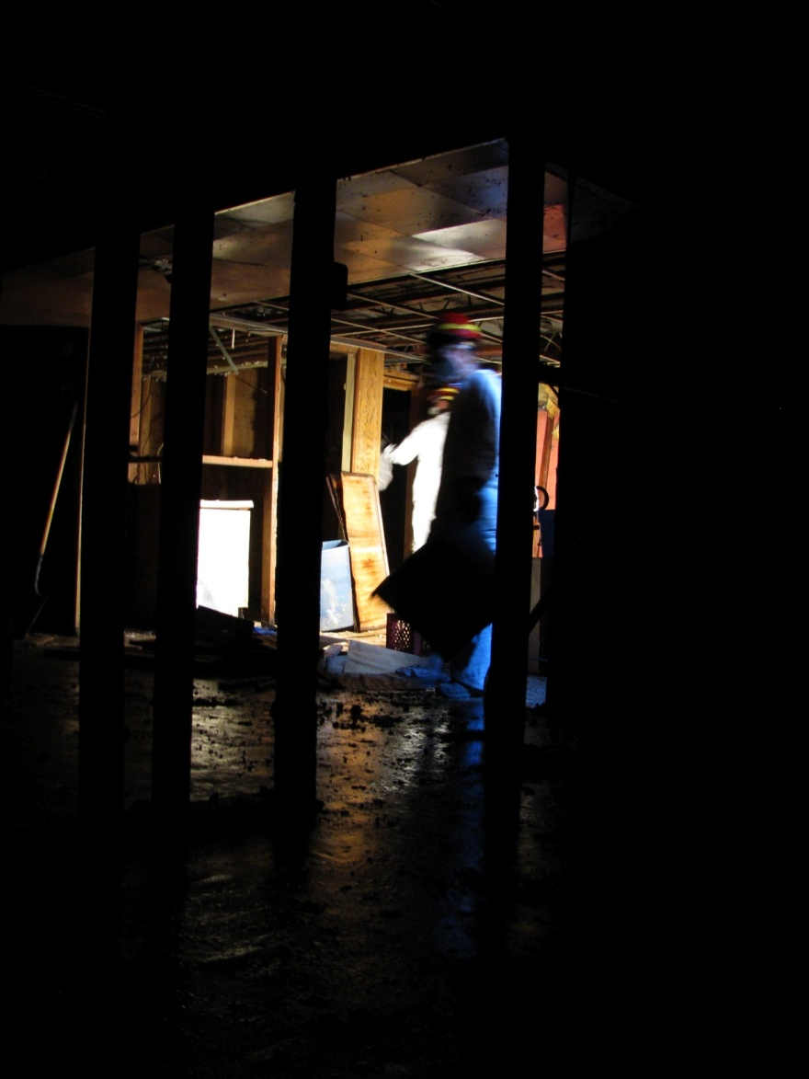
What Can I Do Right Now?
Record available resources
  Who has what?
  Who can/is willing to do what?
Get involved with your churches State and National disaster response programs
Determine niche
Prepare community agreed upon registration/request paperwork

Slide 9
Resource Request Pipeline
Resources Requested
  County Emergency Management
  State Emergency Management Agency
  AmeriCorps St. Louis Emergency Response Team
  CNCS Resources
Resources Requested
Additional Resources Requested
www.ACSTL.org
State Emergency
Management Agency
Request Resources
AmeriCorps St. Louis
Emergency Response Team
Request Needs
County Emergency
Management
State and National Direct
NCCC
Vista
Senior Corps
State Emergency
Management Agency
Request Resources
AmeriCorps St. Louis
Emergency Response Team
Request Needs
County Emergency
Management
State and National Direct
NCCC
Vista
Senior Corps

Slide 10
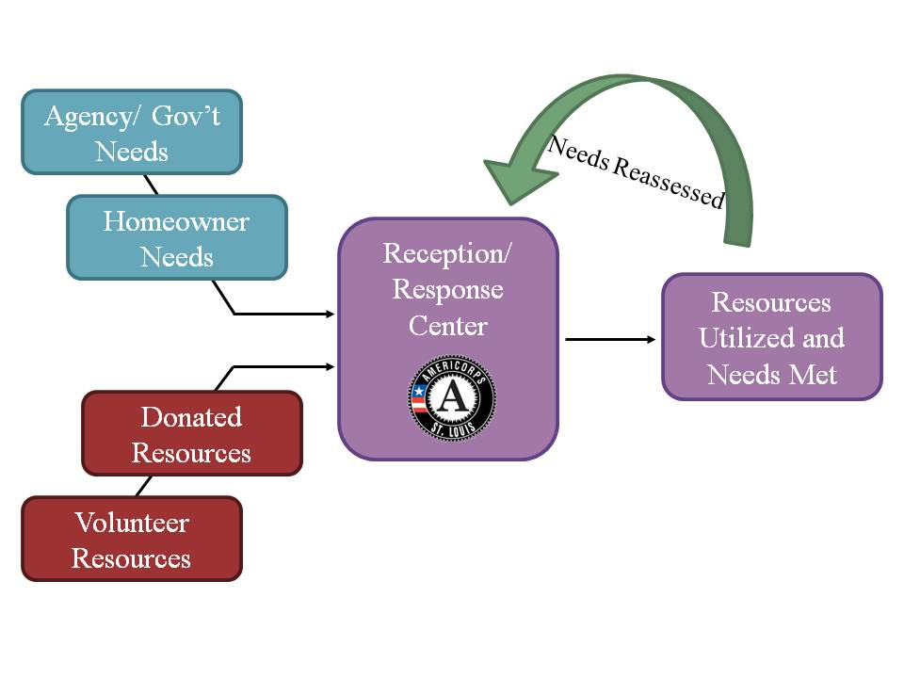
The Basics
Connecting Needs with Resources
www.ACSTL.org

Slide 11

Volunteer types
Pre-trained affiliated volunteers
Volunteers who train for a specific role or function prior to a disaster
Examples: Amateur radio operators, Search and Rescue, CERT
Spontaneous unaffiliated volunteers
Individuals with little or no previous training who come forward to help after a disaster
Also known as convergent, emergent, and “walk-in” volunteers

Slide 12


An “adopt a family” initiative that engages community groups to fundraise for appliances lost in Missouri disasters
Working with LTRC Caseworks across the State to assess needs
Aims to build a statewide network of organizations willing to help in disaster

Slide 13
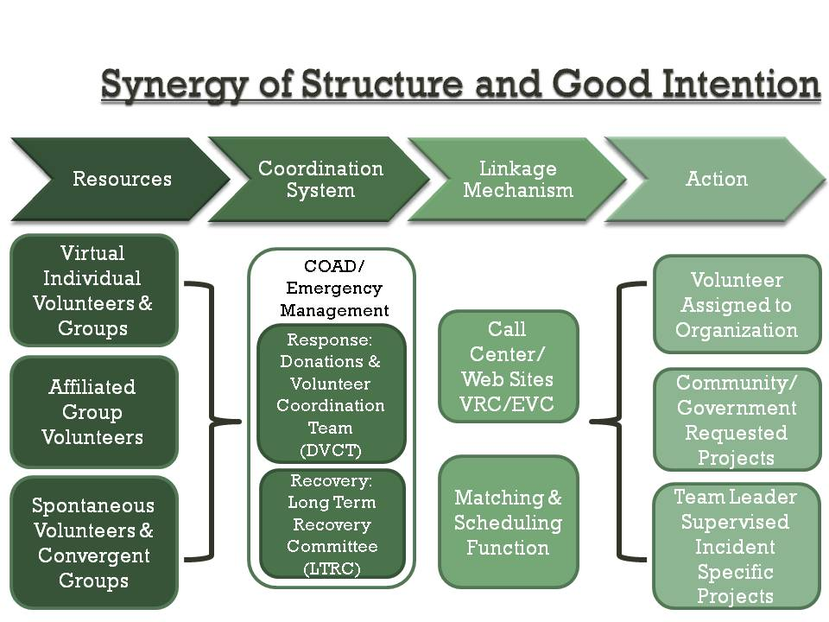
Synergy of Structure and Good Intention
Synergy Of Structure and Good Intention
Notes:
Possibly Removing?

Slide 14
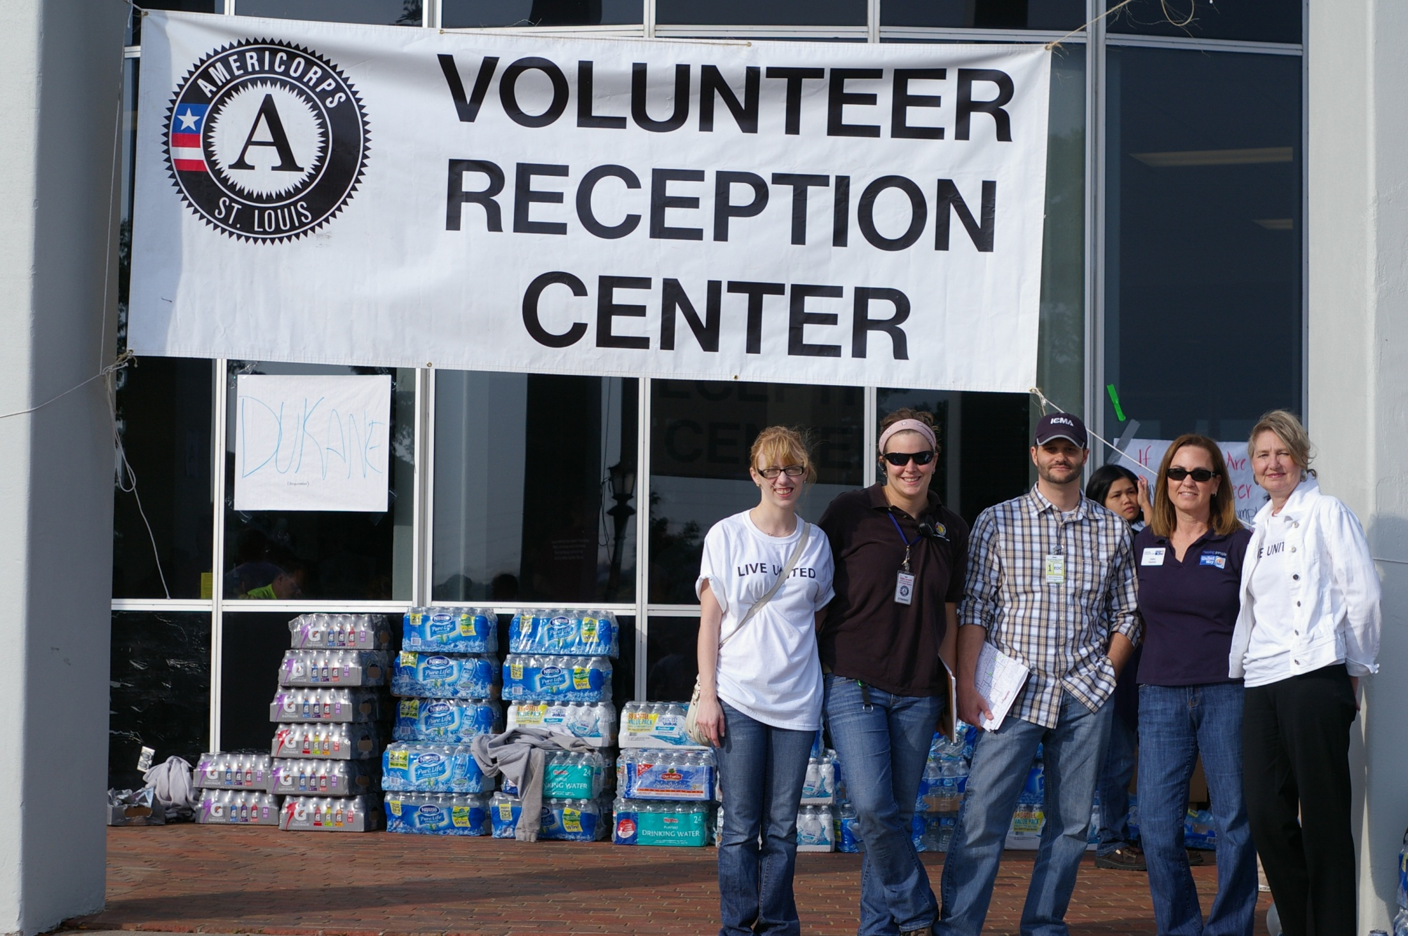
Using the Local Community and Partnership Approach
Photo: United Way 211, AmeriCorps St. Louis, Joplin Assistant City manager

Slide 15
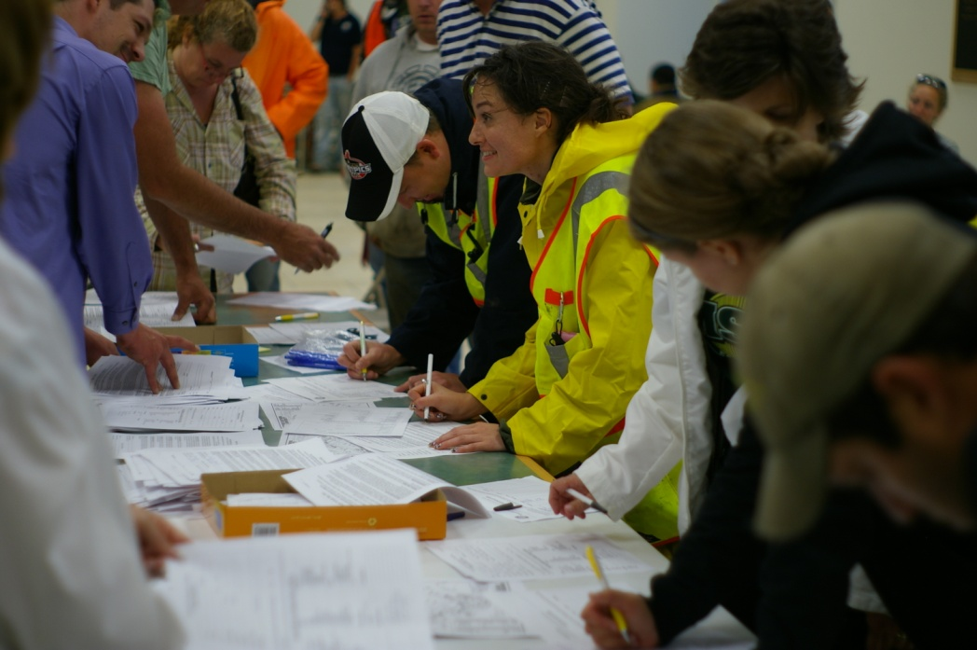
VRC: Key Elements
Safe and Meaningful Work
Customer Service and Appreciation
Documentation and Registration

Slide 16
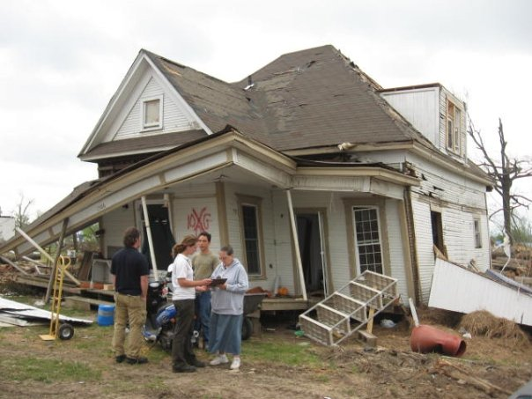
Information to Collect
Name (confirm ID)
Address
Phone
Email
Release Waivers
Skills or available Equipment
Hours and location Served
Equipment Used or Donated

Slide 17
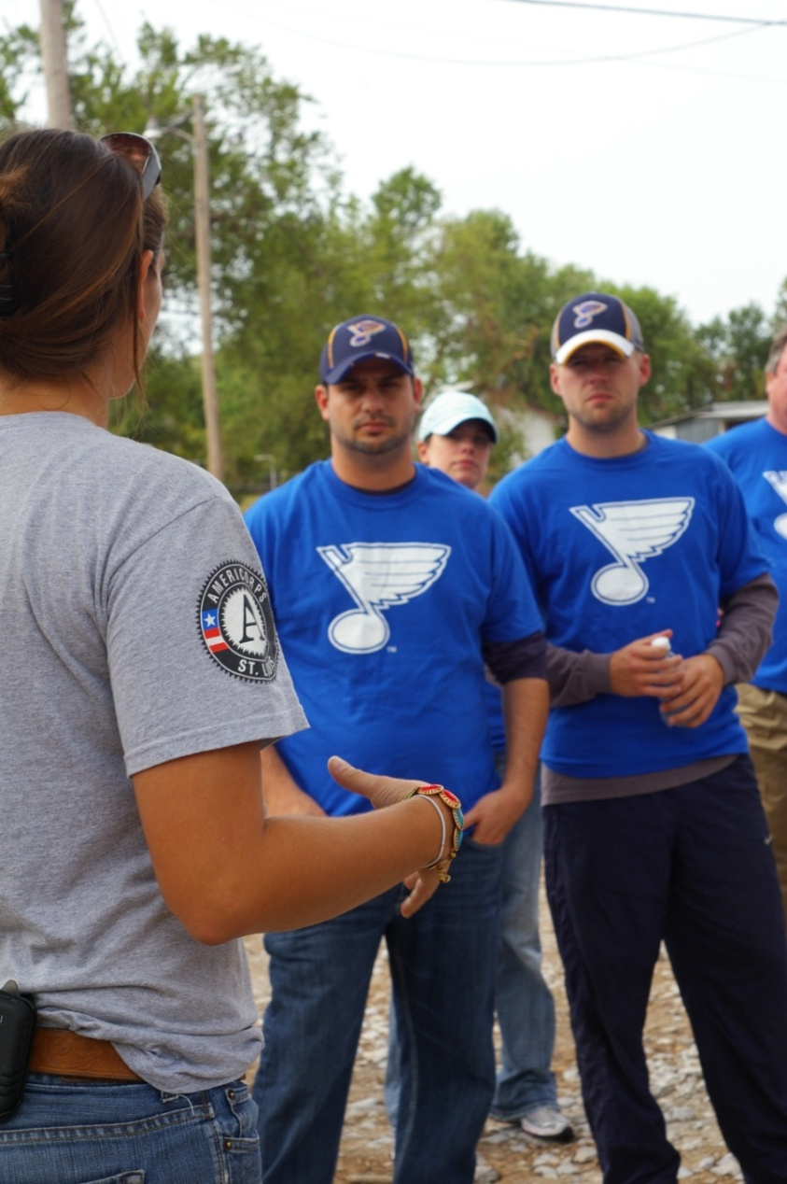
Role of Volunteers
Physical Results
Spiritual & Emotional
Financial

Slide 18
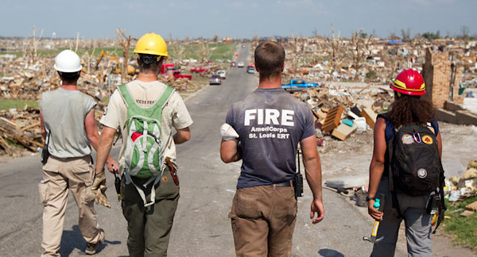
Joplin Response
VRC Results
As of April 2012
75,010 Individual Volunteers
512,286 Volunteer Hours
2,210 Volunteer groups registered
3,334 Homeowner Requests for Assistance
2,615 Homeowner Requests Completed
www.ACSTL.org
Notes:
Check these numbers to make sure they are consistent with others

Slide 19

Over $17.7 Million toward
state and local match of the FEMA cost share
Joplin Response
www.ACSTL.org
Notes:
Check these numbers to make sure they are consistent with others

Slide 20
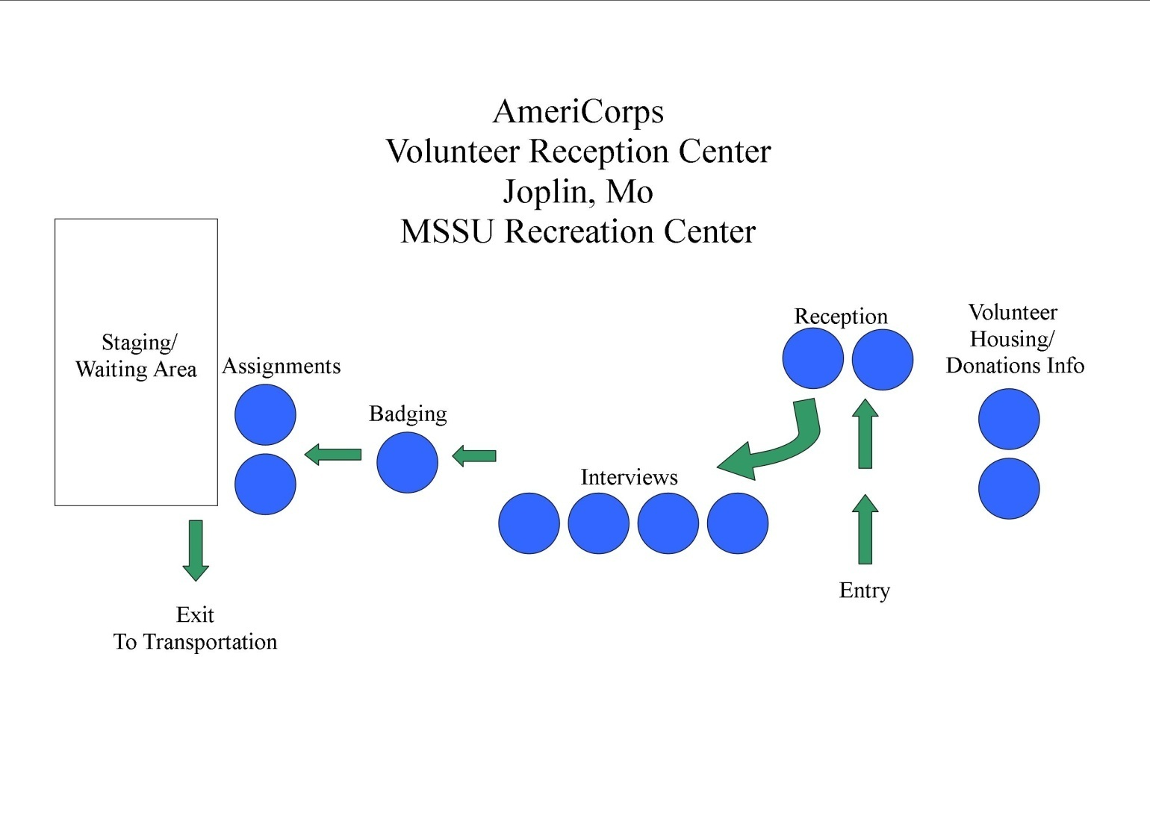
Initial VRC Layout

Slide 21
Do and Don’ts
Do…
Preplan! Gather information about resources available in your congregation and community
Join a COAD, VOAD, LTRC
Wait for resource requests
Record All Volunteer Information
Do NOT…
Self deploy
Send unsolicited goods
Duplicate efforts
Hinder first responders

Slide 22
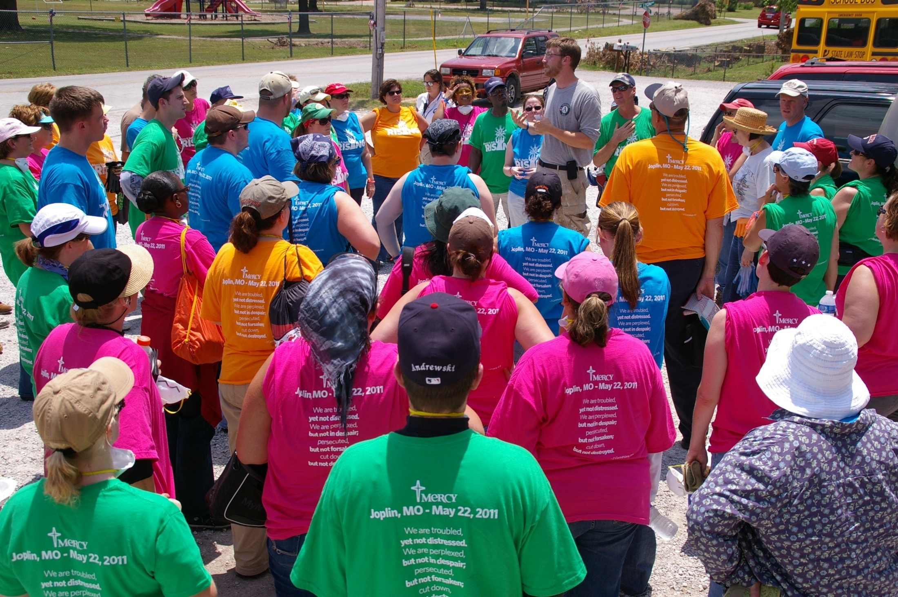
A Successful VRC: Matching Needs and Resources

Slide 23
Q & A
Community Strengthening
Contact
Community
Service
Member Development
Quinn Gardner
ERT Operations Coordinator
quinn@americorps-stl.org
AmeriCorps St. Louis
(O) 314-772-9002; (F) 314-772-7109
www.ACSTL.org
This material is based upon work supported by the Corporation for National Service. Opinions or points of view expressed in this presentation do not necessarily reflect the official position of the Corporation or the AmeriCorps Program.
Reasonable Accommodations Available*EOE/ADA*Material Available in alternate formats

