Slide 1
Missouri
Faith-Based Organization Initiative

Slide 2
Welcome
Red Cross supports the Faith Based Initiative to be engaged in disaster response in the community
Red Cross welcomes your organization to assist primarily in sheltering efforts

Slide 3
Overview
The National Shelter System (NSS) shows 1,818 Red Cross shelters in the state of Missouri
  595 of those shelters are in the Red Cross Kansas City Regional jurisdiction
  321 shelters are in the Greater Kansas City Chapter jurisdiction

Slide 4
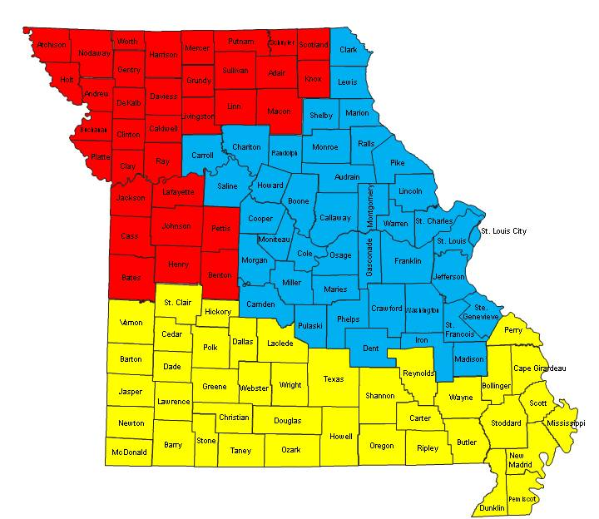
Missouri Regional Groupings
Kansas City Region
St Louis Region
Southern MO Region
Map does not reflect non-Missouri counties included in Kansas City and St Louis Regions

Slide 5
Advantages to Partnering with Red Cross
Support from Red Cross in managing the shelters
  Before
  During
  After
Free training from experienced Red Cross instructors
Over 110 years of sheltering experience--experts in the field
All or partial shelter costs covered by Red Cross

Slide 6
Advantages of Serving as a
Red Cross Shelter
Liability shared by Red Cross
Training and guidelines on how to run a safe and effective shelter provided
Cots, blankets and food supplied by Red Cross
Faith Based Organization (FBO) volunteers can serve with Red Cross beyond the local disaster

Slide 7
Types of Red Cross Shelters
Red Cross Managed Shelter
Red Cross Partner Shelter
Red Cross Supported Shelter

Slide 8
Red Cross Shelter Options
Red Cross Managed Shelter
Opened and fully operated by Red Cross
Red Cross will provide all necessary leadership, trained volunteers, supplies (including food, bedding, signage) and services such as disaster health and mental health services for duration of the disaster
Only a suitable location is needed to run these full service shelters

Slide 9
Red Cross Shelter Options (cont’d)
Red Cross Partner Shelter
With training, these locations work closely with Red Cross disaster operation management over the course of a disaster.
Utilizing a combined volunteer base, these sites can receive full support (management, supplies, bedding, food, disaster expense reimbursement and shared liability).

Slide 10
Red Cross Shelter Options (cont’d)
Red Cross Supported Shelter
May receive basic Red Cross supplies in the form of cots, blankets and food
These sites rely on their own trained volunteer base for management and day to day operations, in accordance with Red Cross guidelines and protocols.
FBO will assume some liability and fiduciary responsibility for shelter

Slide 11
Other Service Options
Facility as Kitchen
Facility as Bulk Distribution Site
Facility as Multi-Agency Resource Center
Facility as Heating/Cooling Center
Volunteers as shelter workers in other shelters
Volunteers as personal care assistants to those in the shelter with functional and access needs

Slide 12
Training Options/Requirements
The American Red Cross requires shelter volunteers to be trained in Shelter Operations
Training is free of charge
Training will be done on either a local or regional basis
Training may be done at your facility or at Red Cross

Slide 13
Agreement To Become Shelter
Red Cross prefers Shelter Agreements signed before facility is used as a shelter
Agreement spells out each organization’s responsibility
Red Cross activates the opening of shelters and coordinates with local EMA

Slide 14
Agreement To Become Shelter (cont’d)
Free to make available or decline at time of activation request
Walk-through before and after
ADA accessible
Large space, such as gymnasium, preferred
Access to adequate toilets and shower

Slide 15
Next Steps
Determine the level of activity or type of shelter your FBO wishes to pursue
Contact your local Red Cross
FBO volunteers and staff attend shelter training

Slide 16
Contact Information
Greater Kansas City Chapter
Sara Loar
816-841-5241

