Slide 1
CH (COL) Gary D. Gilmore
Joint Force Chaplain
Missouri National Guard

Slide 2
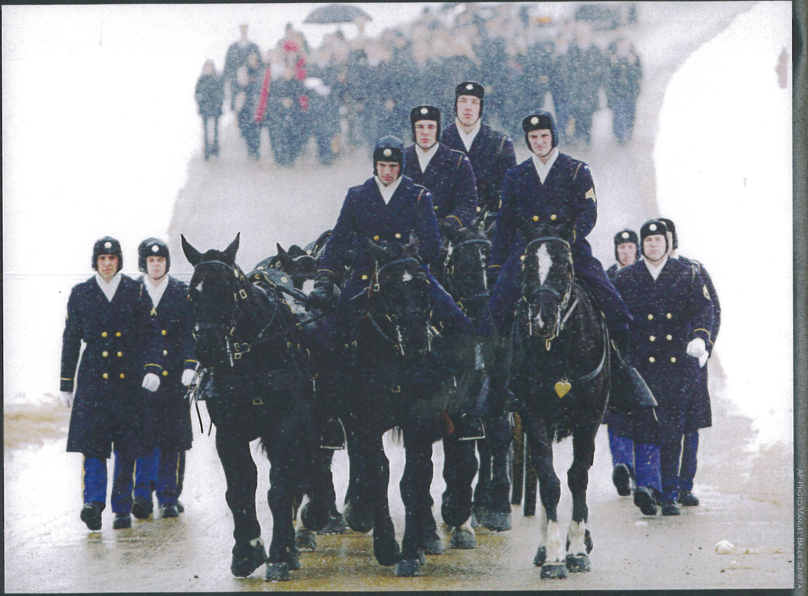

Slide 3
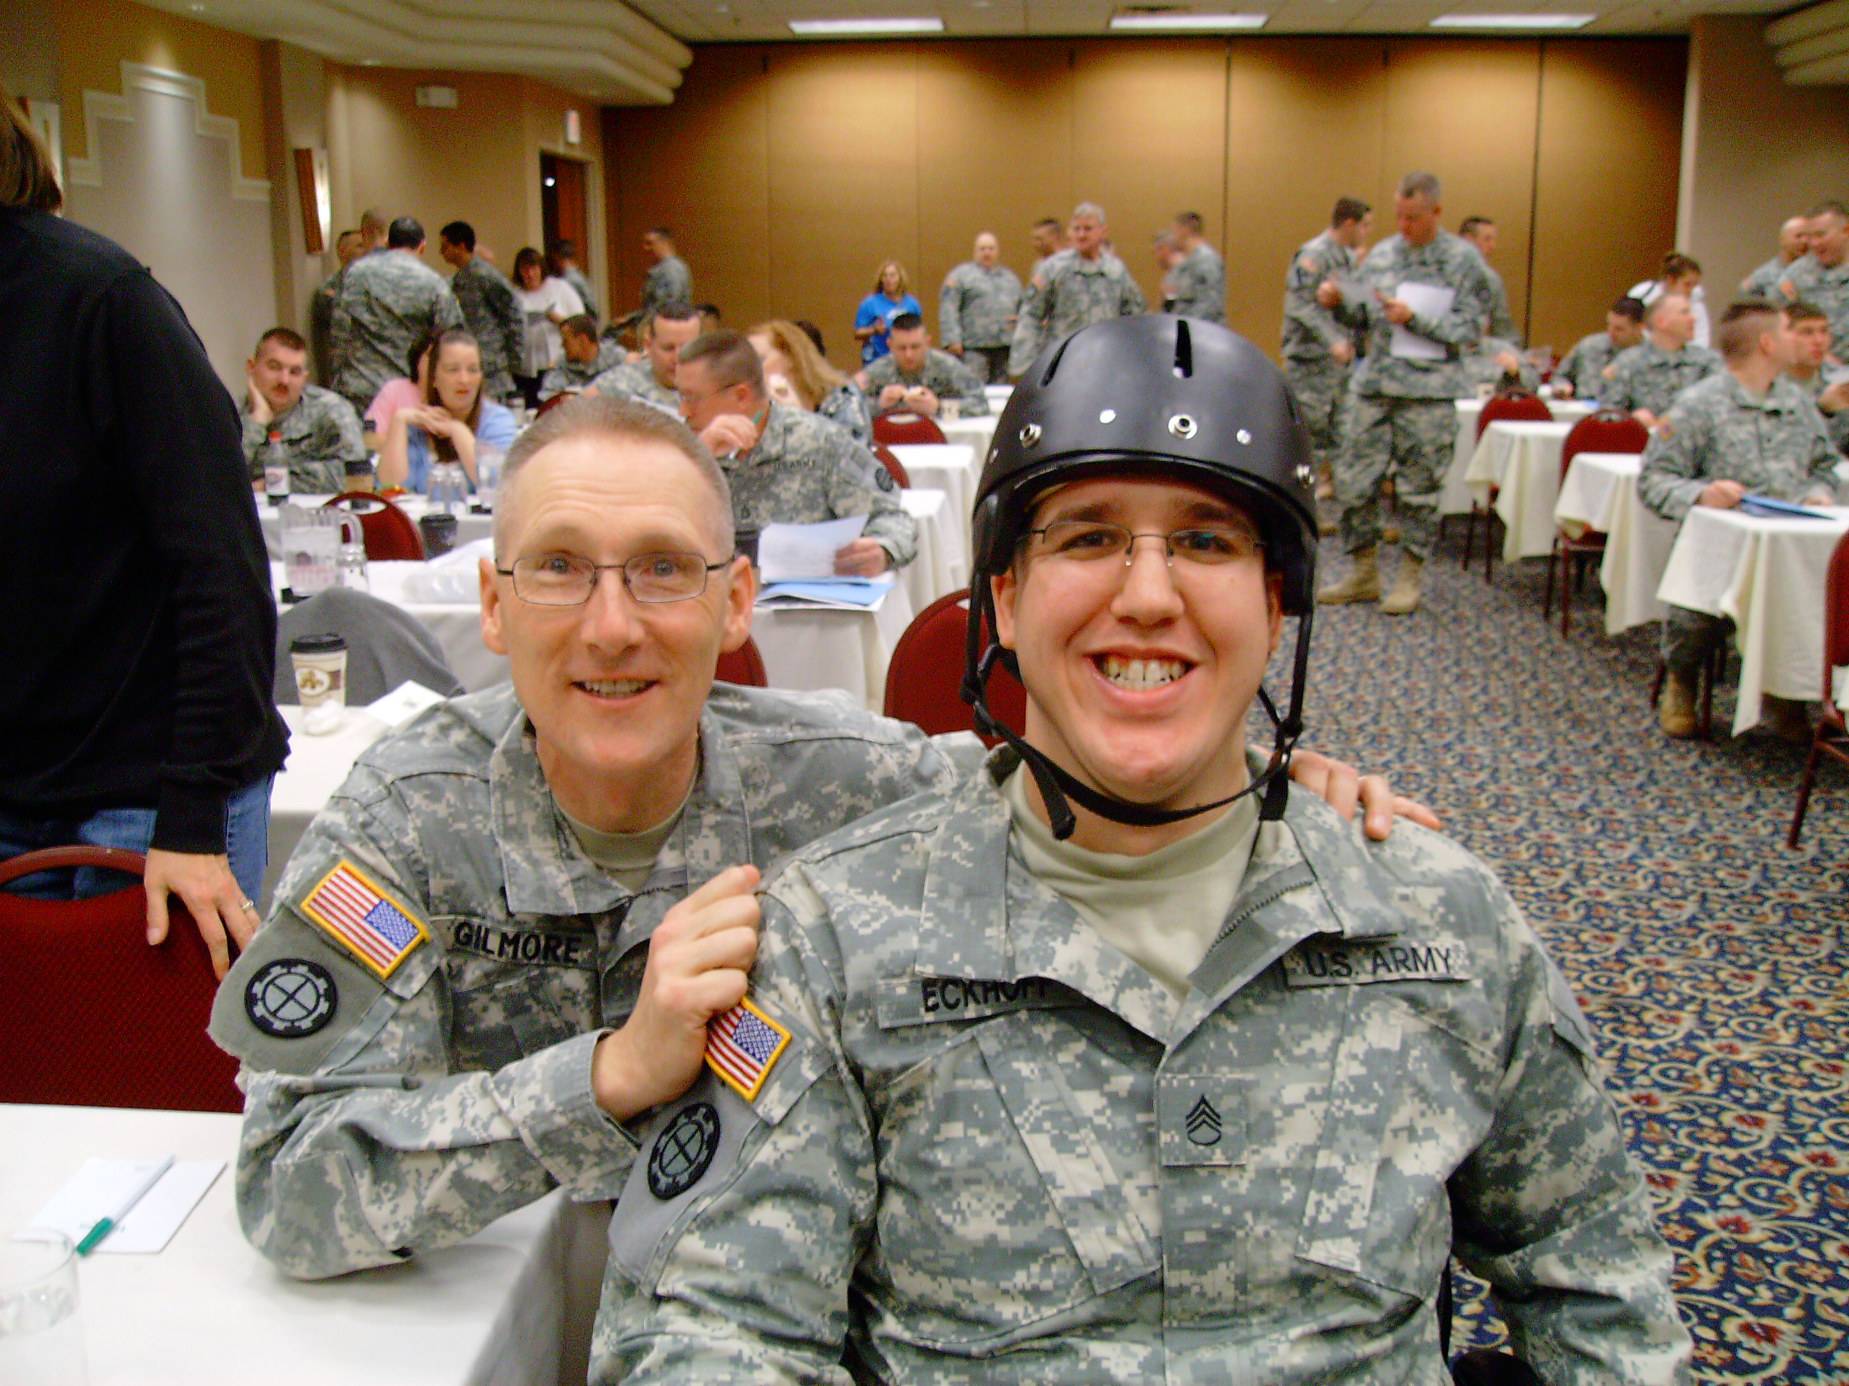

Slide 4
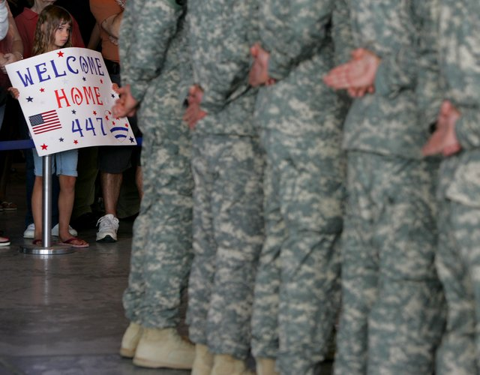

Slide 5
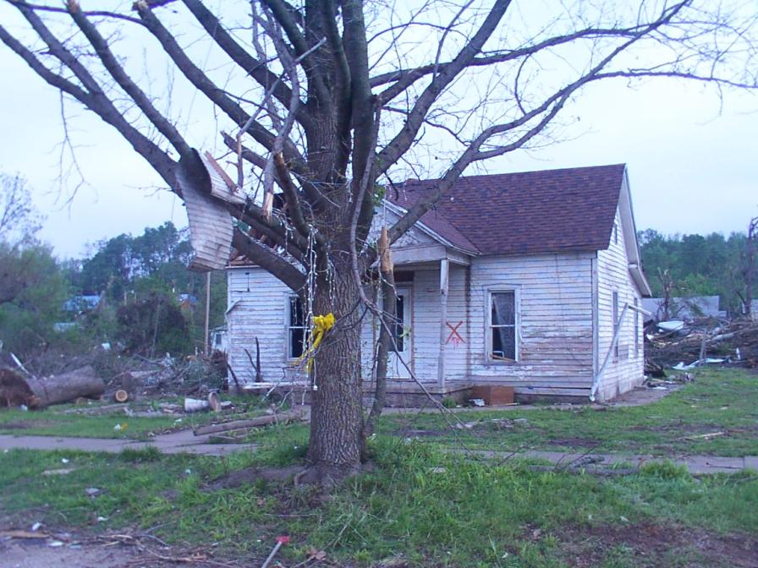
Show of Support for 203rd Engineers!

Slide 6
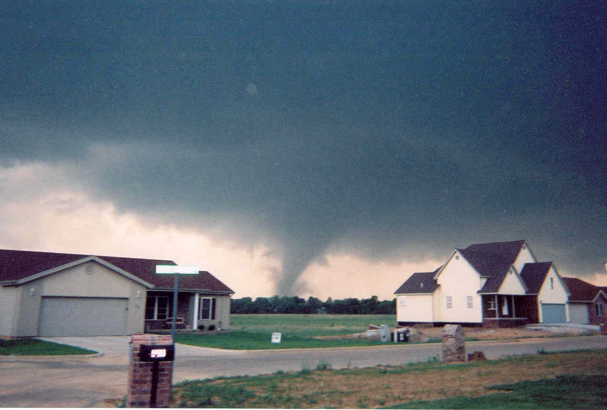

Slide 7
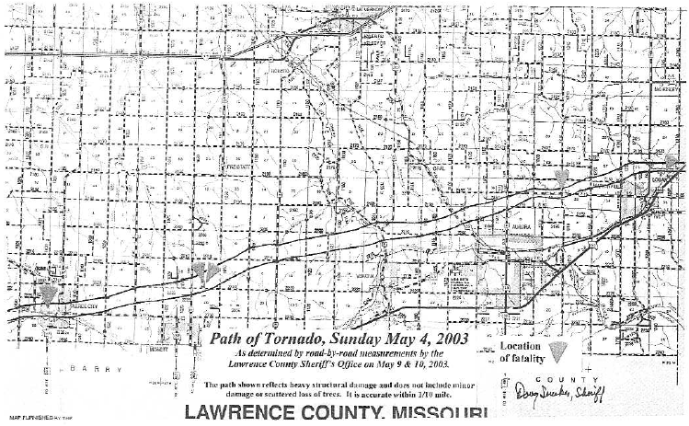
Mount
Vernon
Marionville
Pierce
City
Verona
Aurora
Monett

Slide 8
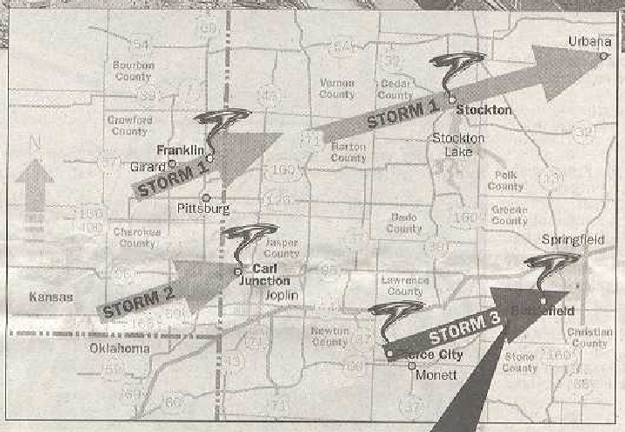

Slide 9
Mount
Vernon
Marionville
Pierce
City
Verona
Aurora
Monett

Slide 10
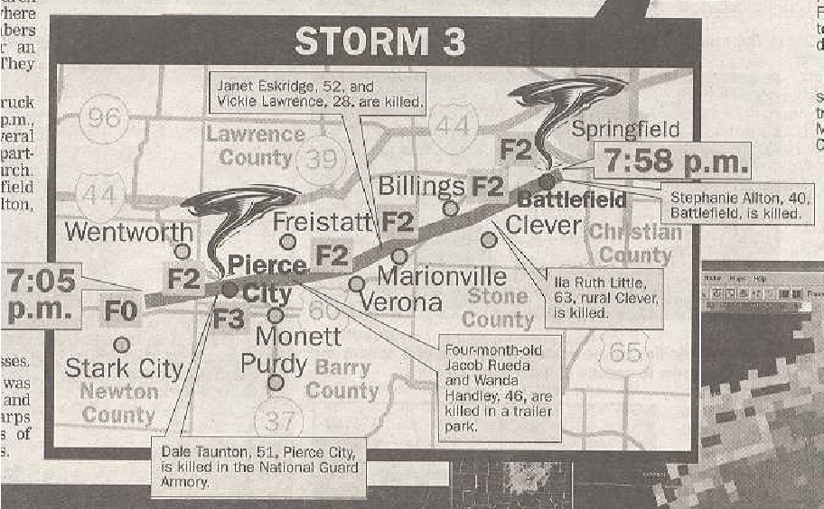

Slide 11
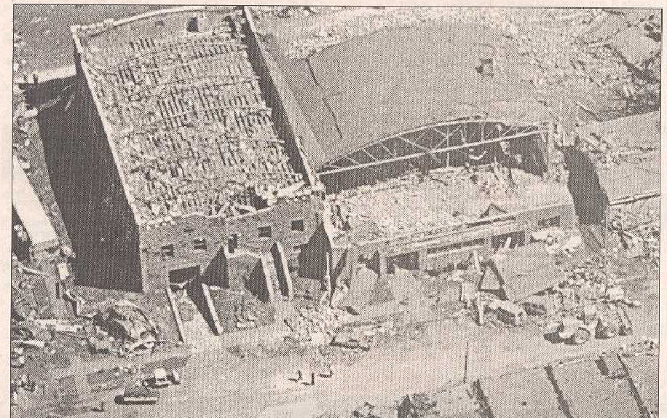

Slide 12
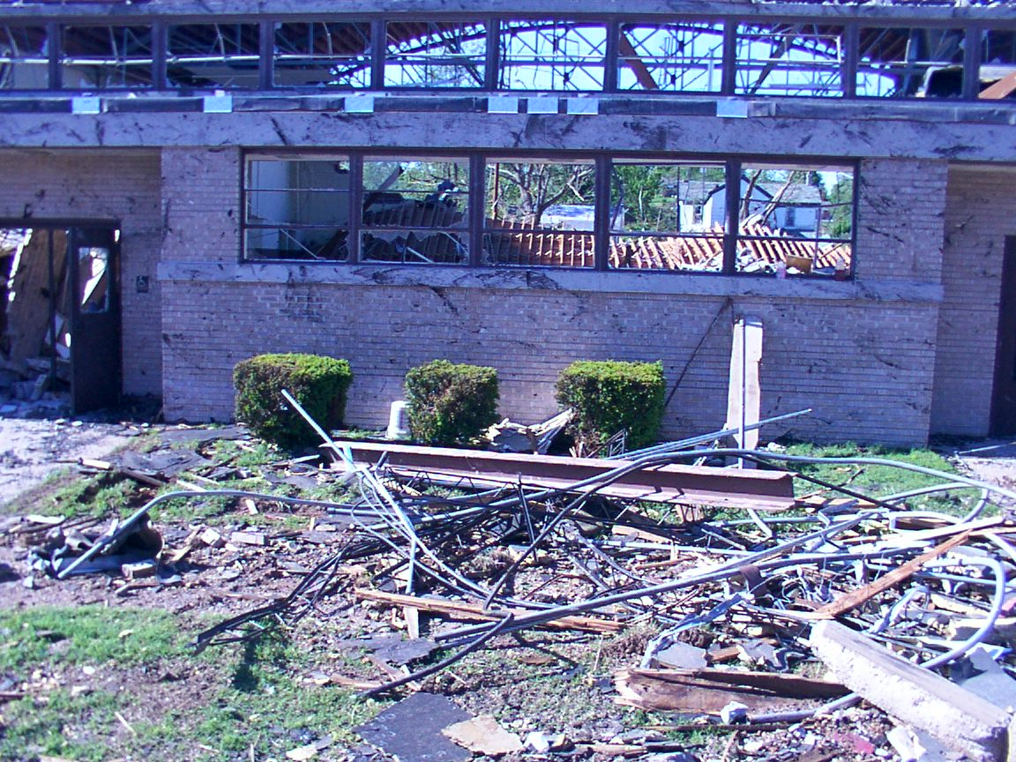

Slide 13
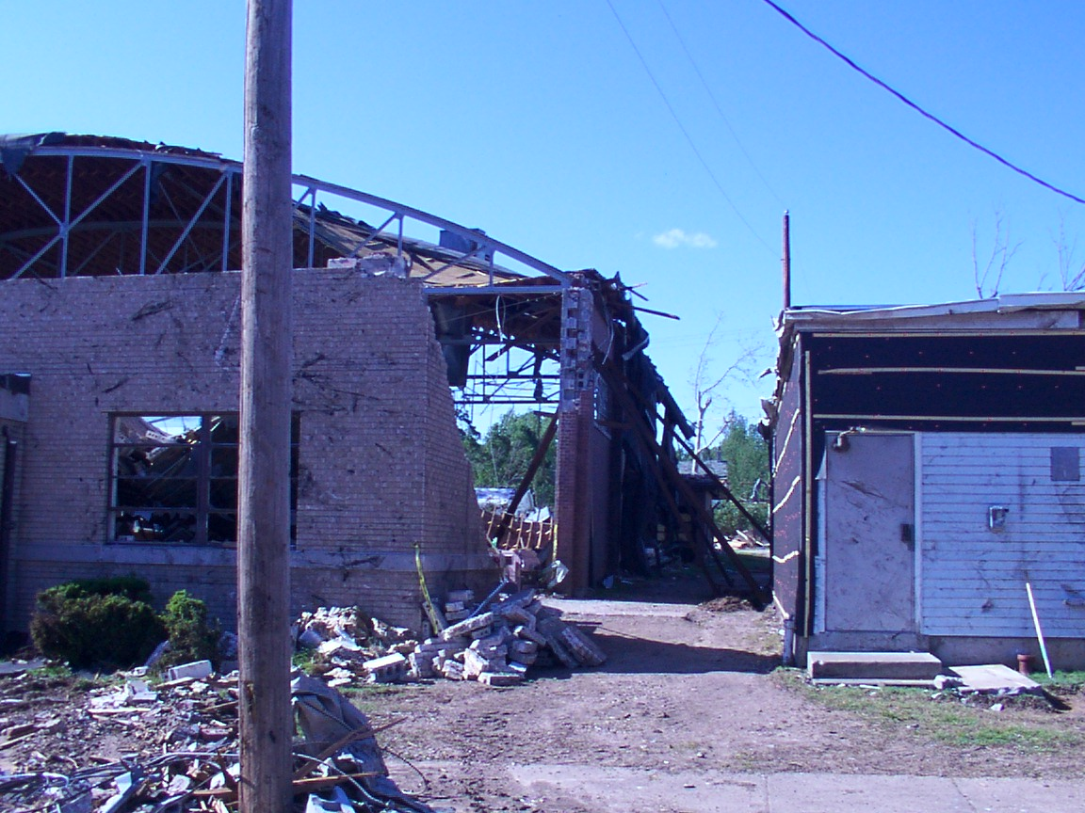

Slide 14
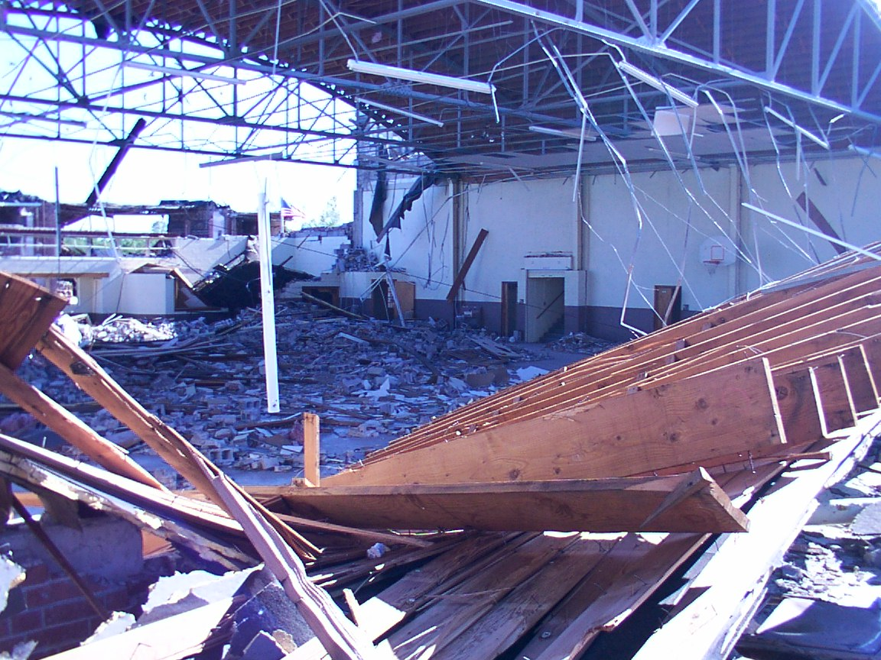

Slide 15
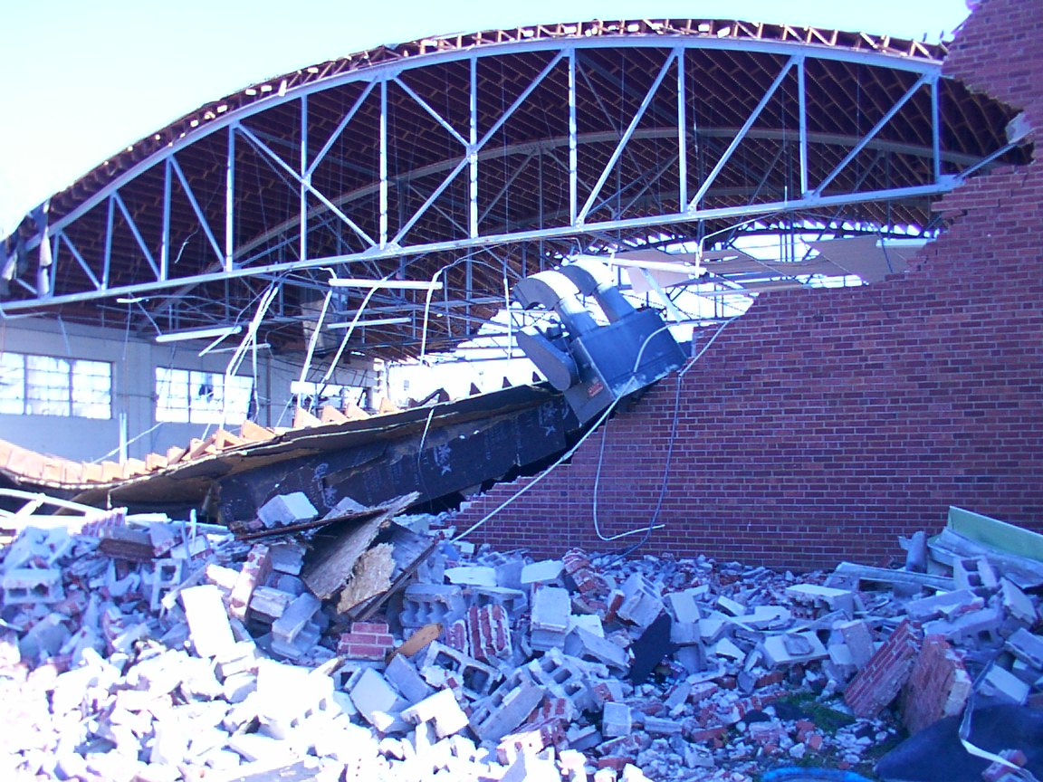

Slide 16
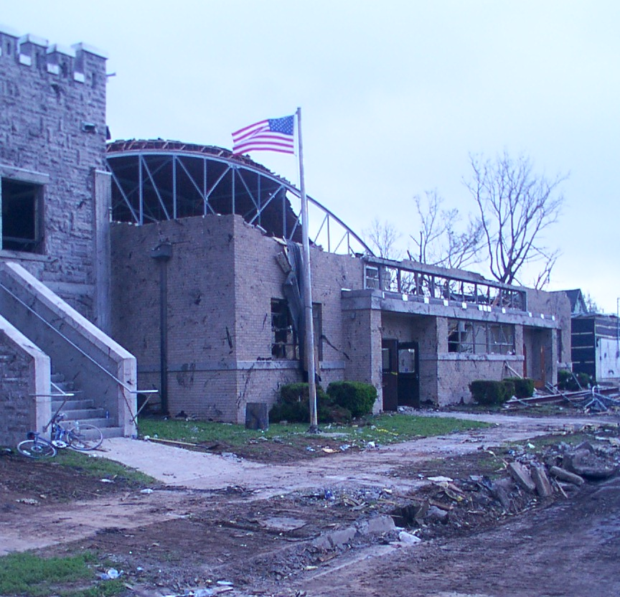

Slide 17
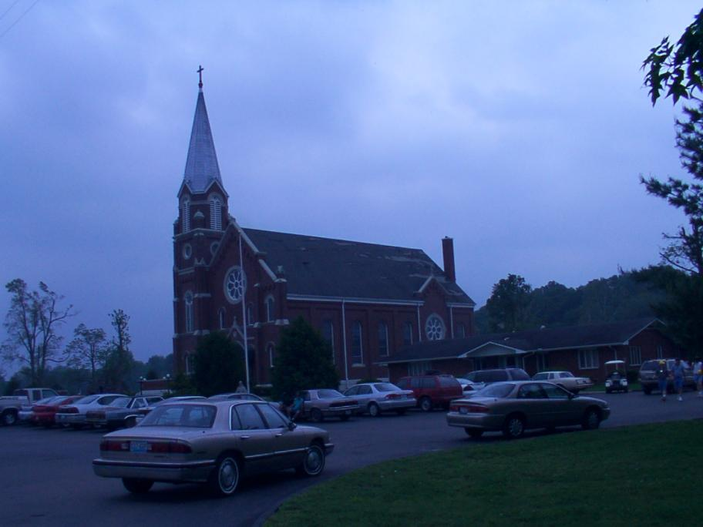

Slide 18
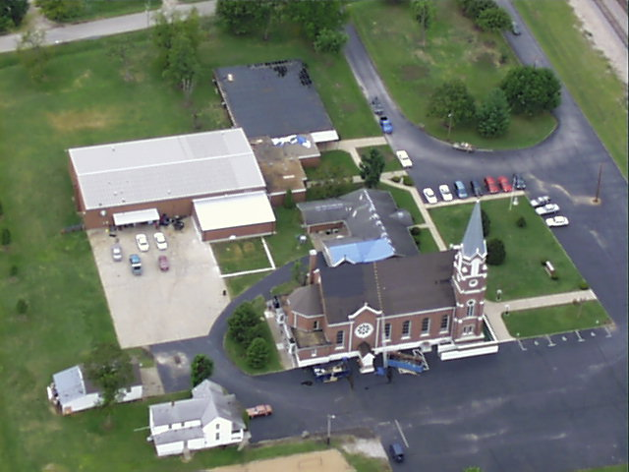

Slide 19
Red Cross Shelter in Gym
Generators
New Shelter
Fridge Trucks
MCI SatPhones

Slide 20
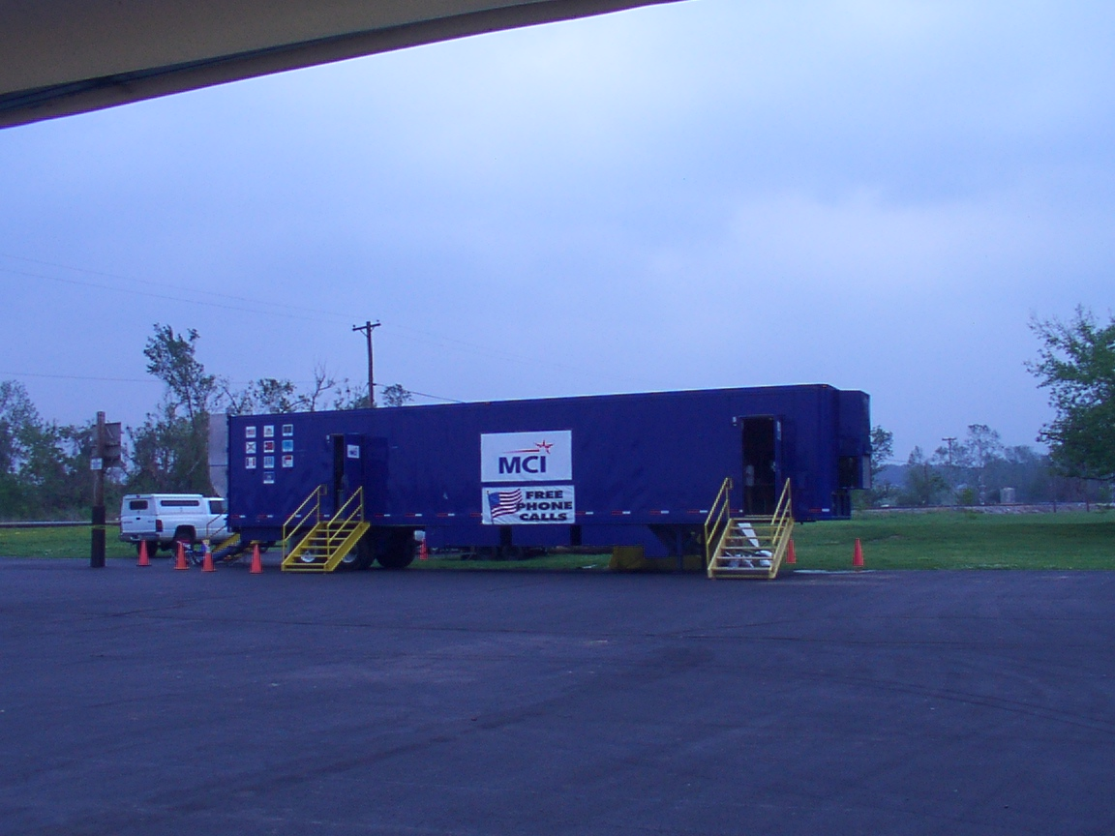

Slide 21
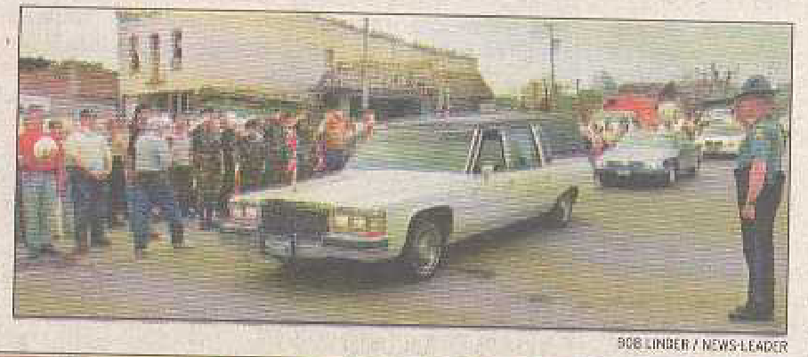

Slide 22
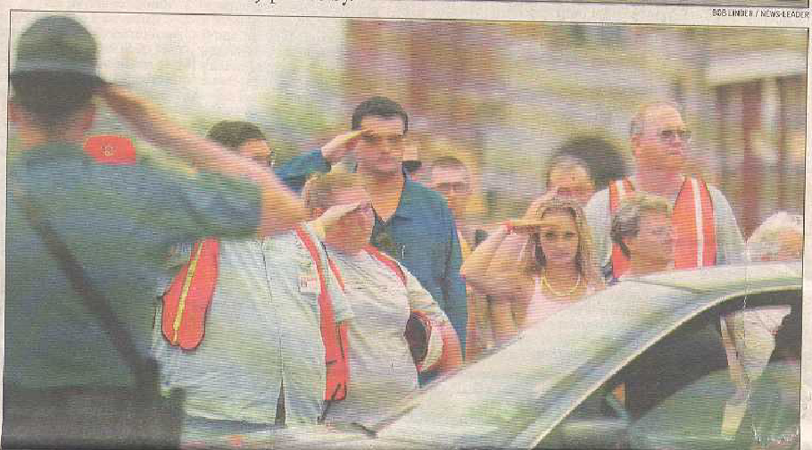

Slide 23
Lessons Learned
Prepare your own home/family for crisis
Have a Plan: a checklist, a packed bag, MRE, field-ready notebook, adverse weather gear, etc.
Make a Kit– water, batteries, radio, fuel
Line up Neighborhood support
Be Prepared to Minister in advance! This is not the time to start thinking about what you will say and do

Slide 24
Are You Ready?
To Care for those you love?
To Give to those in Need?
A checklist
A packed bag
Food and Water
Communication Plan
Shelter- alternate site
Weather radio
Batteries
Rain-winter clothes
Money
Portable phone charger
Neighborhood care plan
Pets
Church as shelter
Food
Cots and blankets
Volunteers
Chaplains/ medical personnel
Haiti Response-- Buckets of Hope

Slide 25
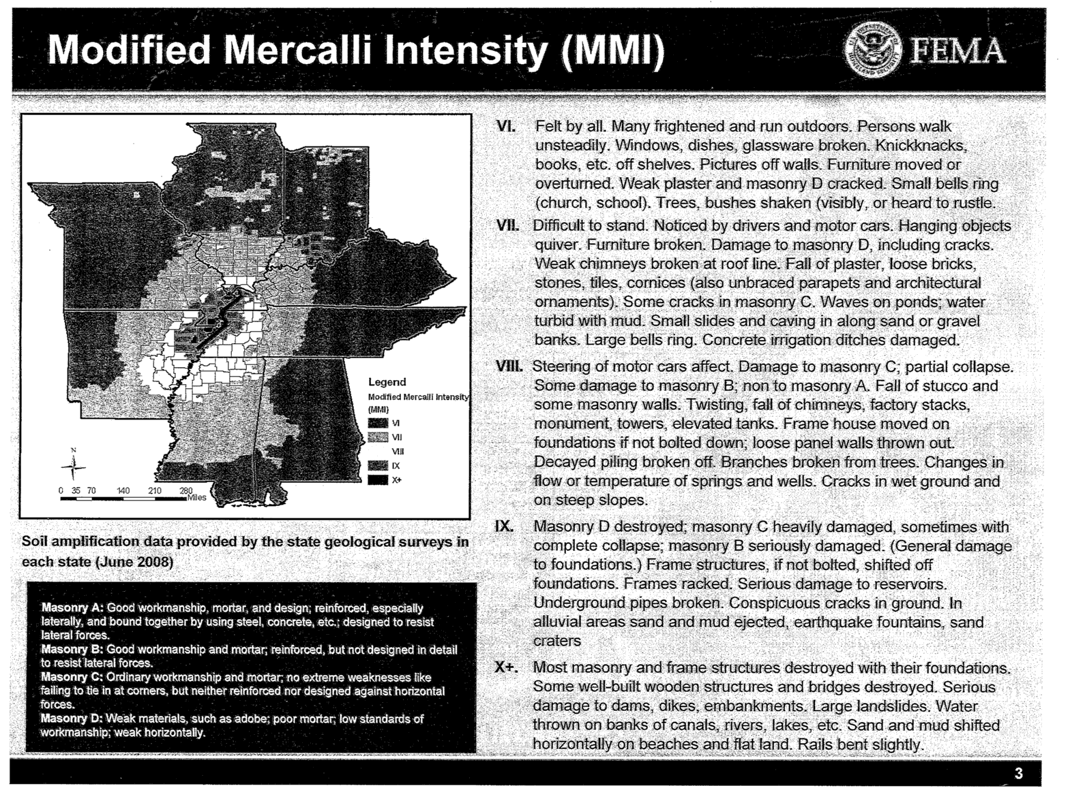

Slide 26
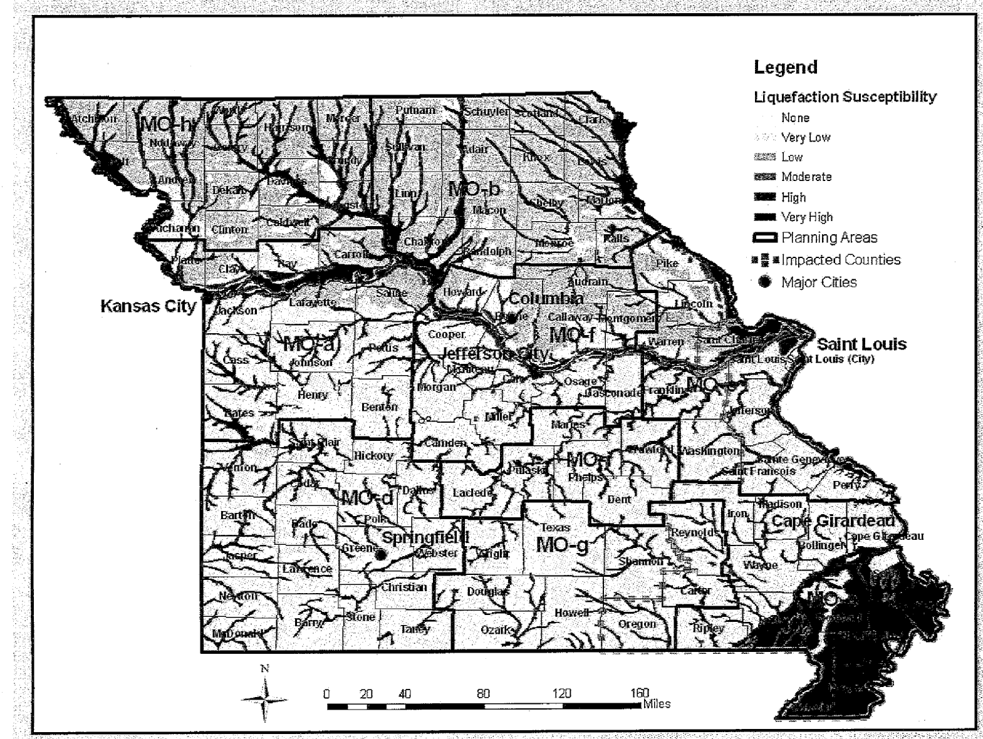

Slide 27
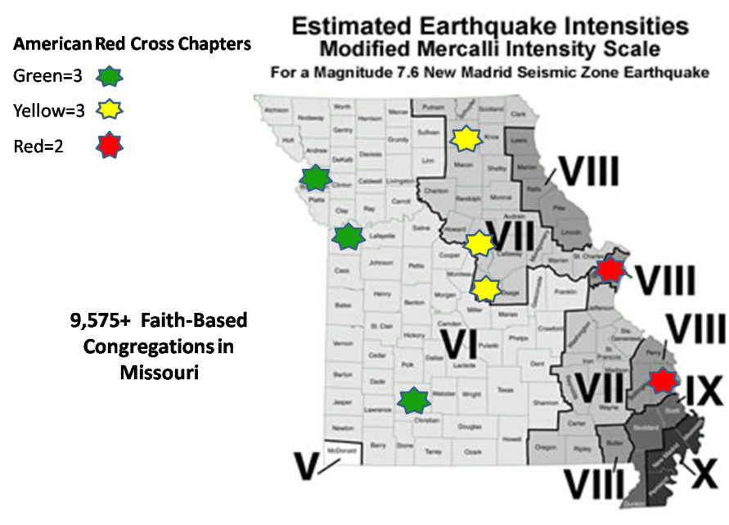

Slide 28
State of Missouri Assessment Overview [FEMA]
By Day 3, approximately 205,000 people will seek shelter and 4001 truckloads* of commodities water, ice, MREs) will be required to support the at risk population
Over 125,000 households are without potable water service, and nearly 310,000 households. are without electric power (Day 1)
There are approximately 13,500 injuries and 680 deaths
Approximately 87,000 buildings are damaged
Nearly 1,000 bridges are damaged
*[25-ton capacity truckloads]

Slide 30
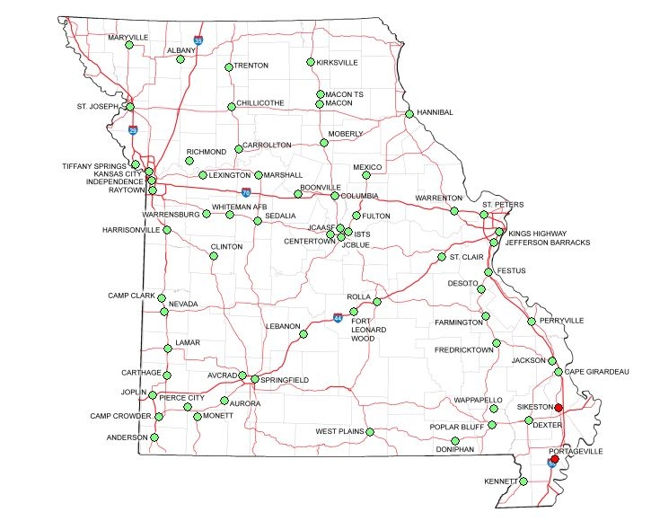
Missouri National Guard
Armory Locations

Slide 31
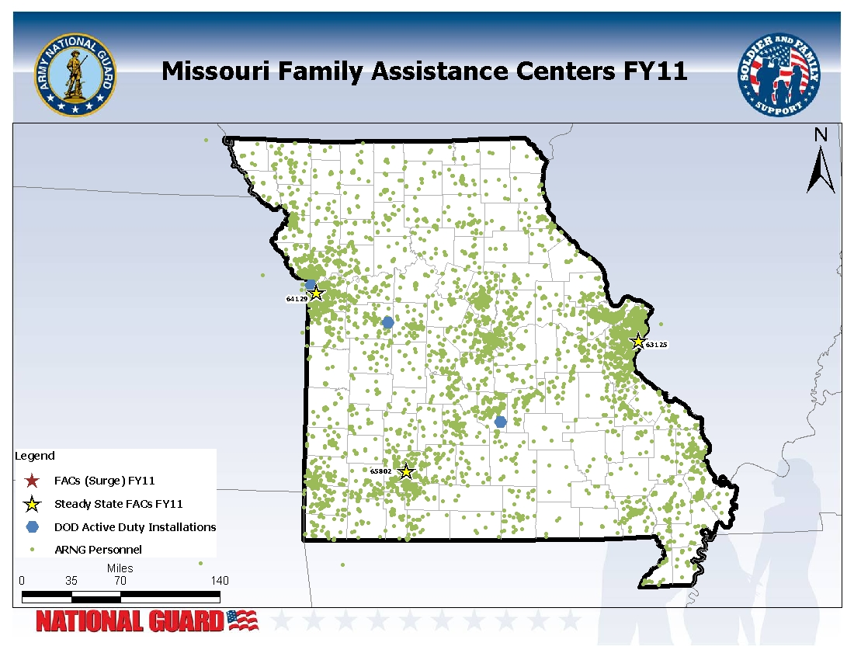

Slide 32
SEMA
MONG
Partnership
DMH
C-SEC
TOC
Provide Services
to Constituents
Direct Care to Responders
Advise Leaders/CDR’s
Coordinate Local Resources
Leadership Team
Area Coordinators
Regional
Teams
Community Resources
1. Deploy
2. Establish C-SEC TOC
3. Support with Services
1. Deploy
2. Support with Services
3. Sustain Services
Enlist & Train
Pre-Activation
Activation

Slide 33
A Network of Networks
MONG Patriot Center
Department of Mental Health
Unit Ministry Teams
Family Assistance Centers
Family Readiness Groups
Family Readiness Council
Family Readiness Support Assistants
Master Resiliency Trainers
Military Family Life Consultants
Youth Program Leadership
SARC/SPPM
RetireeServices
Retiree Council
Missouri Military Reserve
Partners in Care
Training
Special Needs Expertise
Website Network
Community Health Care Clinics

Slide 34
Partners In Care
The purpose is to coordinate support for Missouri National Guard (MONG) service members and families through partnerships with local faith communities.
Notes:
Partners In Care is an initiative of the Illinois National Guard Joint Force Headquarters (ILNG-JFHQ) Chaplain’s office. The purpose of this initiative is to coordinate support for Illinois National Guard (ILNG) members and families through partnerships with local faith communities.

Slide 35
Partners In Care
All faith communities are welcome to participate as “Partners in Care” congregations.
A Memorandum of Understanding (MOU) insures respect for all parties and perspectives.
Referrals of MONG members and families to “Partners in Care” congregations are made through the coordinated effort.
Notes:
All faith communities are welcome to participate as “Partners in Care” congregations.
A Memorandum of Understanding (MOU) signed by the ILNG-JFHQ Chaplain and a representative of the participating congregation formalizes the relationship. The MOU defines the purpose, scope and nature of the partnership. Support is offered by the participating congregation to all referred warriors and families within the limits of congregational resources and abilities, and free of charge without regard to the recipient’s religious affiliation.
Referrals of ILNG members and families to “Partners in Care” congregations are made through the coordinated effort of the ILNG Family Readiness Office and the ILNG-JFHQ Chaplain Office. Guardsmen and families are encouraged to participate in and access their own faith community, if affiliated. Referral to a “Partners in Care” congregation by the ILNG in no way implies endorsement of a particular religion by the ILNG.

Slide 36
Partners In Care
Citizen-soldiers and their families are integral parts of local communities across the State.
They endure the stress incumbent upon those who sacrifice in service.
It is further recognized and understood that within the communities are congregations uniquely equipped and able to provide faith-based support.
Notes:
It is recognized and understood that ILNG citizen-soldiers and their families are integral parts of local communities across the State. These citizen-soldiers and their families endure the stress incumbent upon those who sacrifice in service to the defense of liberty and the safety and security of both State and Nation. It is further recognized and understood that within the communities are congregations uniquely equipped and able to provide faith-based support to Illinois National Guard members and families in times of crisis, stress and need. To that end “Partners in Care” exists.

Slide 37
Churches Provide Community
Small Groups
Inter-generational support
Community Service
Meaning and Purpose
Notes:
As neighbors, the individuals who make up a community, you are an integral part in bringing our service members all the way home. So, What can you do? Ask how are you…get into their lives.
It’s A Dry Heat
Your in a helmet, body armor, neck protector, T-shirt, long sleeve shirt, shoulder protection, under arm protection, side plates, hearing protection, eye protection, groin protector, Cloth over your mouth to keep sand from blowing in. Now take a hair blower and turn it on full blast and point it at your face. That is what a 130 degree heat feels like. It does not matter if it is a dry heat or not. It is hot.
It starts with you!

Slide 38
Sample Congregational Ministries
Marriage Counseling
Child-Care & Sickness Support
Basic Household & Automotive Repairs
Financial Management Classes
Crisis and Grief counseling
Age focused Group support
Fellowship opportunities
Transportation Assistance

Slide 39
Memorandum of Understanding
Voluntary
Support Equally
Services are free
Neither assumes liability on behalf of the other
Provide support to the extent that resources are available
Notes:
The Partners in Care through their respective congregations and the Illinois National Guard recognize a need for a coordinated effort to provide faith based support to members of the Illinois National Guard (ILNG).
The State of Illinois and the Partners in Care realize that this initiative in no way endorses the establishment or requirement to participate in any religion;
NOW THEREFORE, the parties enter into the following agreement and understanding:
1. Facts: Partners in Care is a voluntary relationship between faith communities and the Illinois National Guard. The purpose of this agreement is to provide faith-based support to those members of the Illinois National Guard and their families upon request.
2. The understanding between the parties follows:
a. The congregations agree that support will be afforded to all ILNG members and families equally and without discrimination or regard to their religious beliefs.
All religious and faith-based communities are welcome to participate in this initiative provided they consent to this agreement.
Partners in Care congregations and the ILNG shall designate points of contact and a list of supportive services available for ILNG members and their families.
The services provided to ILNG members and families shall be free of charge and at no obligation to the participants and neither party assumes any liability on behalf of the other.
Partners in Care congregations will provide an agent of their respective congregation to act as a signatory to this agreement.
The ILNG shall provide periodic training seminars related to the initiative.
4. Finally the parties agree to provide support to the extent that resources are available.

Slide 40
More Information
Missouri Soldiers and Airmen need the strength of our Faith Communities.
Partners in Care asks churches, temples, synagogues, and mosques to share their strengths with Guardsmen.
Together, our churches and communities are stronger!

Slide 41
Missouri National Guard
Partners in Care
Organizations
As of 20120201

Slide 42
Missouri National Guard
“Care Team”For a current version go to: www.moguard
click member/employee tab-select “Care Team Map”
ST JOSEPH
Director of Psychological
Health- 139th AW
Phil Pringle
Dedicated to local air wing
STATEWIDE
Sexual Assault/Suicide Prevention
CPT Robin Markham
W: (573) 638-9602
C: (573) 694-4124
BB: (573) 645-9418
Alternate Sexual Assault Response Coordinator
Ms. Harrington
W: (573) 638-9602
BB: (573) 407-0307
Substance Abuse Prevention Training and Outreach
SSgt Ryan Fisher
W: (573) 638-9779
BB: (573) 418-6709
Military One Source
1-800-342-9647
Survivor Outreach Services
Ray Wadley
W: (573) 638-9500, ext. 7784
C: (573) 931-3299
State Fitness Coordinator
CPT Kenneth Huenink
W: (573) 638-9500, ext. 7686
Transition Assistance Advisor (Benefits)
Kay Calton
W: (573) 638-9500, ext. 7764
F: (573) 638-9548
C: (573) 291-8039
JEFFERSON CITY
Chief, Family, Warrior Support
Division
CH (COL) Gary Gilmore
W: (573) 638-9613
C: (573) 301-6964
Director of Psychological Health
Michelle Brown
W: (573) 638-9500, ext. 7489
C: (573) 355-0212
Provide updates to:
WO1 Gilbert
(573) 638-9500, x 7727
ST. LOUIS
Military Family Life Consultant- East
Cheri Dueker
W: (314) 348-8846
Chaplain Support
CH (LTC) K.L. “Chappy” McGhee
W: (314) 832-3262
C: (314) 223-9233
CH (CPT) David Spears
W: (314) 416-6660
Regional Director of Psychological
Health- 131st BW
Cheryl Reed
Dedicated to local air wing
KANSAS CITY
Military Family Life Consultant- West
Peter Gusman
BB: (573) 418-3588
SPRINGFIELD
Survivor Outreach Services
Regina Turner
W: (417) 868-6006
C: (417) 496-7940
Chaplain Support
CH (MAJ) Dustin Kennedy
W: (417) 868-6069
C: (417) 425-1488
Whiteman AFB
Director of Psychological
Health- 131st BW
Julia Smith
Dedicated to local air wing
National Suicide Prevention Lifeline: 1-800-273-TALK (8255)
24/7 Sexual Assault Helpline: 1-877-995-5247
As of 04/12/12

Slide 43
Missouri National Guard
‘Warrior & Family Support’
STATEWIDE
Senior Family Readiness Support Assistant
George Fritz
W: (573) 638-9500, ext. 7733
F: (573) 638-9548
Family Program Youth Coordinators
Sharon Schuman
W: (573) 638-9500, ext. 7739
Family Program Youth Coordinators
Nakole Wooley
W: (573) 638-9500, ext. 7729
Family Assistance Center Coordinator
Jennifer Whitacre
W: (573) 638-9500, ext. 9688
W: (866) 269-7959
Employment Assistance Coordinator
SSG Jared Stewart
W: (573) 638-9500, ext. 9557
C: (573) 694-7027
Chaplains Office
Pauline Spurgeon
W: (573)-638-9500, ext. 9687
Army Wounded Warrior Program (AW2)
Jenene Heavey
W: (417) 868-6049
C: (417) 616-4380
SAINT JOSEPH
DEERS
W: (816) 236-3330
139th AW Airmen & Family Readiness Program Manager
Jane Gabriel
W: (816) 236-3511
C : (816) 390-2777
LEXINGTON
DEERS
W: (660) 259-7731, ext. 13622
TOLL FREE REFERRAL
(866) 269-7959
ST. LOUIS
Military Family Life Consultant
Cheri Dueker
W: (314) 348-8846
Family Readiness Support Assistant
Christine Betcher
W: (314) 416-6638
F: (314) 845-1908
Family Assistance Center
Kim Black
W: (314) 416-6635
F: (314) 845-1908
Food Pantry
Nancy Amundson (JB)
W: (636) 600-0096
C: (314) 378-5495
SFC Terry Britton (Kingshighway)
W: (314) 832-1167
Dawn Mason
W: (573) 631-1848
Katie Eldridge ( Festus)
W: (314) 401-4778
ESGR
Brandy Scheer
W: (636) 778-3449
131st BW Airmen & Family Readiness Program Manager
Kathy Fitzgerald
W: (314) 527-6362
C: (314) 239-6383
DEERS (Bridgeton)
W: (314) 527-6393
JEFFERSON CITY
Military Family Life Consultant
Andrea Chrismer-still, Ph.D
C: (573) 344-8682
Family Assistance Center
Christy Pendegraft (ISTS)
W: (573) 638-9500, ext. 9645
F: (573) 638-9869
Food Pantry
Judy Minard
C: (573) 694-8831
Patty Lecomte
C: (573) 645-1955
DEERS
W: (573) 638-9500, ext. 7731 or 7732
ESGR
Annette Jennings
W: (573) 638-9500, ext. 7730
SEDALIA
Family Readiness Support Assistant
Laura Bennett
W: (573) 638-9500, ext. 8092
F: (816) 559-4115
Family Assistance Center
Brittany LaChance
W: (573) 638-9500, ext. 8296
F: (816) 559-4115
DEERS
W: (573) 638-9500, ext. 8037
W: (816) 559-4116
KANSAS CITY
Military Family Life Consultant
Peter Gusman
C: (573) 418-3588
Family Readiness Support Assistant
Tammy Headrick
W: (573) 638-9500, ext. 5102
F: (816) 922-5039
Family Assistance Center
Sarah Baber
W: (573) 638-9500, ext. 5106
F: (816) 922-5039
Food Pantry
TBD
DEERS
W: (573) 638-9500, ext. 5038
W: (816) 922-5038
ESGR
James “Dutch” Carver
W: (816) 988-7960
SPRINGFIELD
Family Readiness Support Assistant
Vicki Vandergrift
W: (417) 874-1484, PBX 11424
C: (417) 827-1683
Family Assistance Center
Luis Martinez
W: (417) 868-6024
DEERS
W: (573) 638-9500, ext. 6036
FORT LEONARD WOOD
Family Readiness Support Assistant
Teri Spillman
W: (573) 596-1666, ext. 4721
F: (573) 329-9036
DEERS
W: (573) 638-9500, ext. 4729
CAPE GIRARDEAU
DEERS
W: (573) 638-9500, ext. 6215
W: (573) 339-6215
National Vets4Warriors Peer Support Line: 1-855-838-8255 (1-855-VET-TALK)
Vets4Warriors Website: http://www.vets4warriors.com
Updates to: WO1 Gilbert (573) 638-9500, x 7727
As of 04/12/12

Slide 44
How to Get Involved
Disaster Response
MO-VOAD or COAD
FABODI
Church Preparation
Personal Training
Mental Health
Training
Partners in Care- [June 5th 2010 ISTS]
Memorandum of Understanding
List of Church Strengths to share
Training and Networking

Slide 45
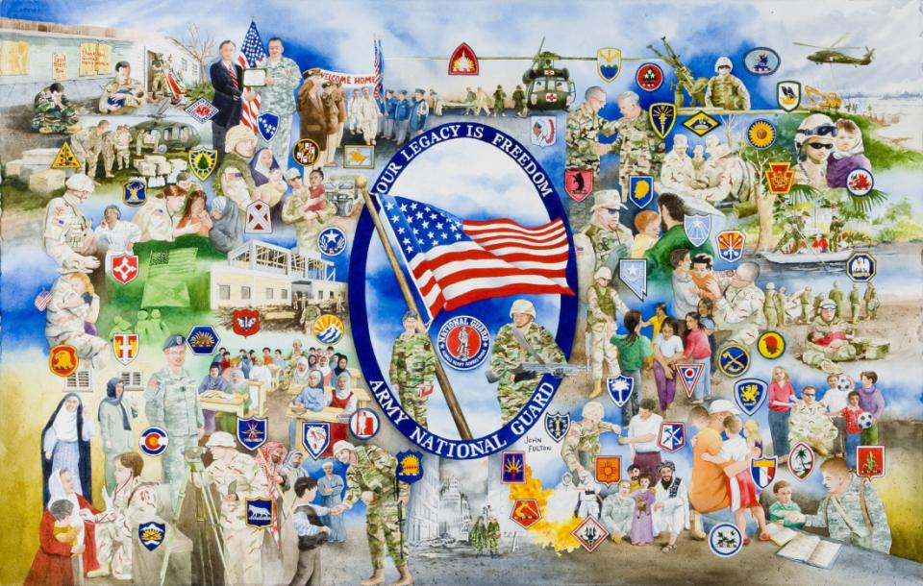

Slide 46
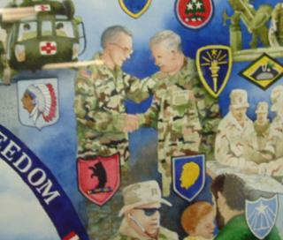

Slide 47
CH (COL) Gary D. Gilmore
Joint Force Chaplain
Missouri National Guard

