Slide 1
Donations and Volunteer Management
Avoiding the Second Disaster
Roy Weeden
Director,
Missouri Adventist Community Services – Disaster Response
and
Chair,
Missouri VOAD

Slide 2
Joplin, MO

Slide 3
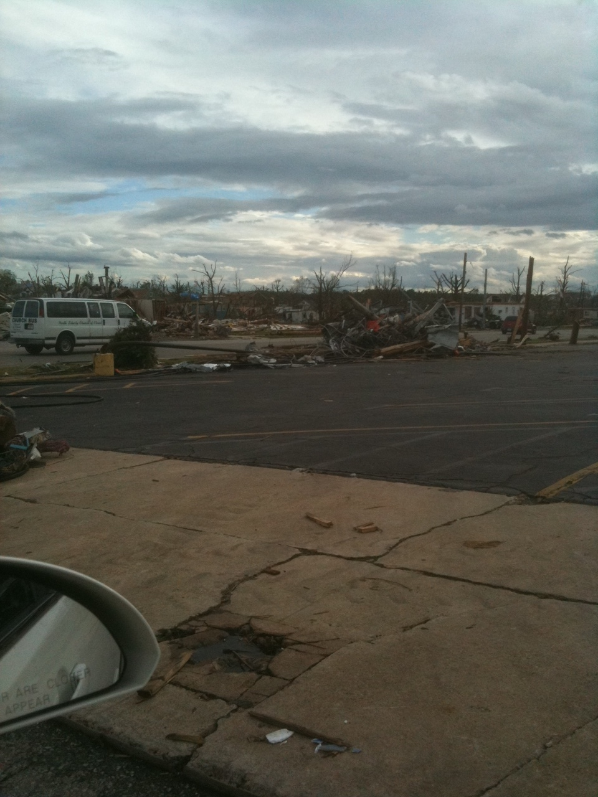
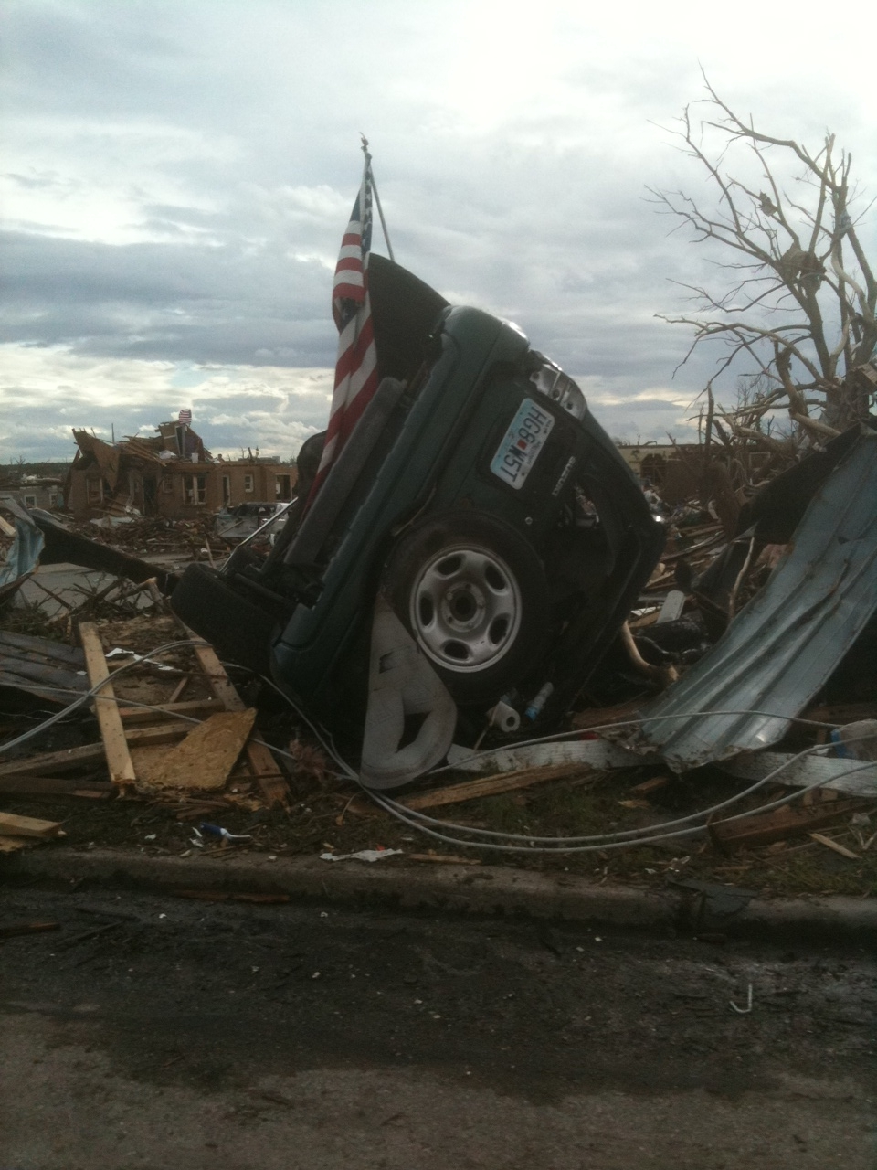
May 22, 2011- 5:41 p.m.

Slide 4
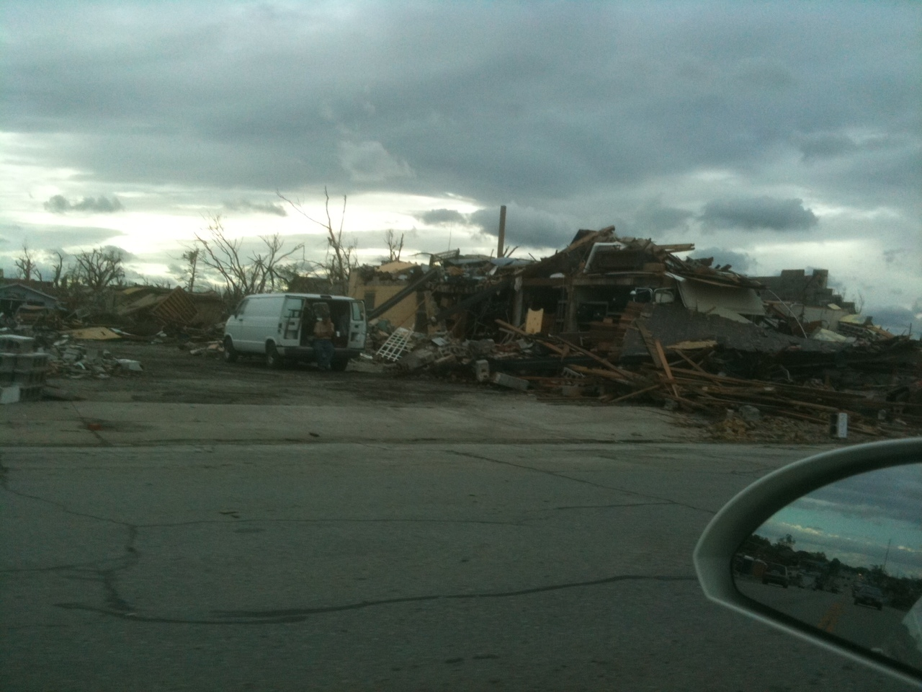

Slide 5
In-Kind Unsolicited Donations

Slide 6
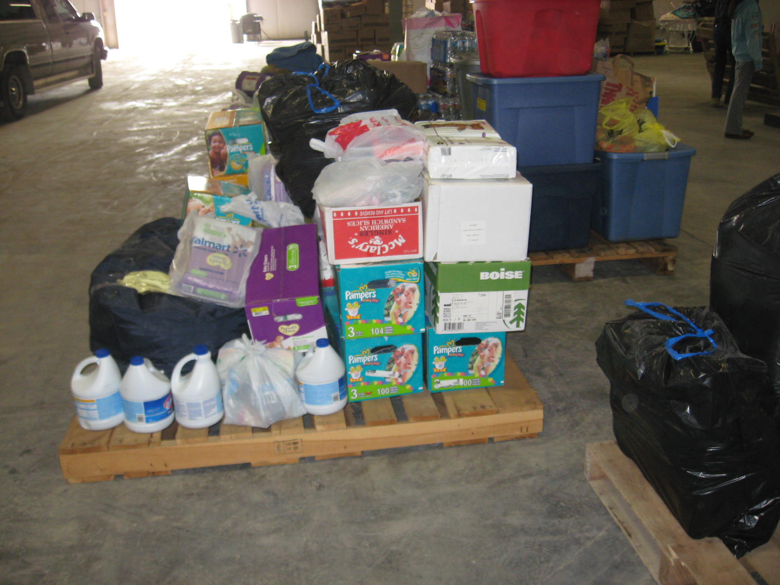
Notes:
A system needs to be in place to adequately receive and sort donated goods so that it can be effectively distributed to disaster survivors. But a secondary but almost equal benefit is to avoid the disaster within the disaster….[Next Slide]

Slide 7
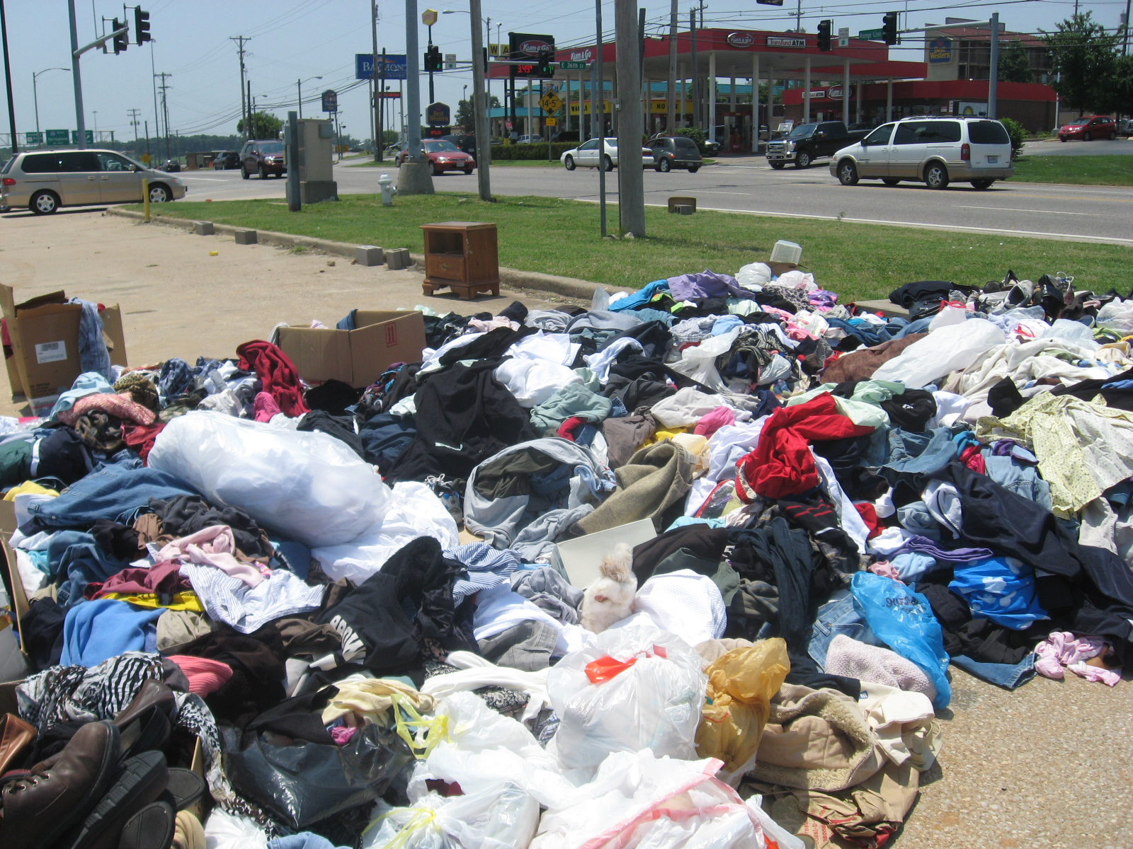
Notes:
We live in a generous country and people want to help….[Net Slide]

Slide 8
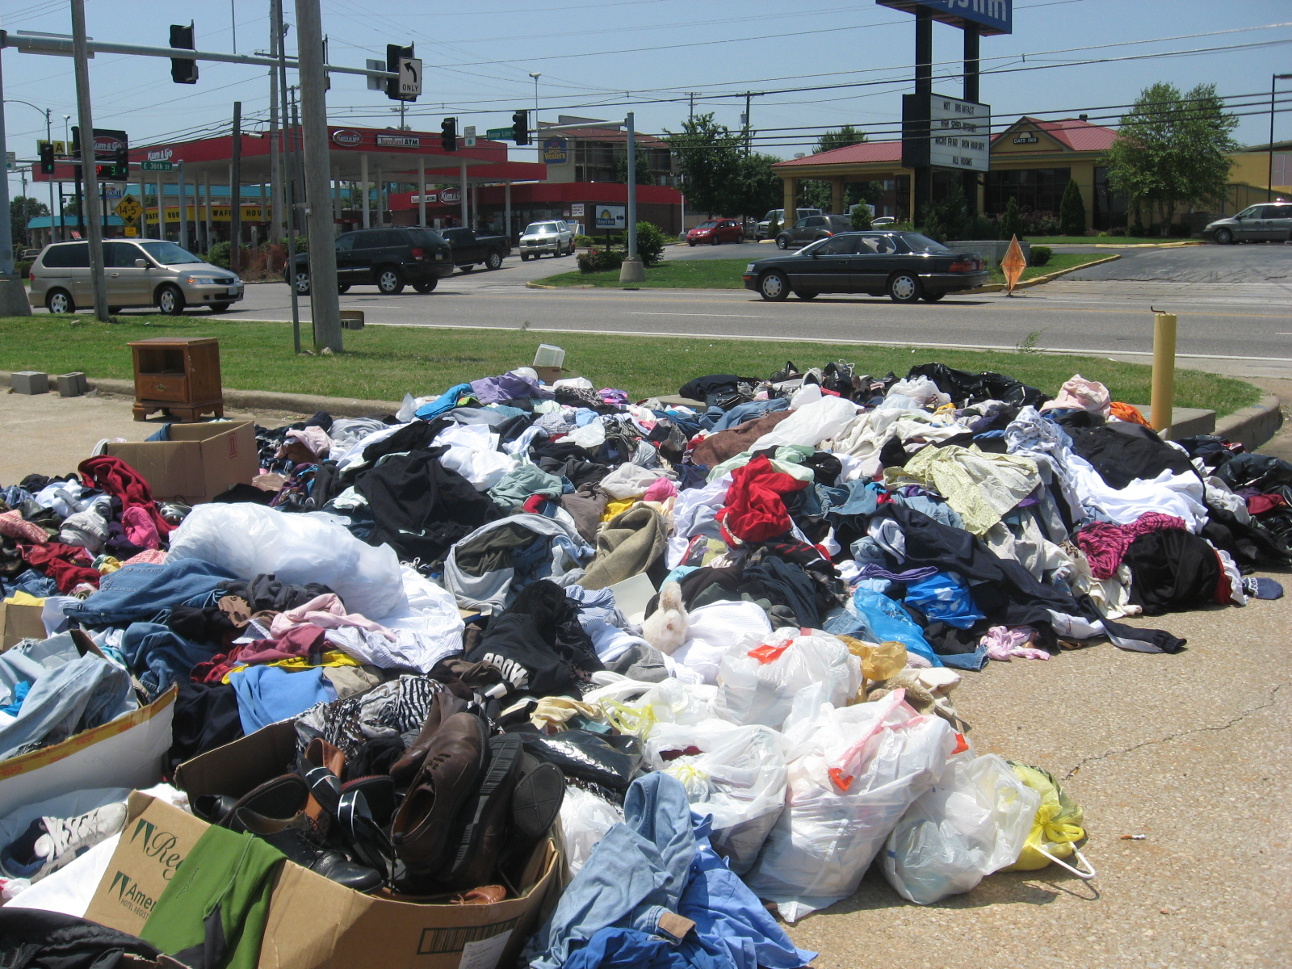
Notes:
But if they cannot find the right place to go to after trucking their goods hundreds of miles….what you see here can happen…

Slide 9
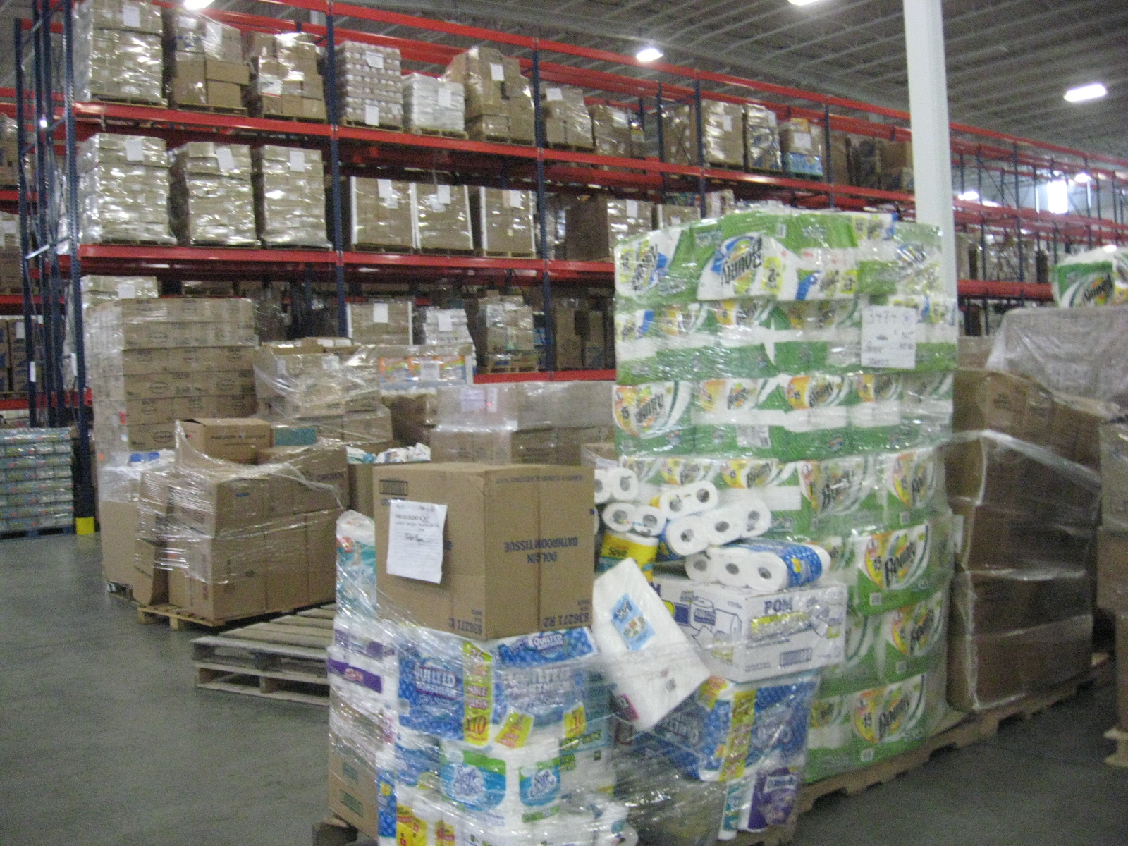
Notes:
It’s supposed to look like this…..[Next Slide]

Slide 10
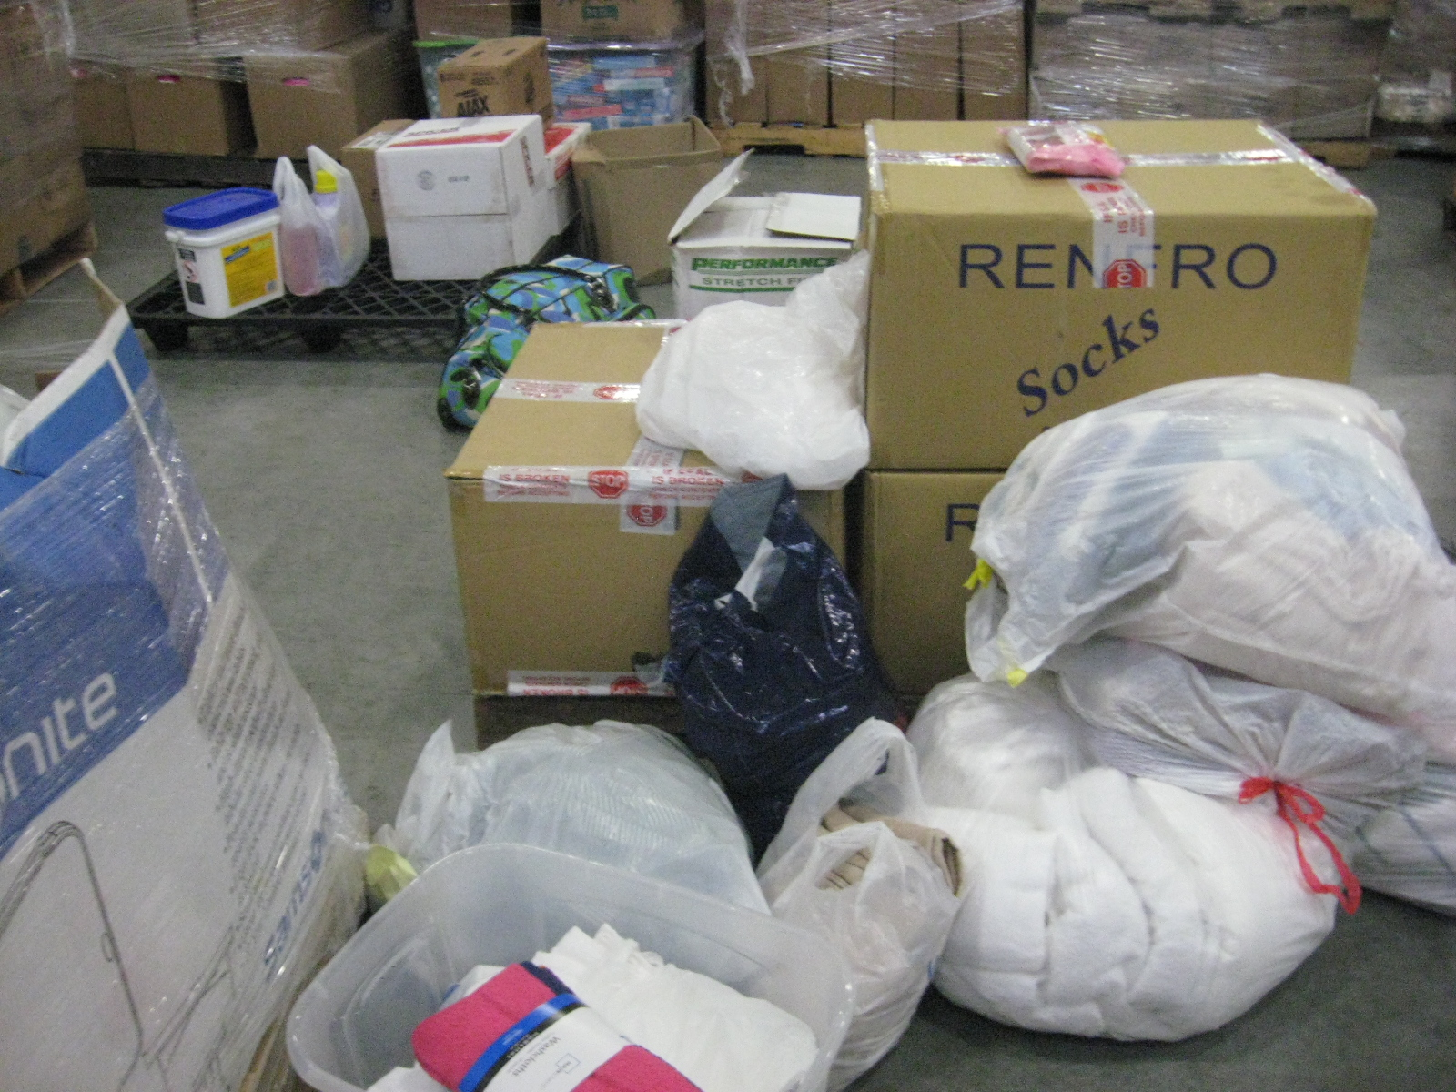
Notes:
Adventist Community Services – Disaster Response takes this…….[Next Slide]

Slide 11
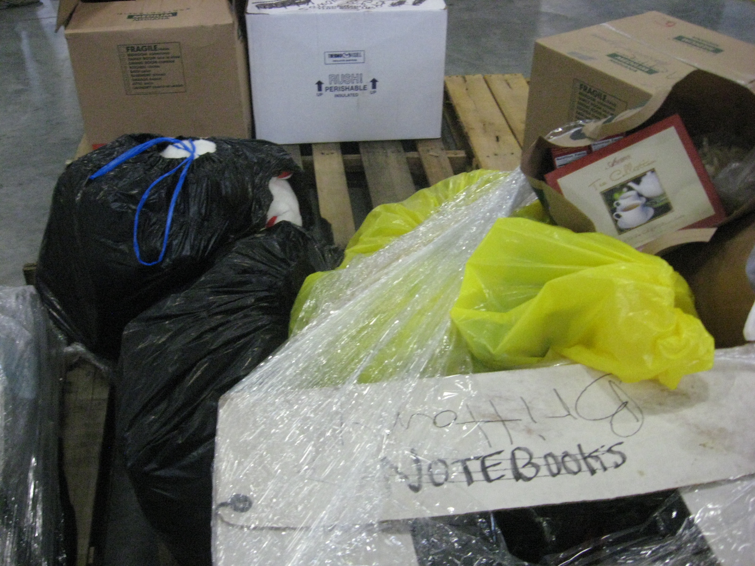
Notes:
And this…..[Next Slide]

Slide 12
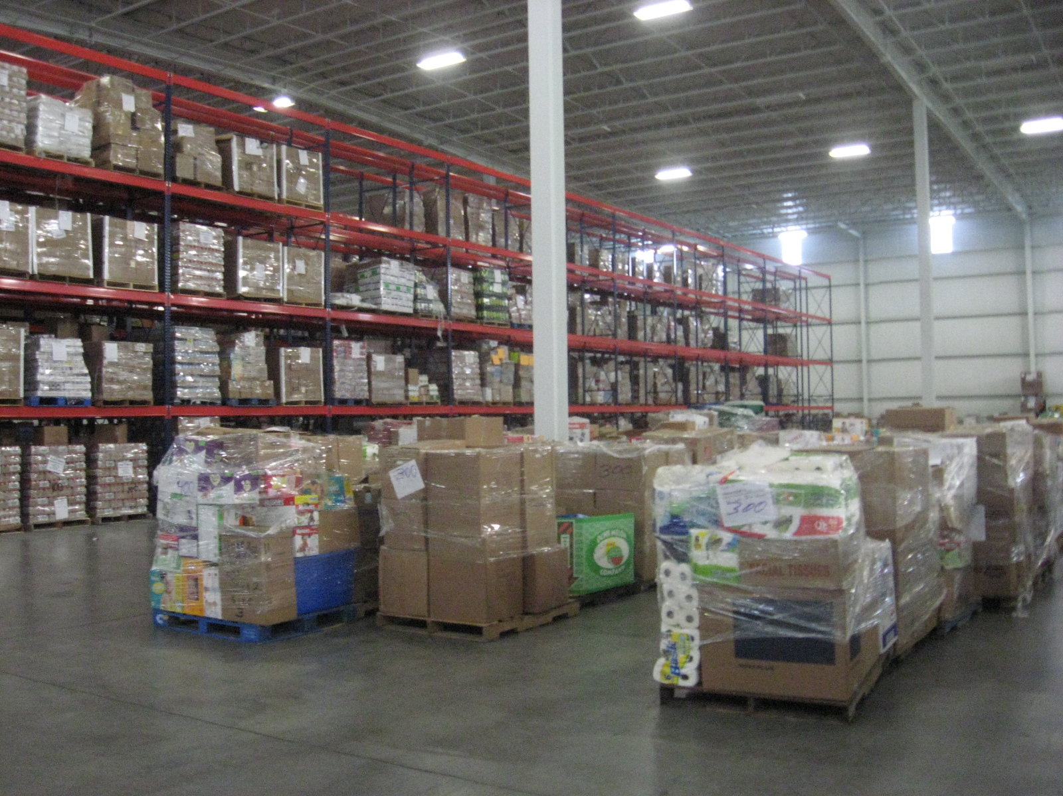
Notes:
And converts it all into this all sorted by their classifications for easy retrieval and distributed to the distribution points in a disaster zone. [Next Slide]

Slide 13
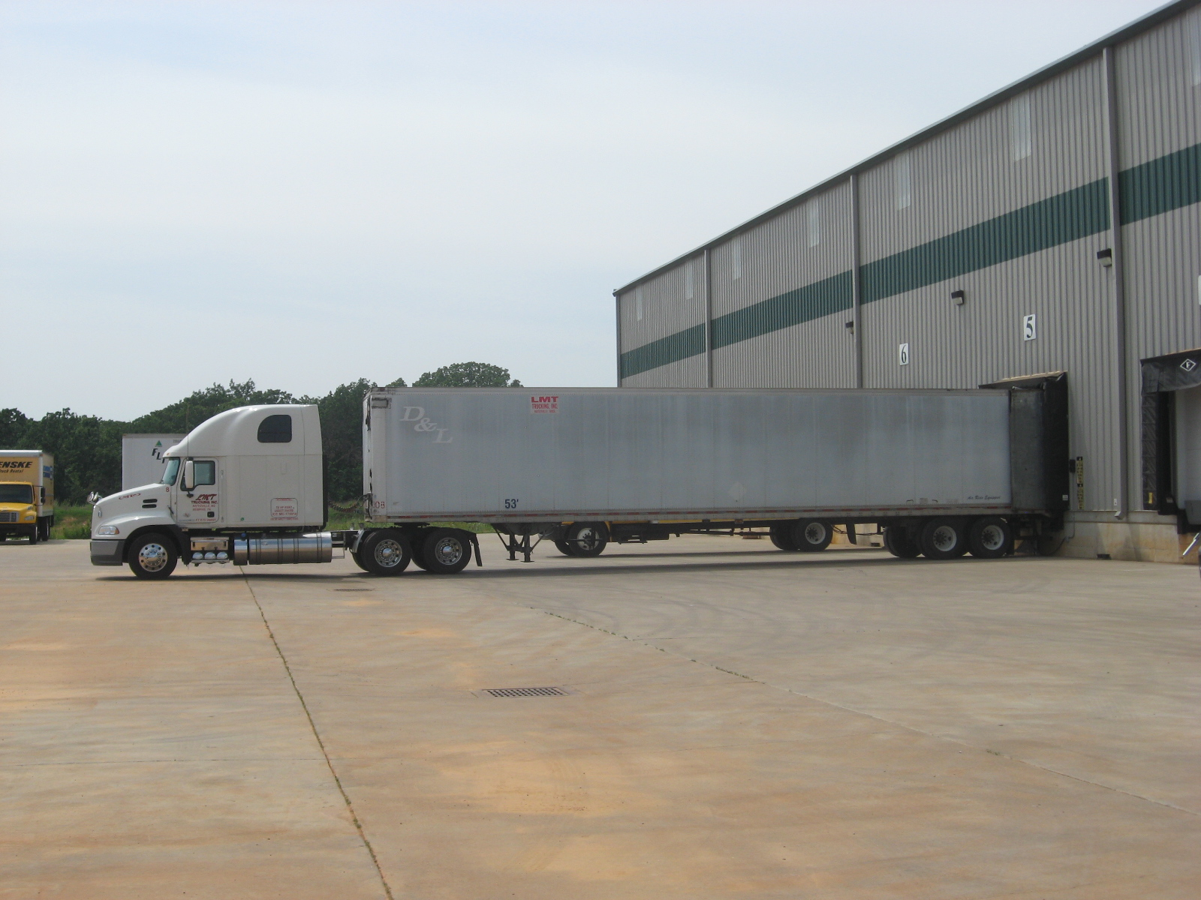
Notes:
This is known as a MAW or Multi Agency Warehouse….[Next Slide]

Slide 14
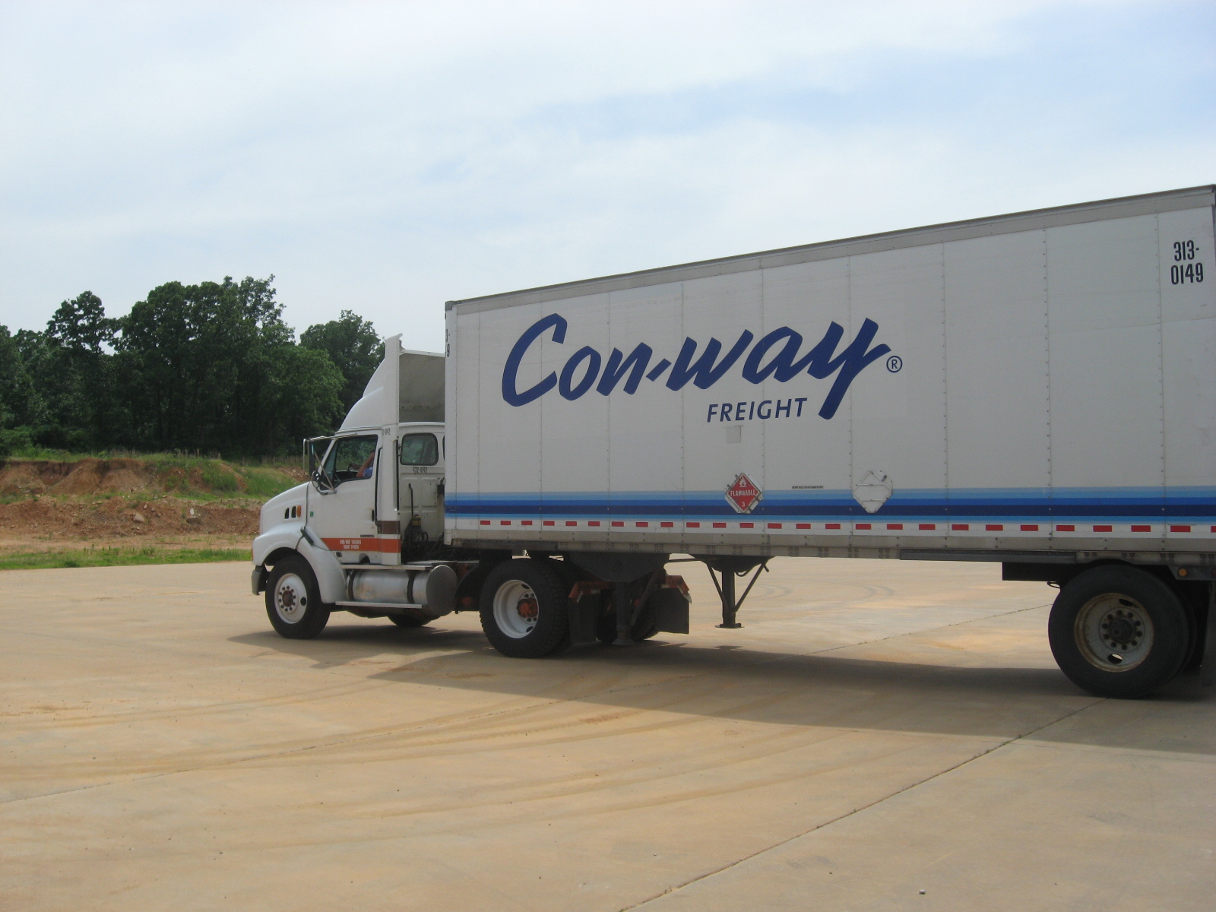
Notes:
ACS is currently operating this warehouse in Joplin, MO together with the State of Missouri for the relief effort in that area. [Next Slide]

Slide 15
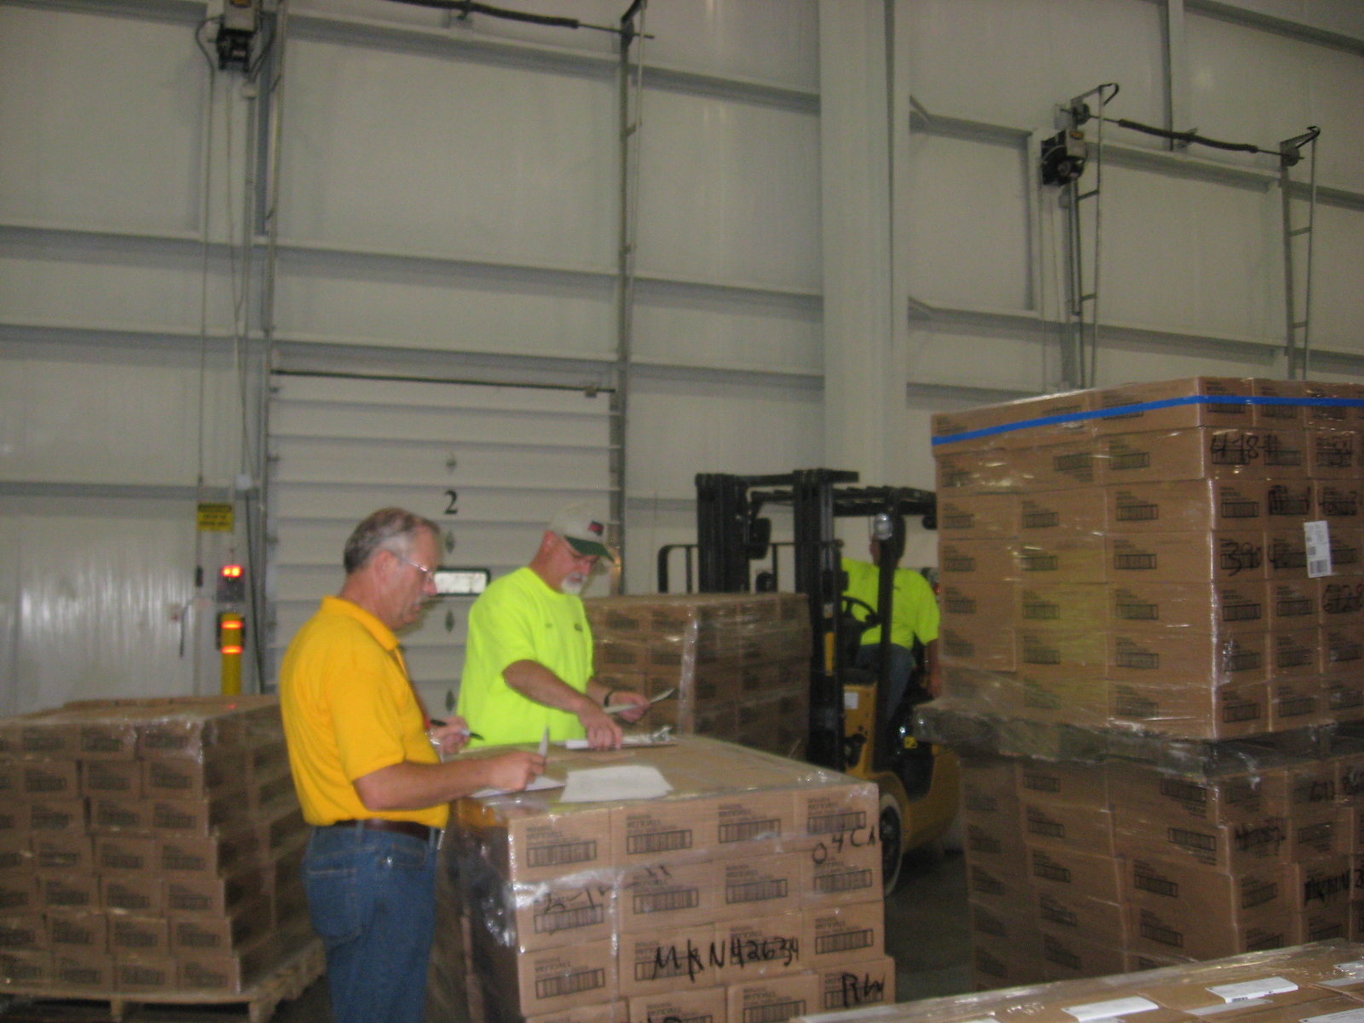
Notes:
Our warehouse managers receipt the merchandise that comes to us and we can track items that are earmarked for specific organizations and projects or can be made available to the generally affected public per the request of the donors. [Next Slide]

Slide 16
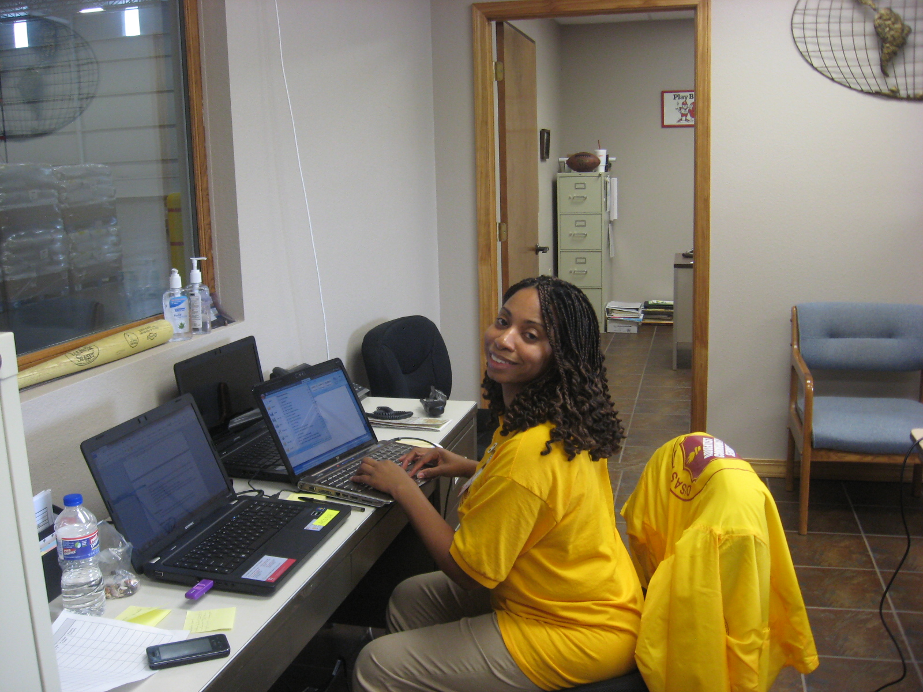
Notes:
ACS tracks and processes the goods as a fiduciary agent for the donors using our charitable 501 © 3 status. [Next Slide]

Slide 17
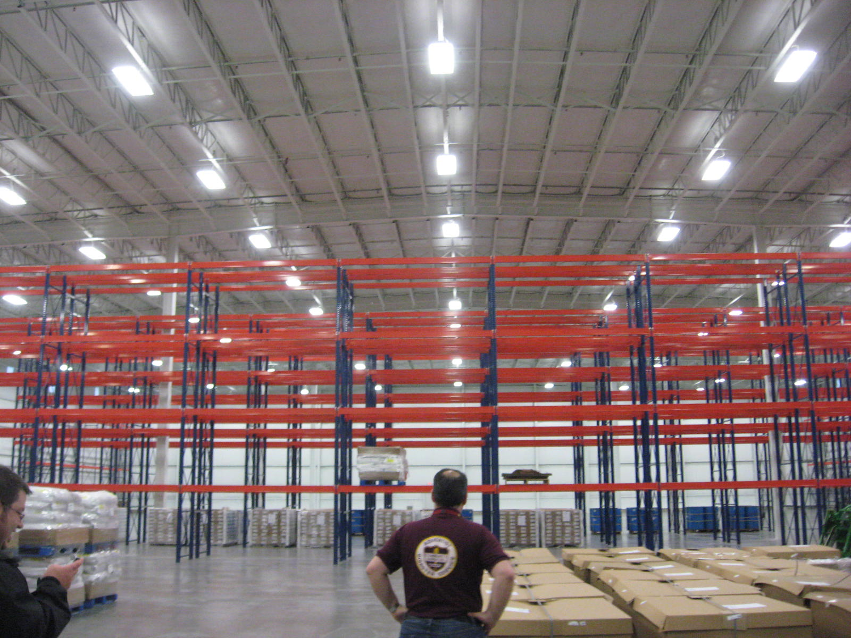
Notes:
On May 28, 2011 the MAW looked like this…[Next Slide]

Slide 18
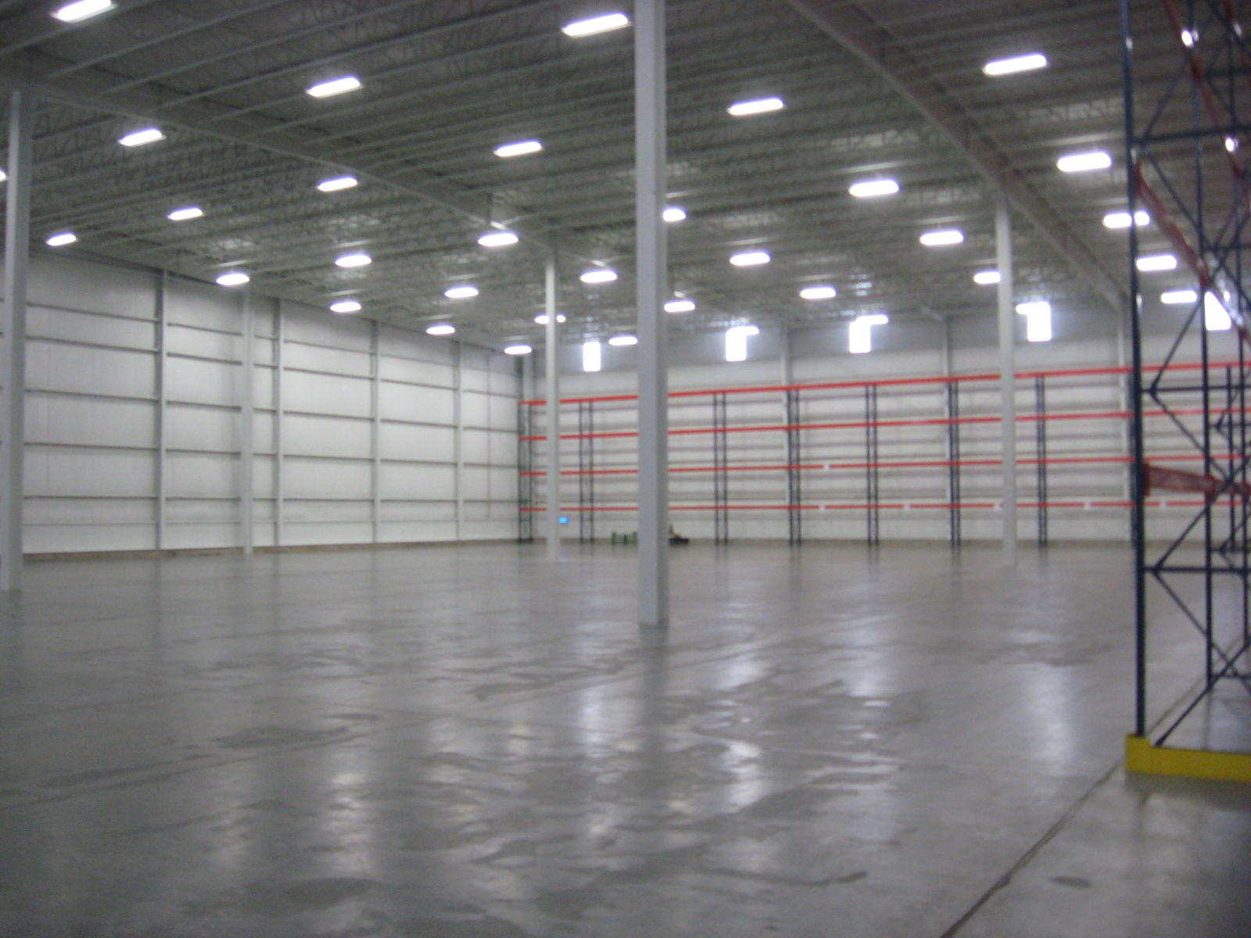
Notes:
And this…[Next Slide]

Slide 19
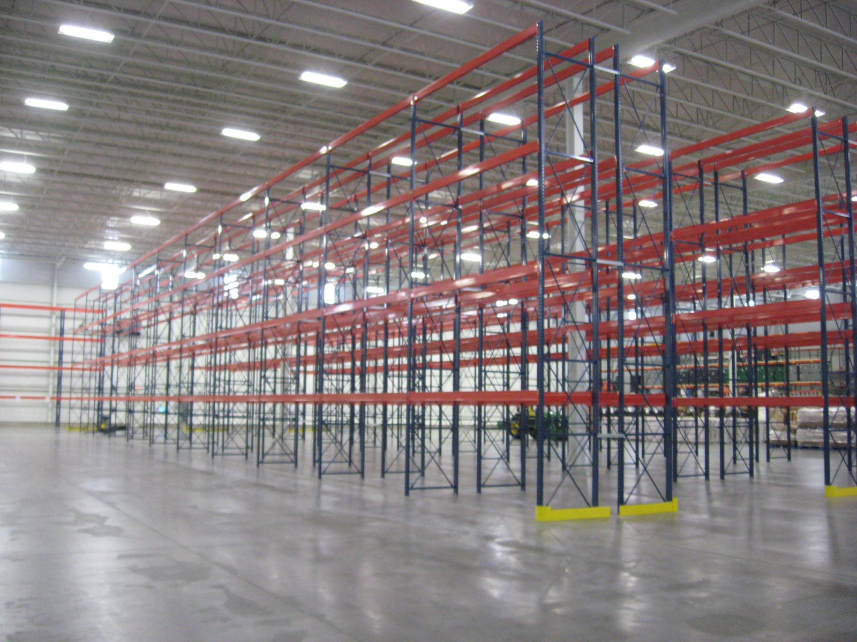
Notes:
And this….[Next Slide]

Slide 20
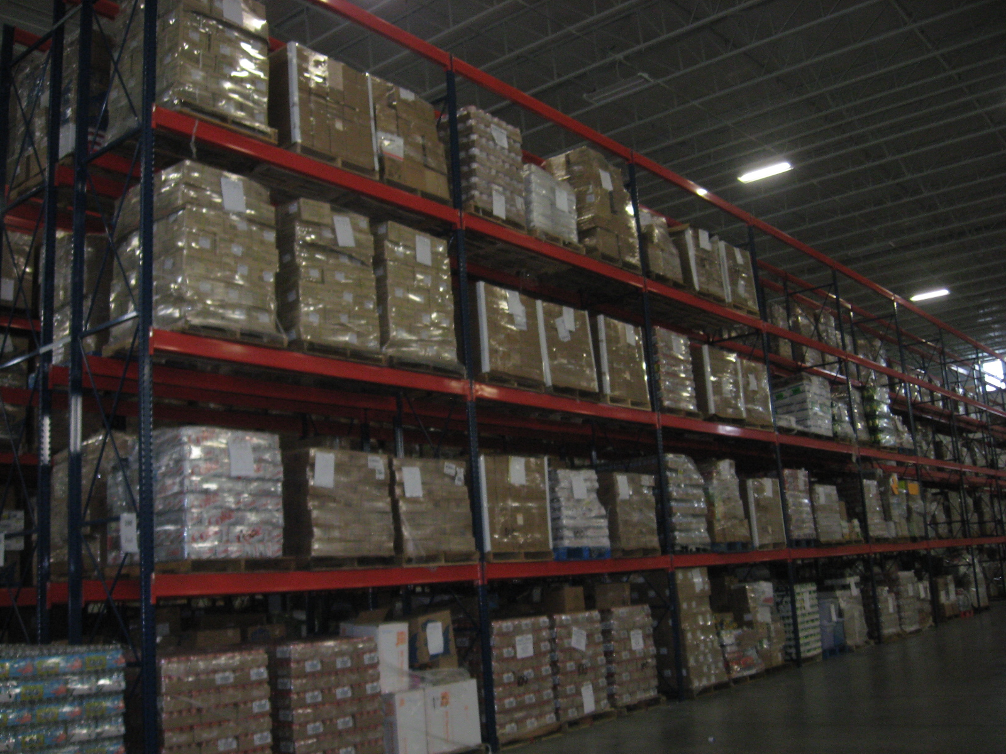
Notes:
A few weeks later it looked like this….Millions of dollars of goods have been processed to the survivors through this warehouse.

Slide 21
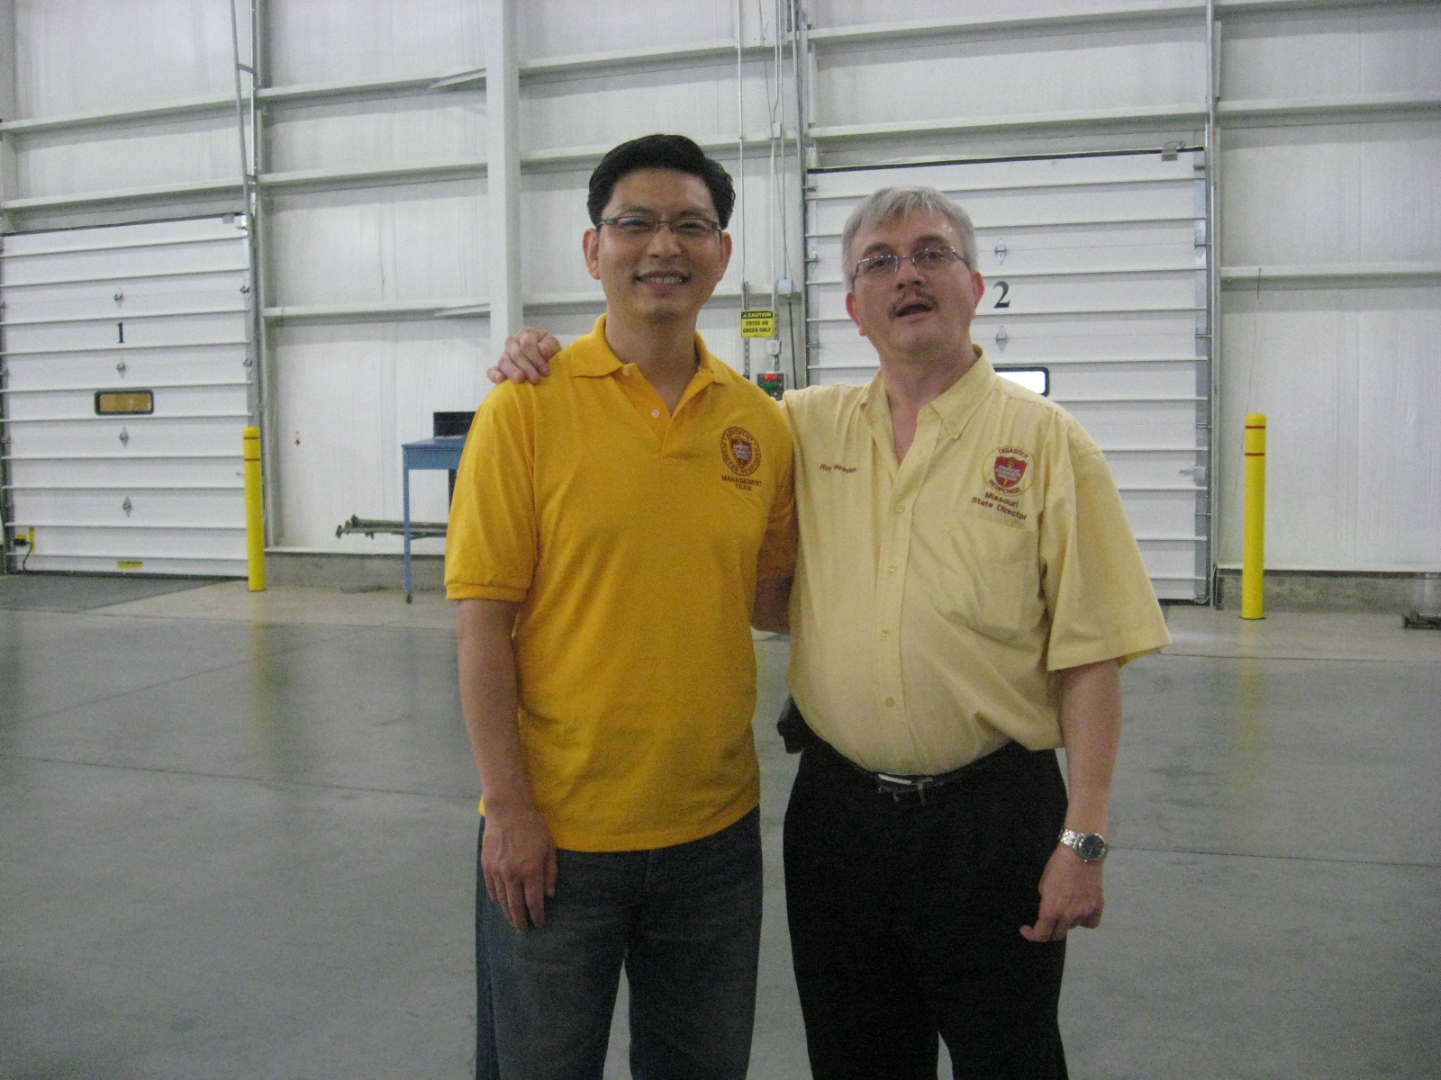
Notes:
Even though ACS has played a lead role in this warehousing enterprise…it would not be nearly so successful without the thousands of volunteers….[Next Slide]

Slide 22
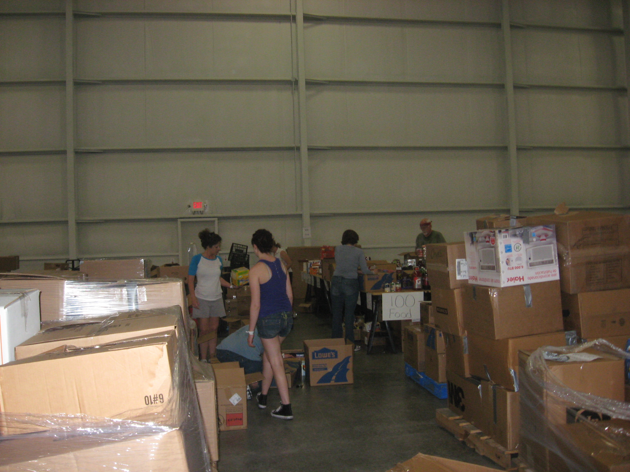
Notes:
Who gave of themselves….[Next Slide]

Slide 23
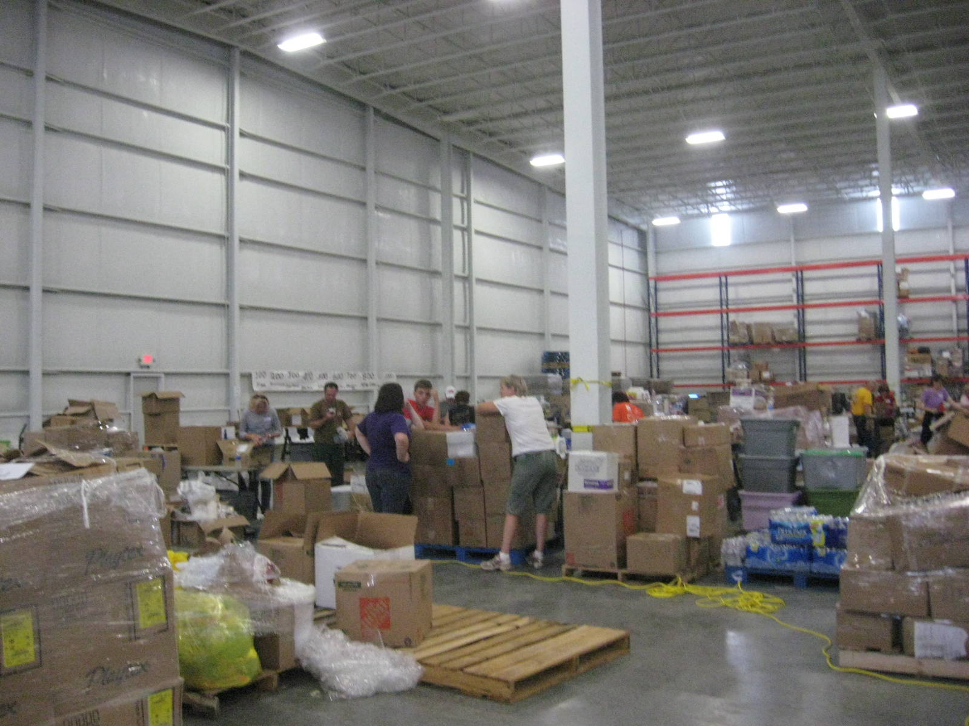
Notes:
And helped to break down mixed pallets of donated goods and sorted them by their categories for easy distribution. This has become one of the most successful warehousing operations inside a disaster zone. Thanks to the state of Missouri and FEMA for most of the funding of the operation, the ACS Management teams and the thousands of volunteers that performed many hours of service, the MAW is still filling a needed role in Joplin.

Slide 24
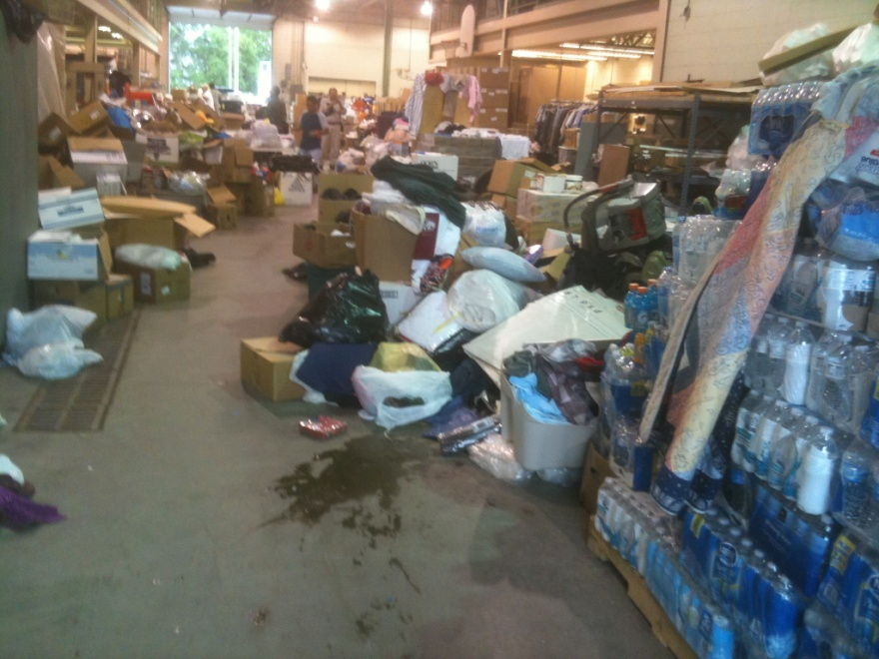
Challenges
Outpouring of Assistance Overwhelming
Need for Storage
Initial lack of a Coordinated Response
Seeking Donated Space
Spontaneous Points of Distribution (POD) throughout the city

Slide 25
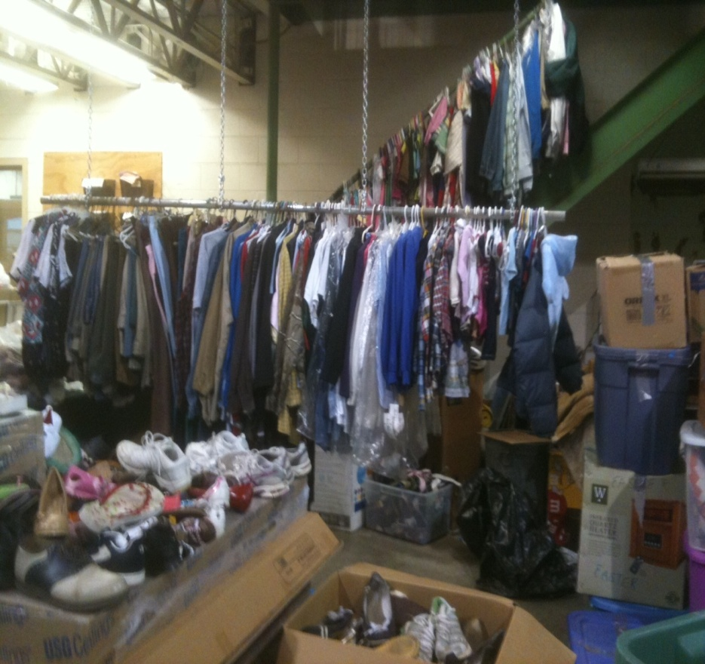
Missouri Southern State University Warehouse
MSSU Physical Plant
Opened immediately
10,000 sq. ft.
AmeriCorps
Accepted all donations
On line for one week only

Slide 26
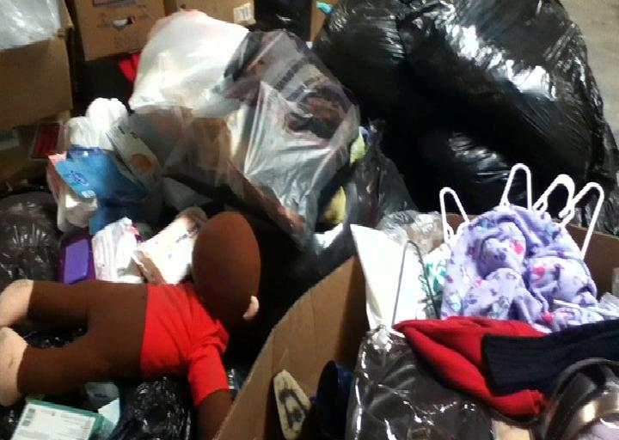
Airport Warehouse
Joplin, MO 22,000 sq. ft.
Donated to Joplin (one month)
AmeriCorps
MSSU inventory
Donations from across the country
Water
Food
Clothes (sorted on site)

Slide 27
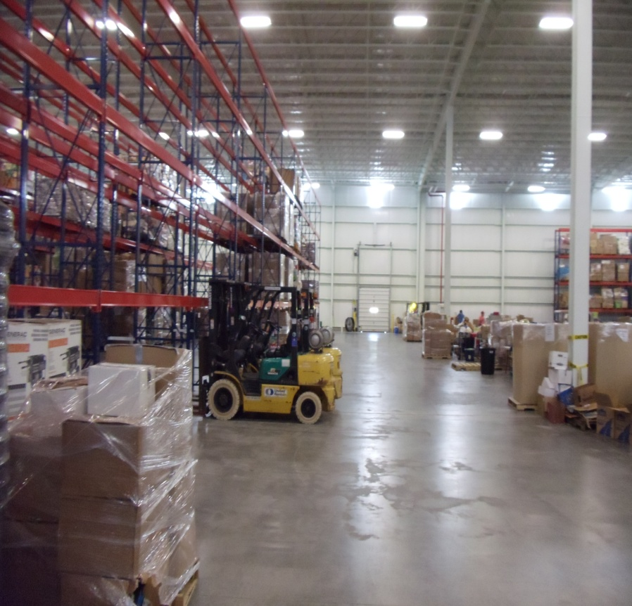
Joplin Multi-Agency Donations Warehouse
Joplin, MO 60,000 sq. ft.
State Funded
Adventist Community Services
Food
Water
Cleaning Supplies
School Supplies
Building Supplies
ABC (Anything But Clothes)

Slide 28
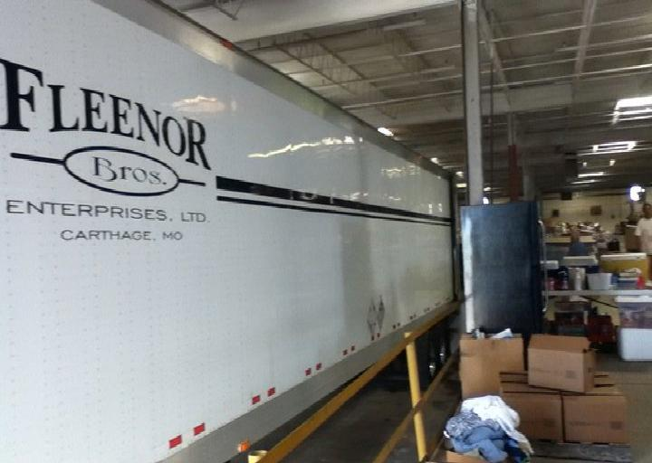
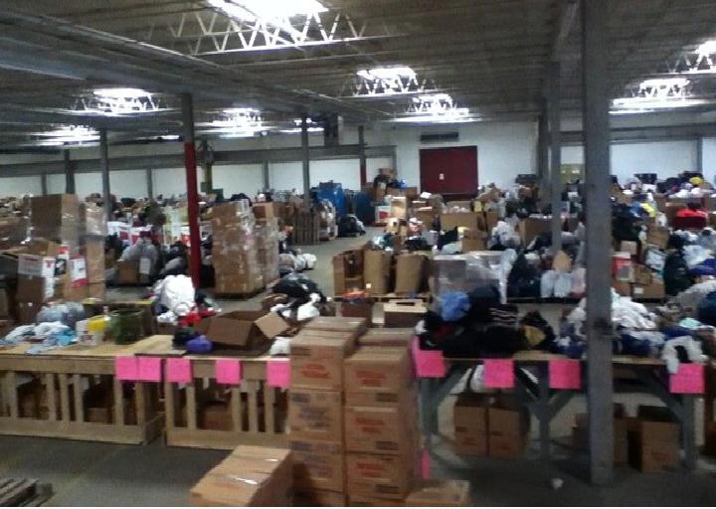
Marshfield Warehouse
Marshfield, MO 72,000 Sq. Ft.
Volunteers from Webster County
Facility donated along with most equipment
Accepting trucks from across the country
No items turned away

Slide 29
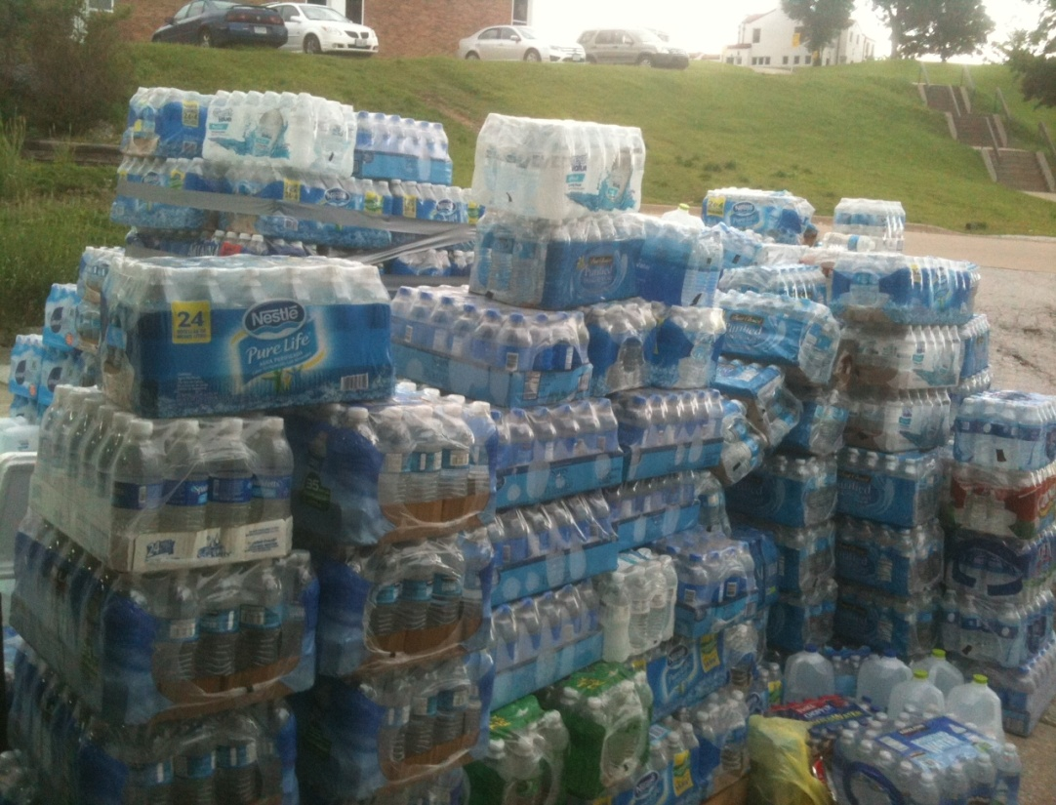
Storage Facilities
Neosho, MO 72,000 sq. ft.
Clothes
240 pallets of Water
Carthage, MO 100,000 sq. ft.
400 pallets of water

Slide 30
Volunteer Management
Volunteers poured in from across the country.
Outside church groups and civic groups providing volunteer labor for debris removal and warehouse sorting.

Slide 31
How Do Faith-Based Organizations Get Involved in Donations Management?
Contact the Missouri VOAD (Roy)
Contact SEMA (Mike Pickerel 573-526-9247)
Contact Local Emergency Management Agency (See SEMA Web Site for EM Director List)
Contact Local Community Organizations Active in Disaster (See SEMA Web Site – Partnership Pages)

Slide 32
How Do Faith-Based Organizations Get Involved in Donations Management?
Plan (with Partners)
Prepare (Train, Drill, Exercise, Identify Resources)
Partner with Emergency Management, COADs, Missouri VOAD, etc.
Find a Mentor (Individual or Agency or Association like Missouri VOAD)

Slide 33
Donations Management Key Concepts of Operation
Faith-Based Organizations
Donations Coordination Center
Phone Bank
Web Site
Multi-Agency Donated Goods Warehouse (MADoGW)
Support Agencies
Communications
Public Information
Internal
National Donations Management Network (NDMN)
Plans and SOGs
Local Jurisdictional Donations Management Ops
Points of Distribution (PODs)

Slide 34
Donations Management Resources
Voluntary Organizations
Faith-Based Organizations
Seventh day Adventist
Convoy of Hope
The Salvation Army
Red Cross
National Service Programs (AmeriCorps)
Faith-based Organizations
National Donations Management Network
FEMA Voluntary Agency Liaisons
Mutual Aid from Other States
National VOAD Contract with FEMA
Businesses
State Agencies

Slide 35
Resources – Training and Exercises
Donations
State Donations Course (G)
Managing Donations and Volunteers EMI Course
Regular Webinars (monthly)
NDMN Training (Aidmatrix)

Slide 36
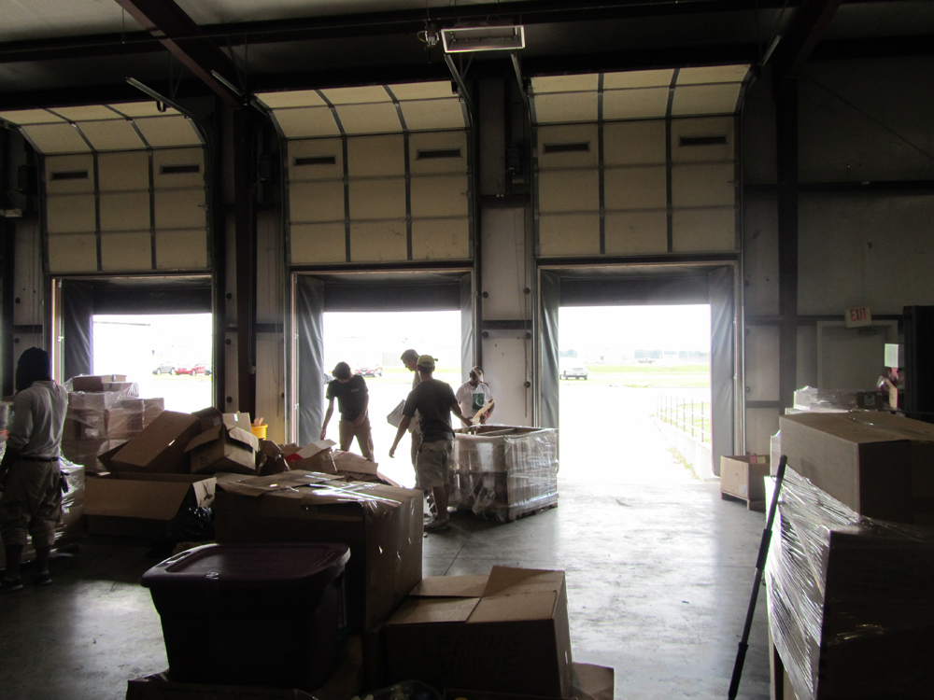
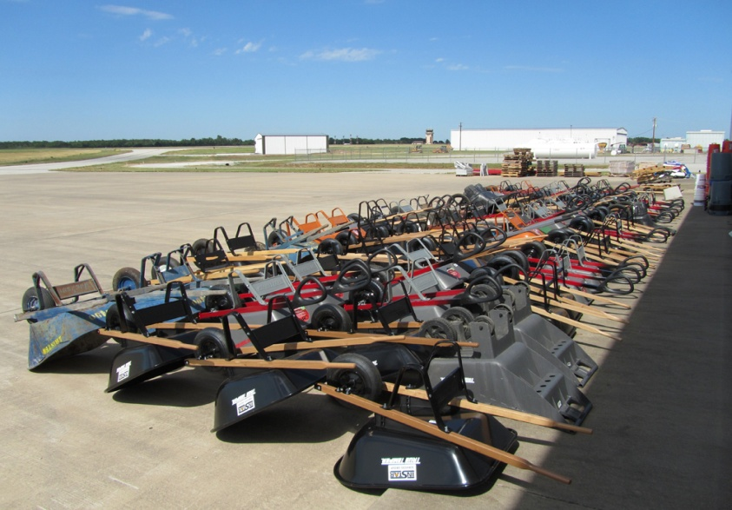
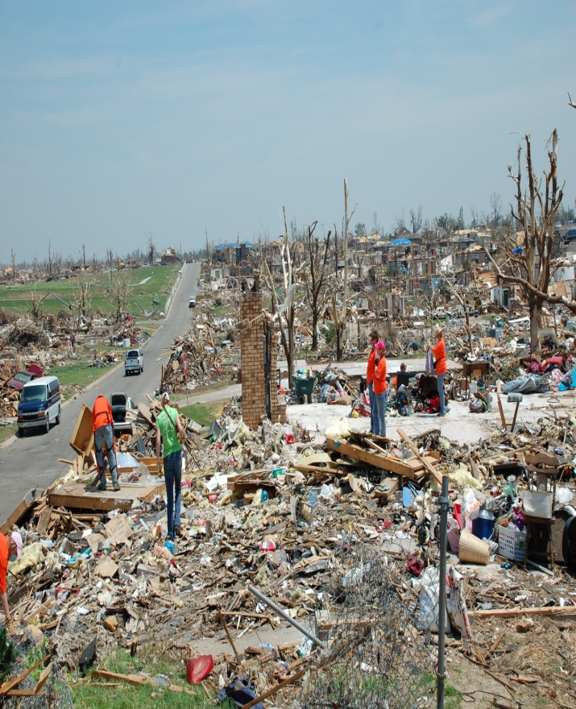
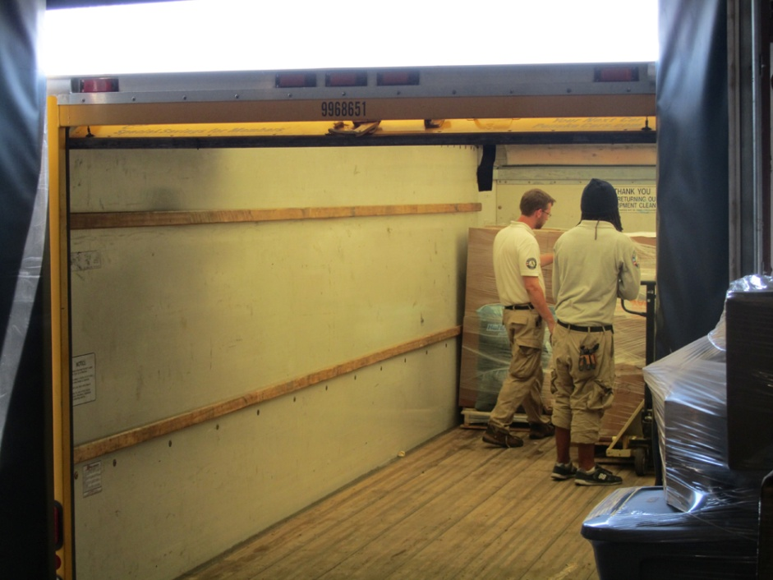
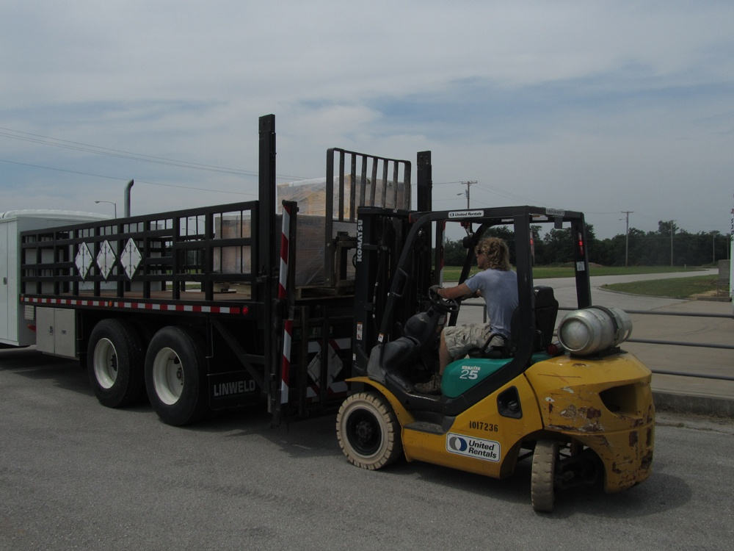
Available for Questions After Close

Slide 37
Donations and Volunteer Management
Avoiding the Second Disaster
Roy Weeden
Director,
Missouri Adventist Community Services – Disaster Response
and
Chair,
Missouri VOAD

