Slide 1
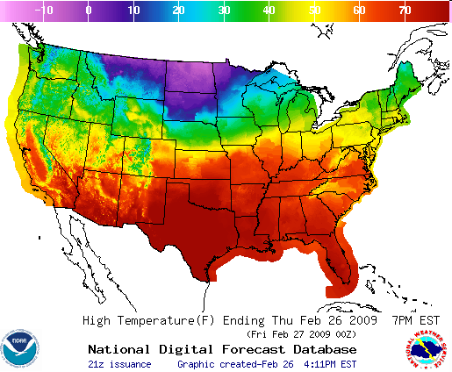
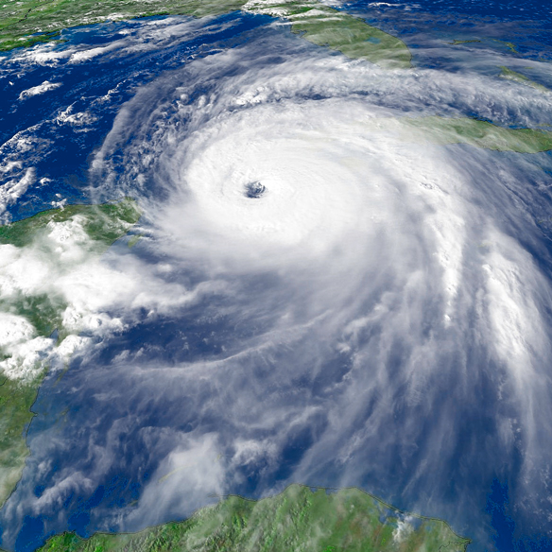
National Weather Service
Building a Weather-Ready Nation

Slide 2
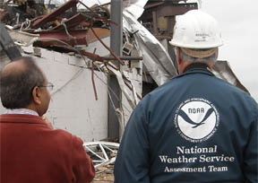
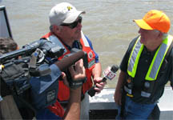
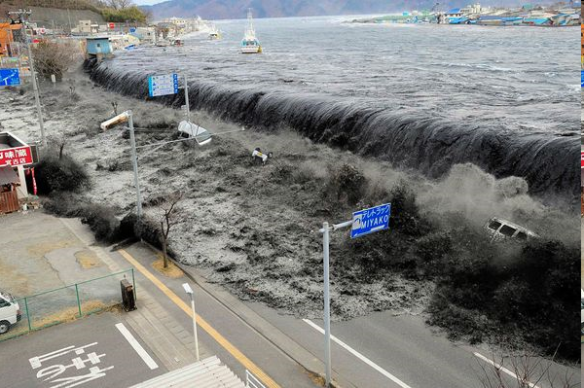
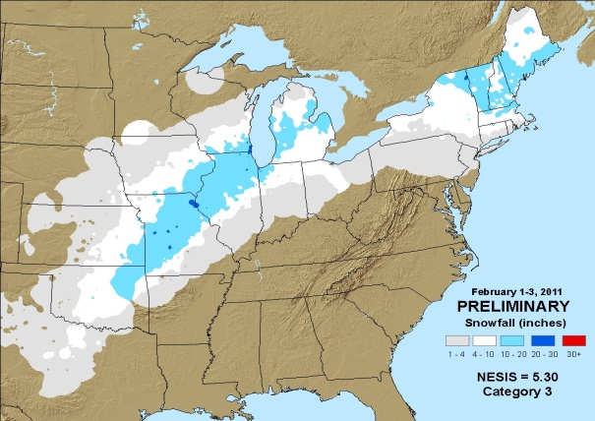
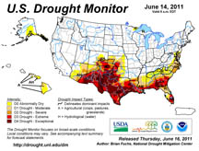
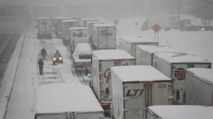
2011: A Year of Extremes ~600 Fatalities $35 Billion in Economic Losses
546 Fatalities from
1,676 Tornadoes
Historic U.S. Floods
Pacific Tsunami
6 Million Acres Burned
Devastating Blizzards
Notes:
2
2

Slide 3
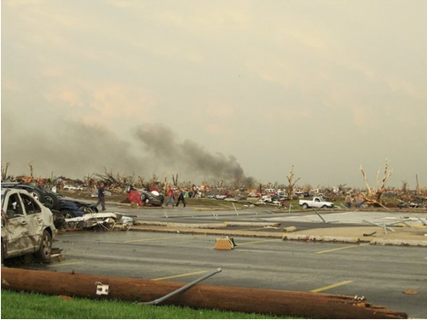
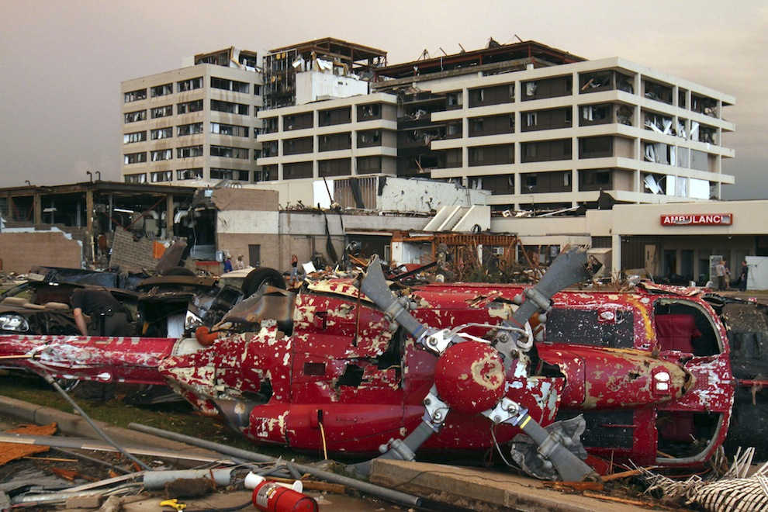
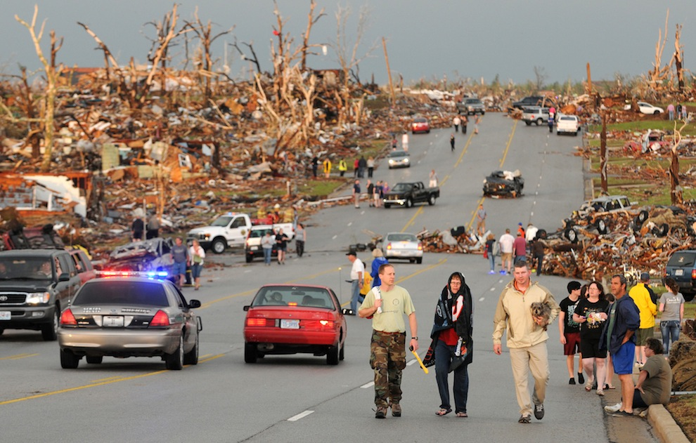
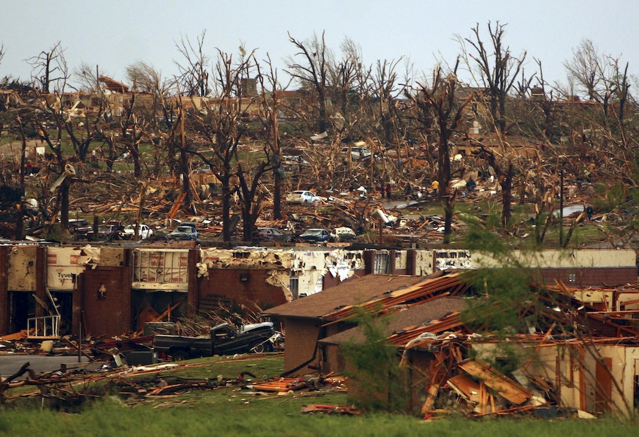
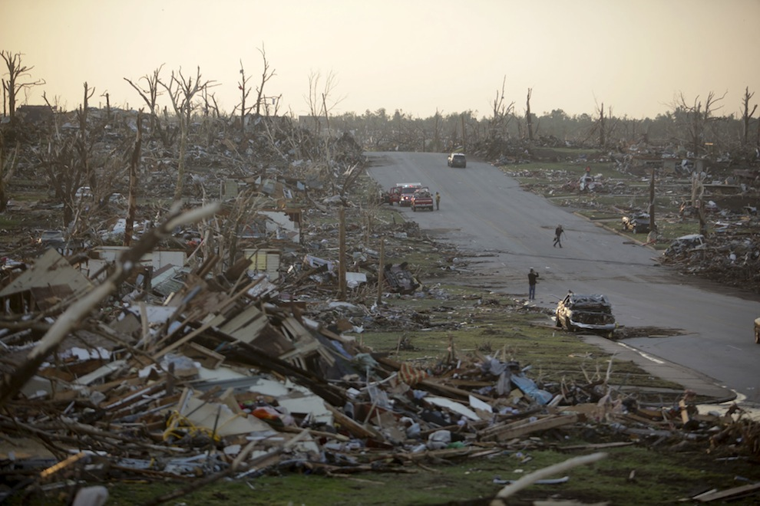
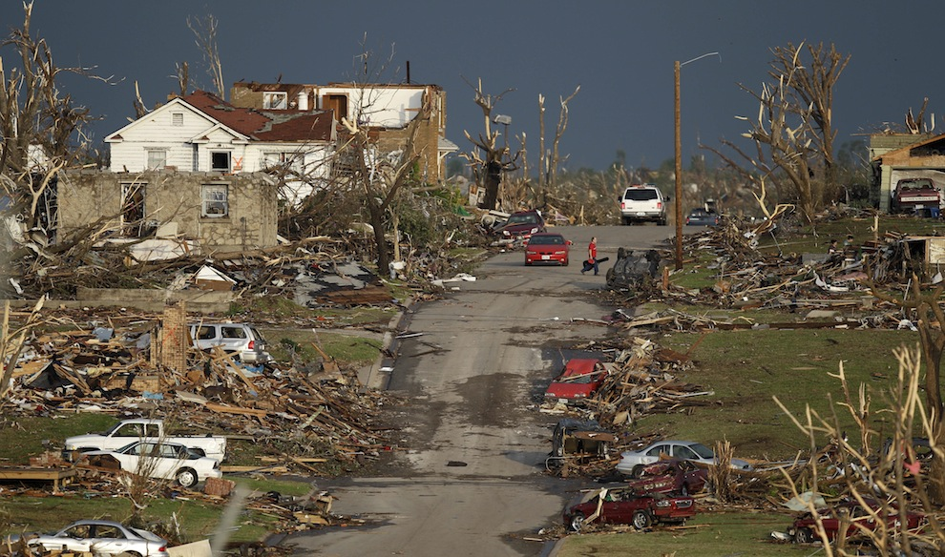
JOPLIN
2.8 BILLION IN LOSSES
1 MILE WIDE
200+ MPH WINDS
22 MILES IN LENGTH
EF-5

Slide 4
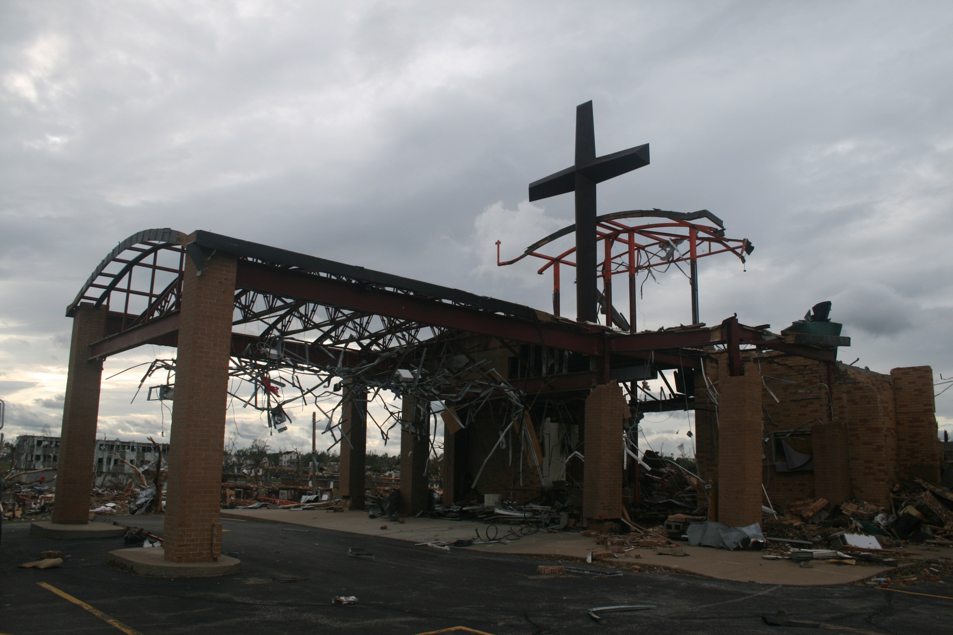
St Mary’s Church

Slide 5
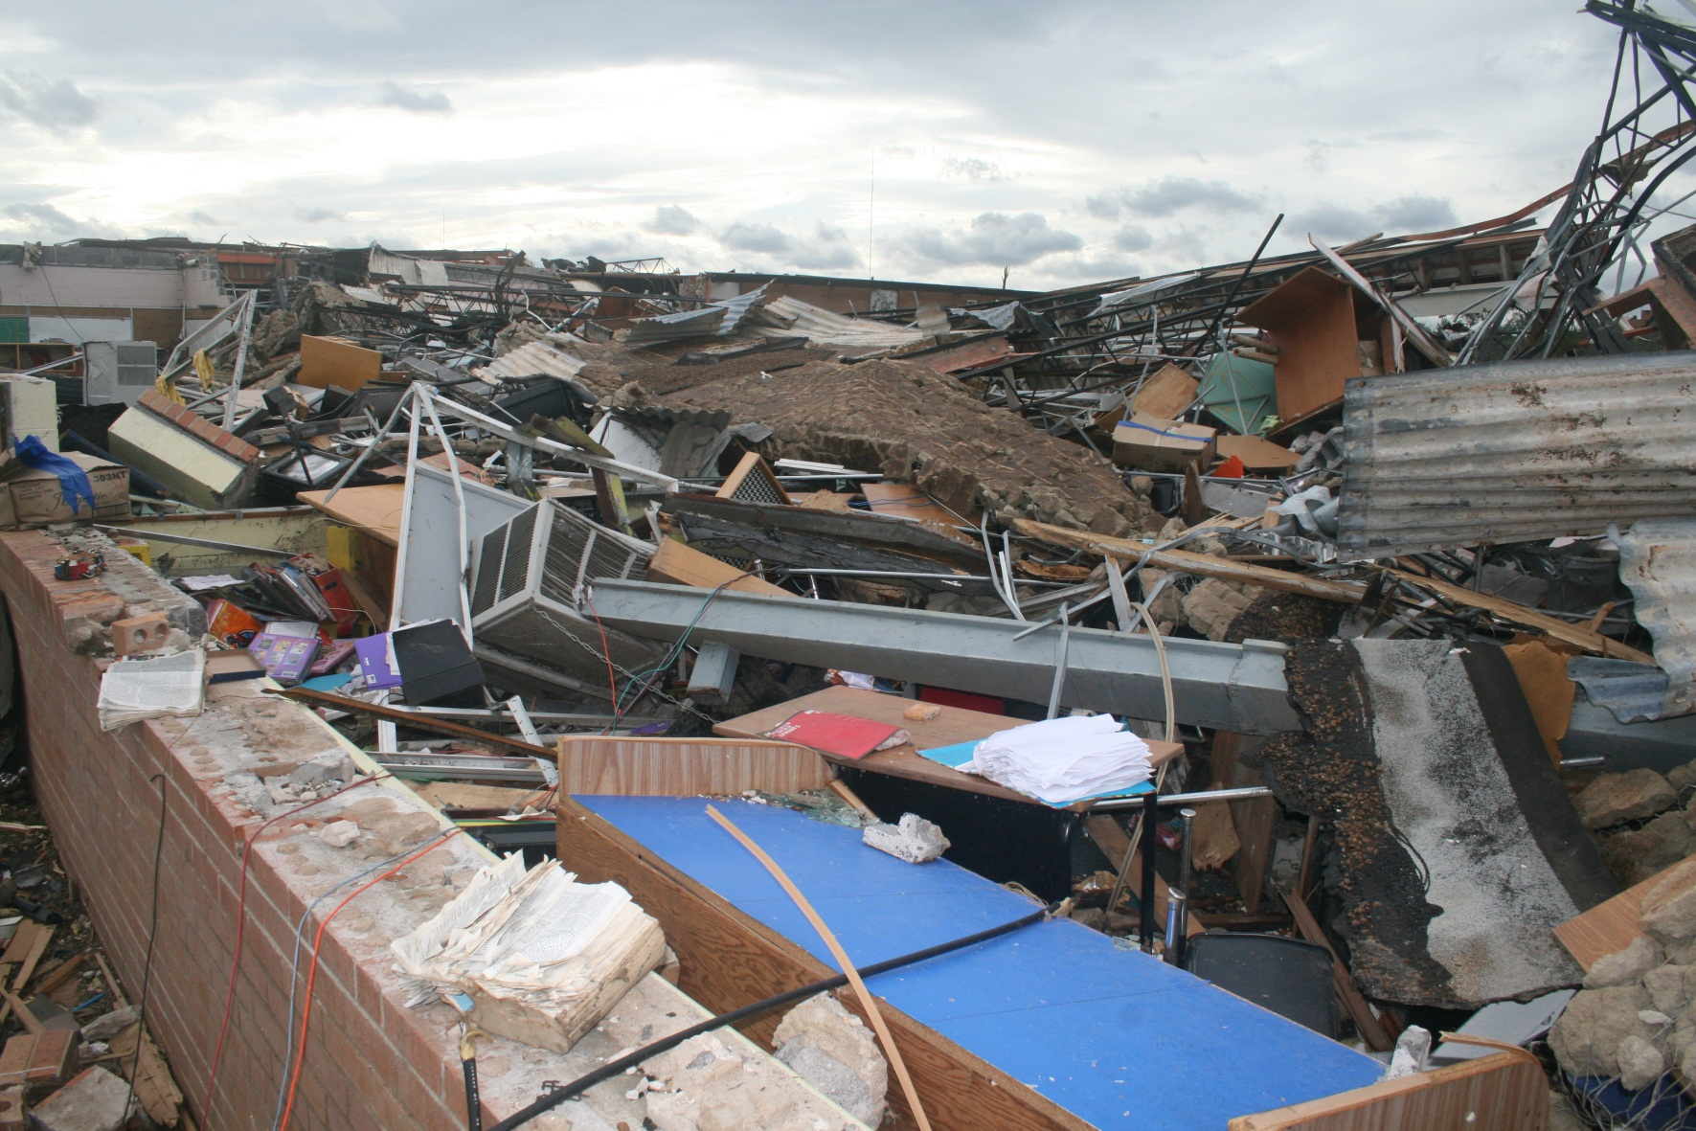
St Mary’s Church

Slide 6
JOPLIN TORNADO

Slide 7
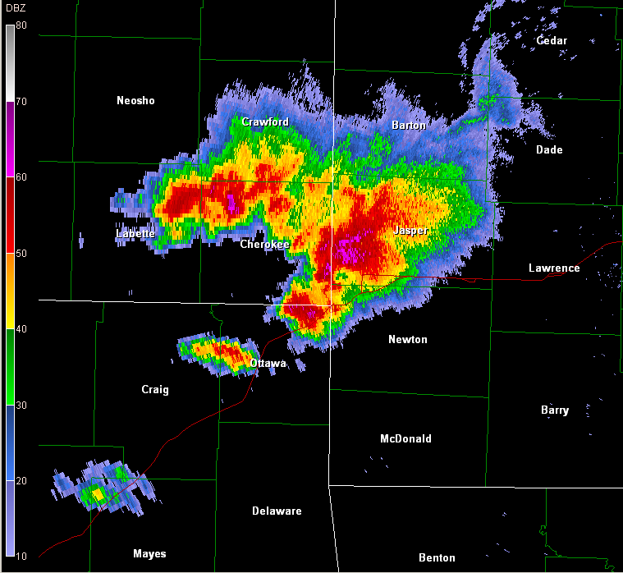
534
PM

Slide 8
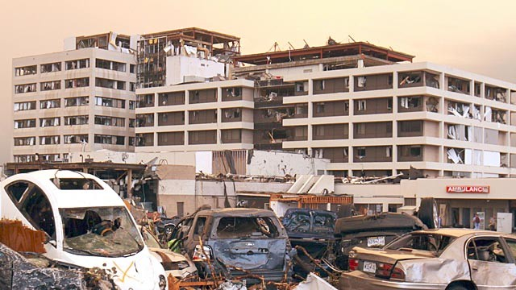
PLAN AHEAD!

Slide 9
THANK YOU !!!

