Slide 1
Church Emergency Preparedness
Brought to you by
The Kentucky Weather Preparedness Committee
Today’s Presenter:
Pat Spoden
Pat.spoden@noaa.gov
Notes:
Church Emergency Preparedness
Brought to you by the Kentucky Weather Preparedness Committee

Slide 2
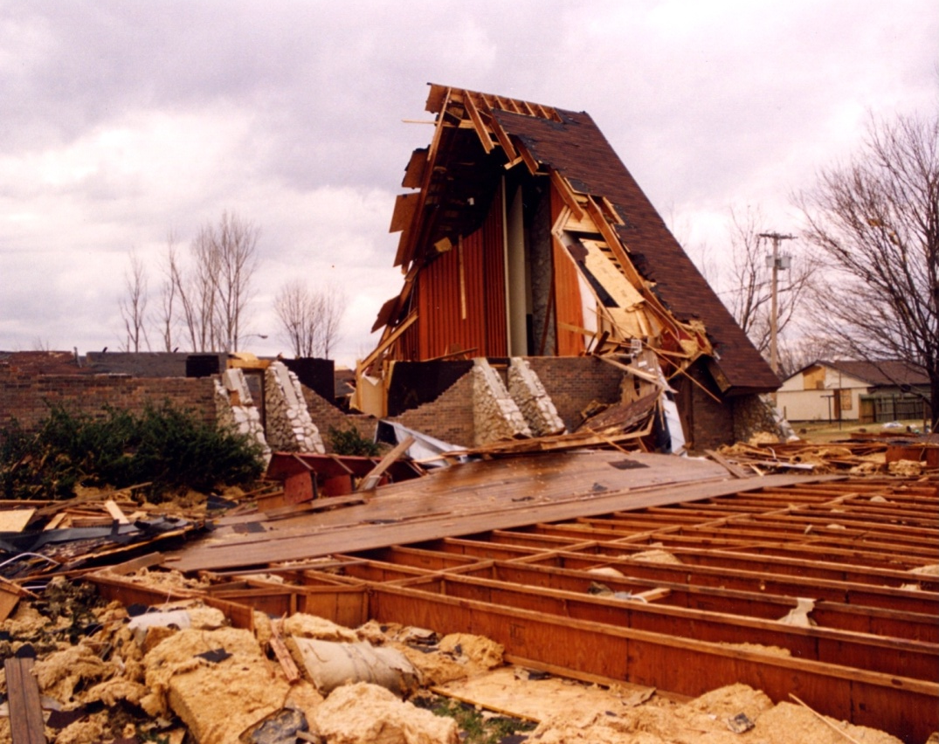
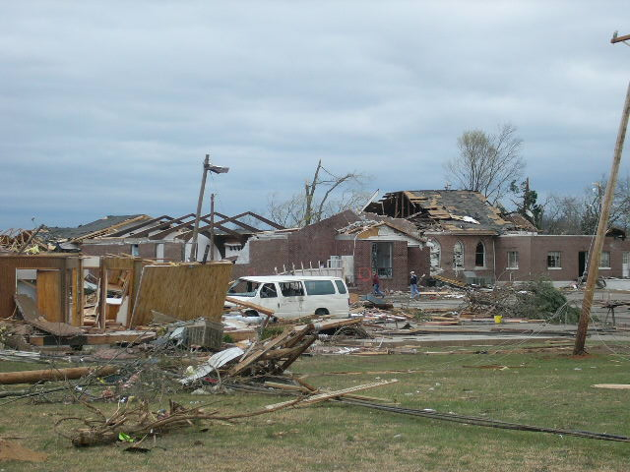
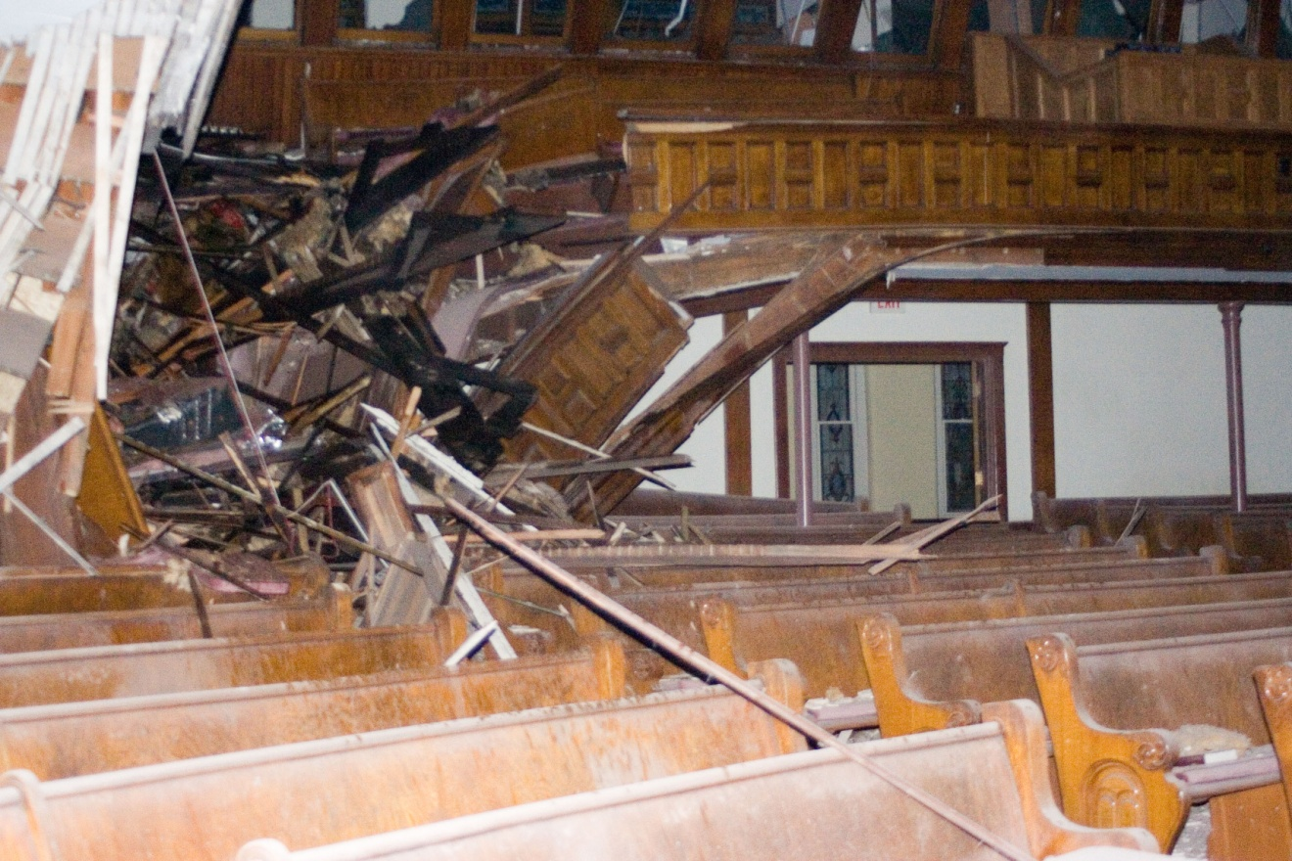
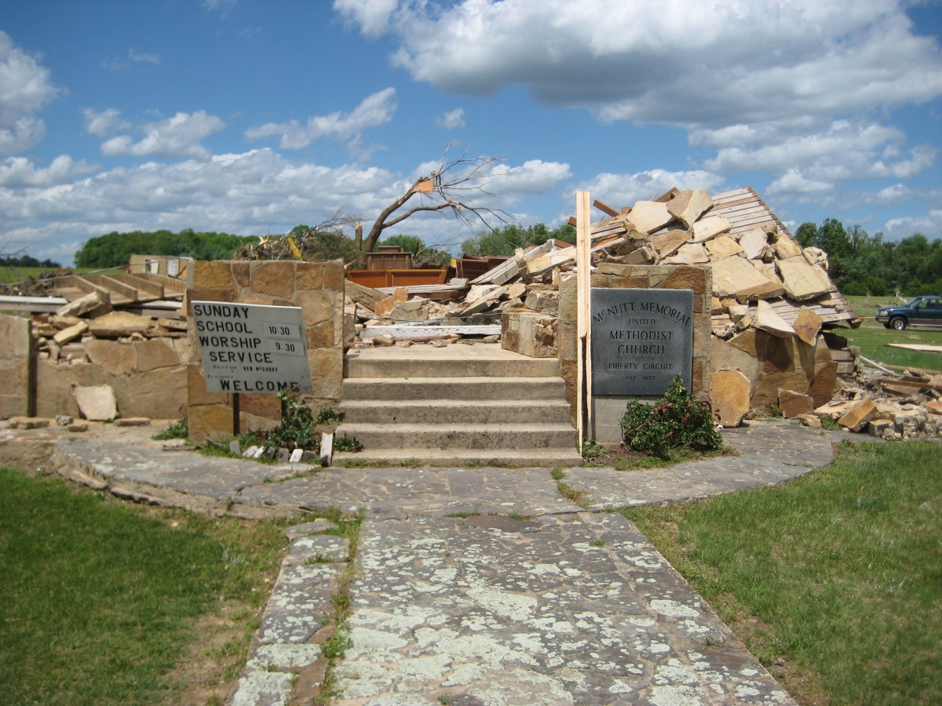
Severe Weather: Don’t Be Caught Off Guard!
Owensboro, January 3, 2000
Near Hopkinsville, April 2, 2006
Owensboro, October 18, 2007
Notes:
So, why are we here?
These are some examples of why. Churches, like any other building, are susceptible to severe weather. Three of the four of these pictures are of damaged or destroyed churches in west Kentucky. Luckily, there were no services occurring at the time of the tornado. But what if there had been?

Slide 3
Why is this important?
Each year across America there are on average 10,000 thunderstorms, 5,000 floods, 1,000 tornadoes, and 6 named hurricanes. Additionally, about 90 percent of all presidentially declared disasters are weather related, leading to around 500 deaths per year and nearly $14 billion in damage.
Notes:
Each year across America there are on average 10,000 thunderstorms, 5,000 floods, 1,000 tornadoes, and 6 named hurricanes. Additionally, about 90 percent of all presidentially declared disasters are weather related, leading to around 500 deaths per year and nearly $14 billion in damage.

Slide 4
How Much Severe Weather Do We Typically See Each Year?
Notes:
Here is the number of severe thunderstorm watches that are issued each year by the Storm Prediction Center in Normal, Oklahoma. You can see the max out over Oklahoma and southern Kansas. In west Kentucky, there may be between 9 and 15 severe thunderstorm watches issued each year for our county.
(hit space-bar or arrow to see the next graphic)
This is the number of tornado watches issued per county. While most tornado watches are issued along the Gulf Coast, notice how the maximum comes up the Mississippi River and then the Ohio River. Most counties in west Kentucky will average 10 tornado watches in a year.

Slide 5
Documented Tornadoes Since 1950
Notes:
This depicts the tracks of documented tornadoes since 1950. This is just to show that tornados happen anywhere and everywhere through the lower Ohio and middle Mississippi River areas.

Slide 6
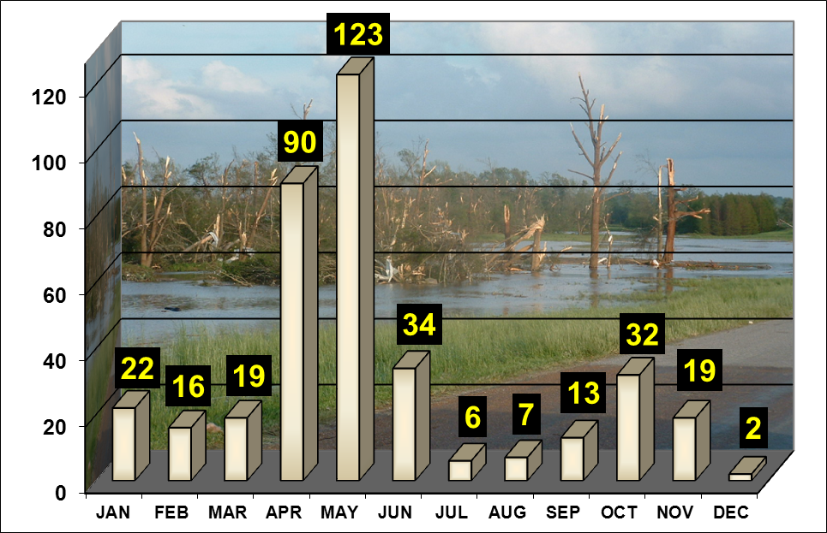
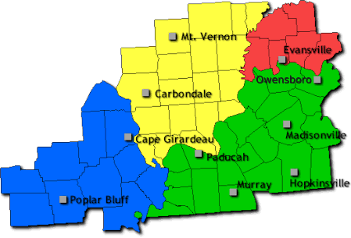
Tornadoes Can Occur Any Month But Are Most Common In The Spring
Notes:
As this graph shows, tornadoes can occur during any month of the year in our region. The small map in the upper right shows the forecast and warning area for the National Weather Service Office in Paducah. While April thru June is our peak time for tornadoes, tornadoes do occur during the winter months when warm air and the fast moving wind flow of winter don’t mix well. Wind fields are typically stronger in the winter than summer, and if tornadoes do occur in the winter months they tend to be stronger.

Slide 7
Tornadoes in the Paducah CWA: 1996-2011
Average # of tornadoes: 21
Notes:
This chart shows the number of tornadoes that have occurred in the warning area for the National Weather Service Office in Paducah since 1996, when their area of responsibility expanded. The average number of tornadoes in a year is 21.

Slide 8
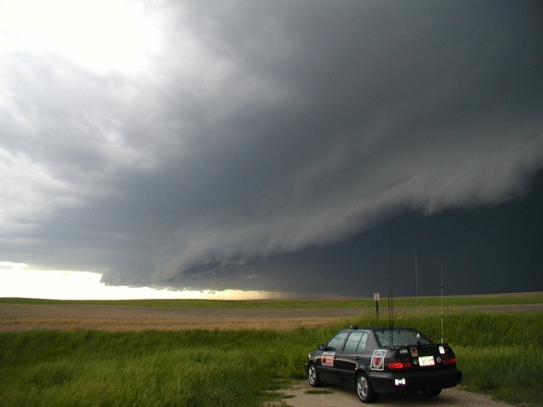
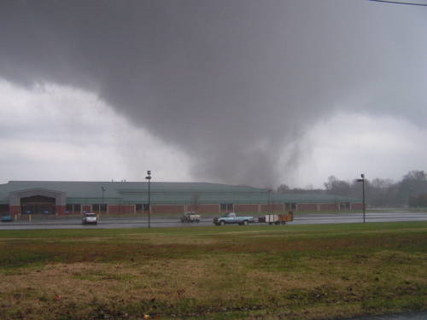
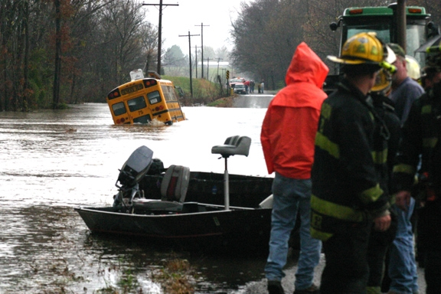
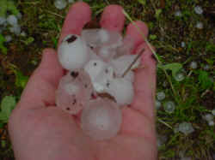
Severe Weather Events
Tornado
Straight Line Winds (58 mph or greater)
Flash Flood
Hail (1” or larger)
Lightning
EF4 Tornado near Madisonville, KY
November 15, 2005
Photo Courtesy of the Marion Daily Republican
Flash Flood, Southern Illinois, November 2005
Large Hail, Paducah, Kentucky
May 4, 2003 (Up to tennis ball size hail fell)
Notes:
Severe weather in our area includes: tornadoes, straight line winds of 58 mph or greater, flash floods, and hail greater than one inch. Lightning is not considered “severe weather”. Lightning by definition occurs with all thunderstorms but this should not diminish its danger.

Slide 9
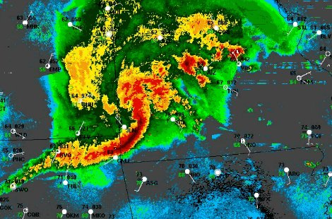
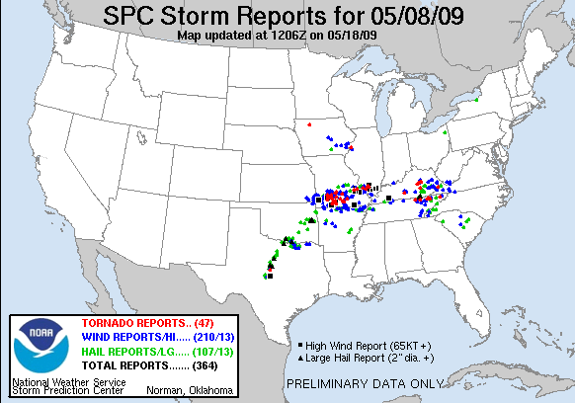
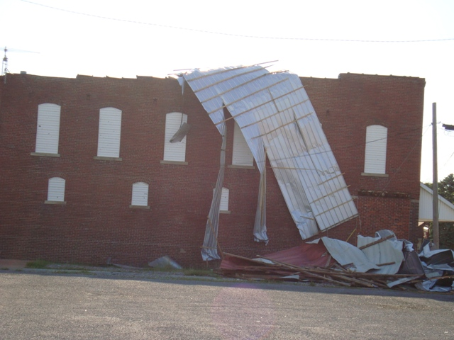
Derecho
This was at 6-7AM!
These storms produced damage from Kansas to Illinois!
Notes:
The RIJ can help to produce a large area of significant wind damage. It can be 10 to over 50 miles wide. This is most likely to occur along and north of the apex area of the bow. Depending upon the situation, small scale mesovortices can form along the leading edge of the derecho. These smaller circulations can locally enhance the wind speed (i.e. Microburst) or produce tornadoes.

Slide 10
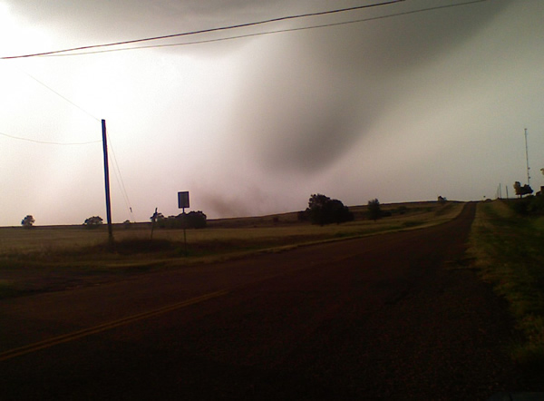
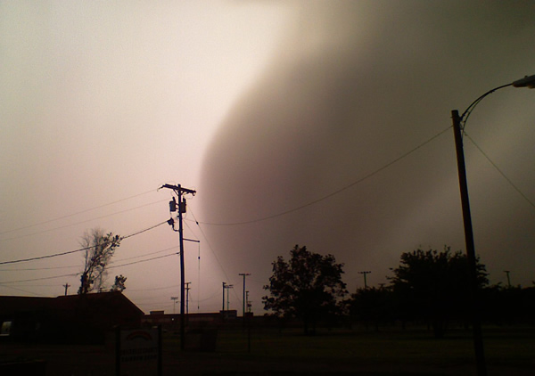
Thunderstorms Can Produce Damaging Winds
Winds were estimated between 75-95 mph…
A “downburst” from a thunderstorm recorded near Childress, TX in 2008.
Images courtesy Brian James, KVII-TV Amarillo.
Notes:
Thunderstorms can produce damaging winds. When cold, dense air comes rushing down out of a storm, it can produce as much damage as a lower-end tornado. Here is an example from Childress, TX in 2008. It produced winds between 75 and 95 mph.

Slide 11
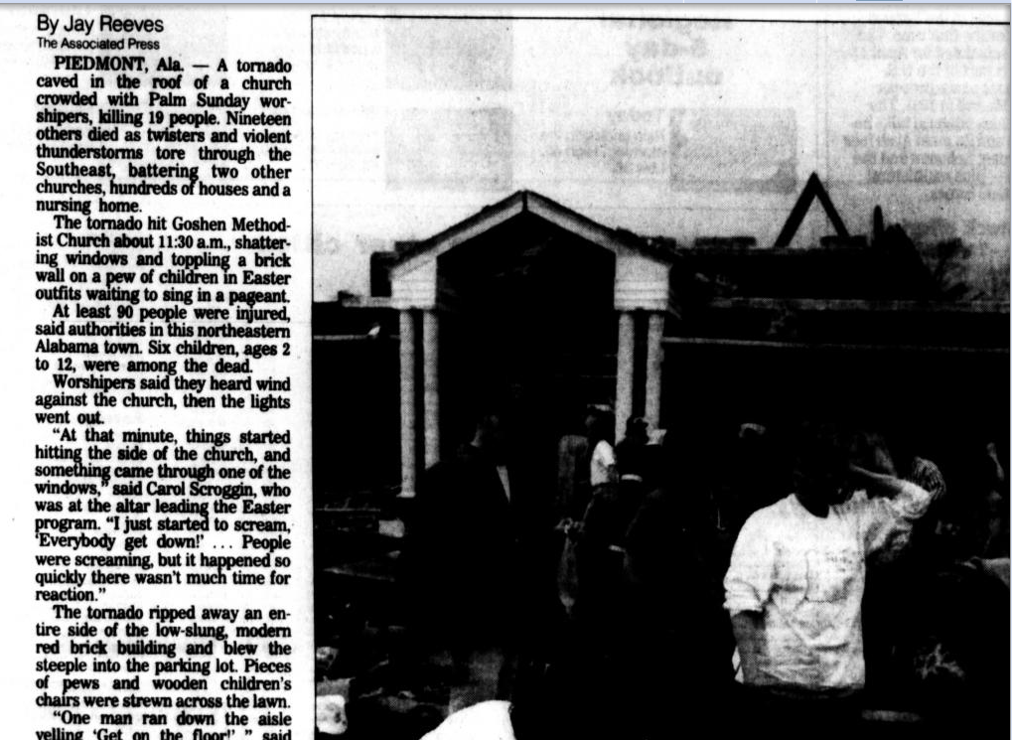
Palm Sunday Tornado Outbreak
March 27, 1994 (Palm Sunday morning)
Piedmont, Alabama
Twenty people were tragically killed at the Goshen United Methodist Church as a violent tornado moves across the area, ripping the roof off, and collapsing wall.
Notes:
The Palm Sunday Tornado Outbreak occurred on March 27, 1994
In Piedmont, Alabama, twenty people were tragically killed at the Goshen United Methodist Church as a violent tornado moves across the area, ripping the roof off, and collapsing wall.

Slide 12
Palm Sunday Tornado Outbreak
Unusual outbreak in the sense that it was at its strongest during the late morning hours (when church services were in session).
A very intense supercell thunderstorm produced a tornado in northeast St Clair County, and tracked northeast toward Piedmont.
At 11:39 a.m. CST, an F4 tornado slammed into the Goshen United Methodist Church collapsing the roof on a congregation during a Palm Sunday service.
Notes:
This was an unusual outbreak in the sense that it was at its strongest during the late morning hours (when church services were in session).
A very intense supercell thunderstorm produced a tornado in northeast St Clair County, and tracked northeast toward Piedmont.
At 11:39 a.m. CST, an F4 tornado slammed into the Goshen United Methodist Church collapsing the roof on a congregation during a Palm Sunday service.

Slide 13
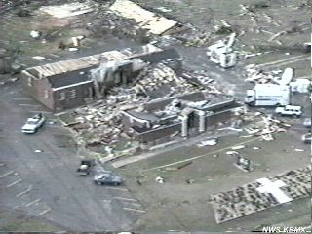
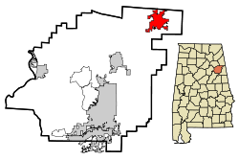
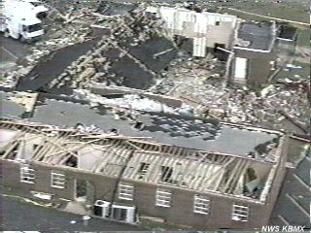
The storm entered Cherokee County at 11:35 am CST.
At 11:39 am CST the tornado destroyed the Goshen United Methodist Church located 1 mile north of the Cherokee/Calhoun County line on County Highway 9 killing 20 people and injuring 92.
St. Clair, Calhoun, Cherokee Counties - Tornado (F4)
Notes:
The storm entered Cherokee County at 11:35 am CST.
At 11:39 am CST the tornado destroyed the Goshen United Methodist Church located 1 mile north of the Cherokee/Calhoun County line on County Highway 9 killing 20 people and injuring 92.

Slide 14
Palm Sunday Tornado Outbreak: What went wrong here?
The National Weather Service issued severe thunderstorm warnings for eastern Jefferson and St. Clair counties at 10:24 a.m. and issued a tornado warning for Etowah and Calhoun counties at 10:49 a.m.
The tornado warnings broadcast over radio and television advised persons to seek immediate shelter.
At 10:53 a.m., local television and radio stations broadcast a tornado warning for St. Clair County.
At 10:55 a.m., the tornado struck southwest of Ragland in St. Clair County.
At 11:27 a.m., a revised tornado warning was issued for northern Calhoun, southeastern Etowah, and southern Cherokee counties.
At 11:39 a.m., the church in Cherokee County, approximately 32 miles northeast of the tornado's initial point of impact, was destroyed.
Notes:
So what went wrong?
This is a timeline of the warnings and reports for this tornado that morning. Note that warnings were issued for counties to the southwest of Cherokee County, where the church is located, at 10:49 am and 10:53 am. The warning for Cherokee County was issued at 11:27 am, 12 minutes before it struck the church.

Slide 15
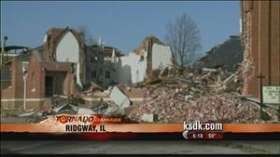
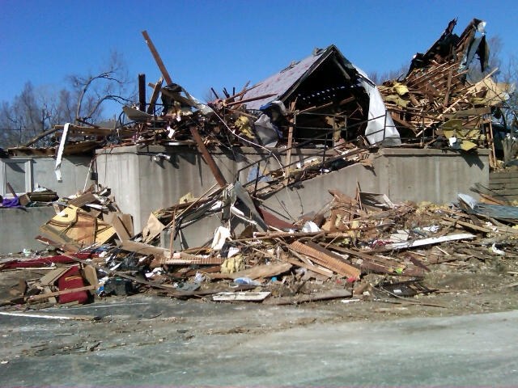
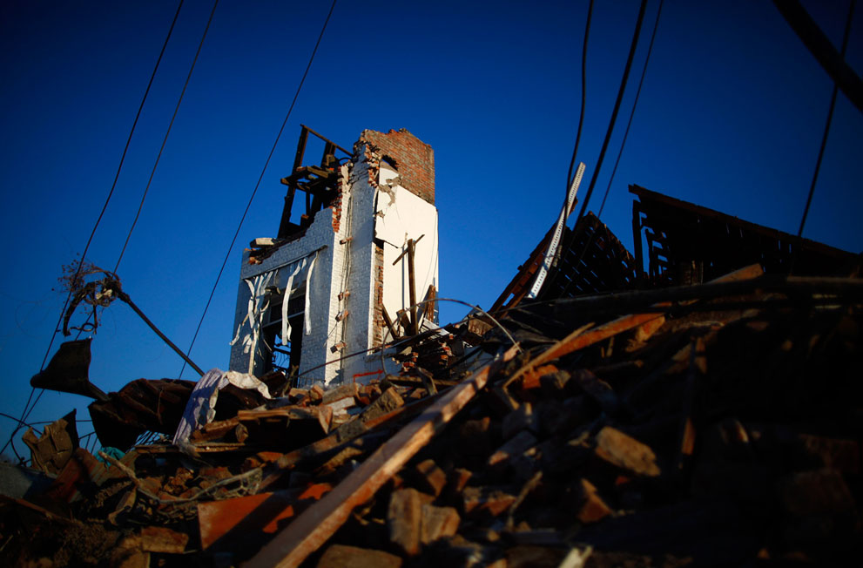
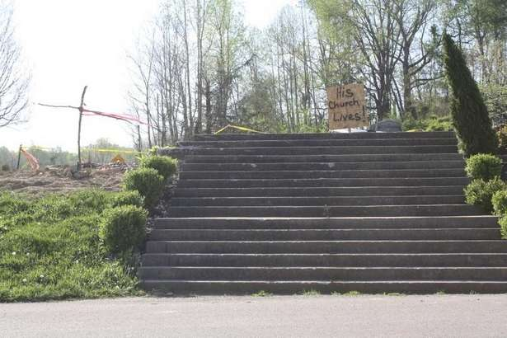
Other Local Events
Ridgeway Catholic Church
February 29, 2012
Julie Pohl http://www.kansaseast.org/galleries/slideshow/27
Harveyville, KS UMC
Reuters/Eric Thayer
A church in West Liberty, KY
Steps lead up to the gaping hole that was the
basement of Mt. Moriah Baptist Church in
Henryville on Easter Sunday. (By Jenna Esarey,
Special to the Courier-Journal) April 8, 2012.
Henryville, IN

Slide 16
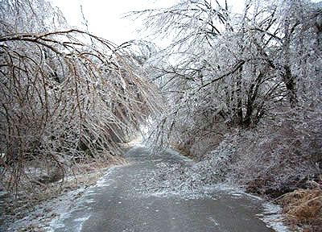
The Key is Basic Preparedness
KWPC Recommendations
Have a Plan!
Contact local EM for preparedness plan
Consider CERT training
Consider Spotter Training
Notes:
The Kentucky Weather Preparedness Committee recommends that:
Have a Plan!
Contact local EM for preparedness plan
Consider CERT training
Consider Spotter Training

Slide 17
The Key is Basic Citizen - Family - Congregation Preparedness
Questions to Ask?
Do we have a way to get weather information including Severe Weather/Tornado Messages?
Tornado Watches and Warnings?
Notes:
Questions you need to ask yourself:
Do we have a way to get weather information including Severe Weather/Tornado Messages? This is crucial. Is there someone or a group responsible for getting watches and warnings when people are gathered at the church?
Do we have a NOAA Weather Radio? Where is it located? If there is threatening weather during church services/meetings, will someone be monitoring it?
If a warning is issued, what will you do? High span roofs, such as those found on most church sanctuaries, are not safe! Where will the congregation be moved? How fast can this be accomplished? How much notice will you need to move all to a place of safety?

Slide 18
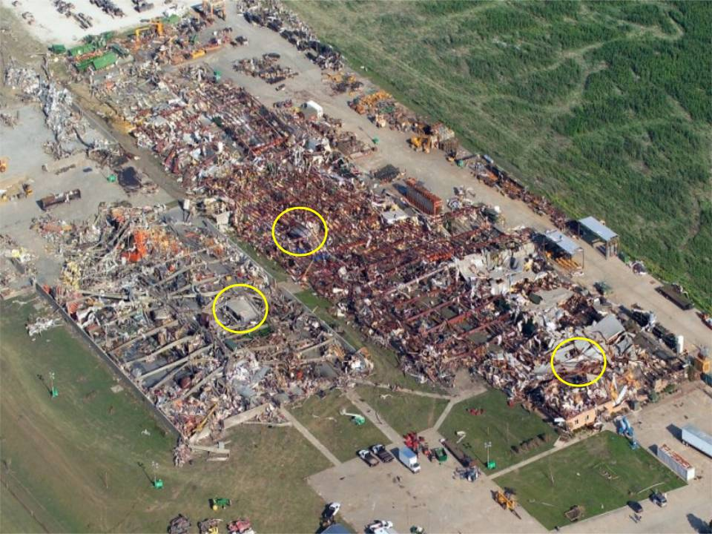
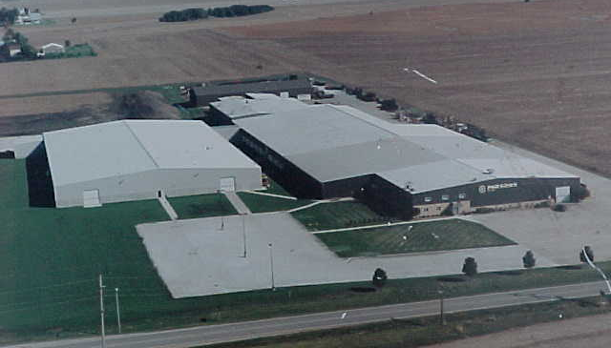
Great example of preparation…
Parsons Manufacturing 120-140 employees inside
July 13, 2004 Roanoke, IL
Storm shelters
F4 Tornado – no injuries or deaths with lead time due to spotter reports
Notes:
While this is not a church, it is a series of buildings with high-span roofs. This company had a plan with designated storm shelters. They also had 2-3 volunteers that kept up with the weather. They were responsible for keeping management informed.
(click to show the “after” picture)
This was after the F4 tornado moved across the plant. The storm shelters are marked. There were no injuries or deaths.

Slide 19
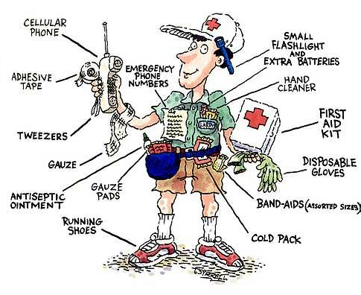
The Key is Basic Citizen - Family - Congregation Preparedness
Questions to Ask?
Do we have a plan to check on church members, especially the elderly ?
City leaders need your help!
Notes:
If a disaster strikes your community, do you have a plan for checking on members of the congregation? Do you have members that can check on the elderly?
By keeping a list of those okay and those in need of assistance, you can help first responders get to those who need the most help.

Slide 20
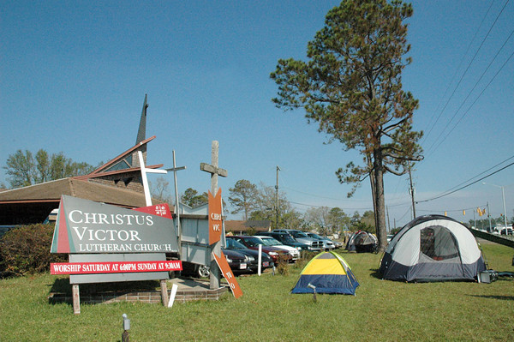
Provide or house volunteers?
Need to contact local Emergency Management and get some training!
Volunteers can actually slow down response/recovery efforts without proper training!
Lutheran Disaster Response coordinators are pitching tents to house volunteers who are needed for clean-up work in Hurricane Katrina-affected areas.
Notes:
As a leader in your community, are you able to assist in recovery efforts? Can you supply volunteers? Can you house or feed volunteers?

Slide 21
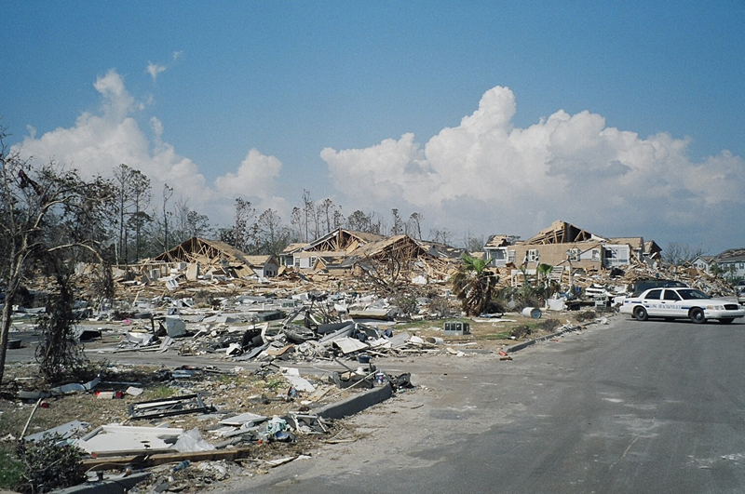
Are you available to help shelter residents after a storm?
Need to contact local Emergency Management and get some training!
Government entities are involved in response efforts, but not as much in recovery efforts!
Damage from Hurricane Katrina
Notes:
Can you provide shelter for those that find themselves homeless after a disaster?

Slide 22
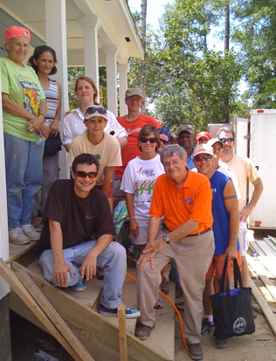
The Key is Basic Citizen - Family - Congregation Preparedness
Questions to Ask?
Do we have a training plan?
Churches and other faith based organizations can provide basic safety training for its members.
Local churches have the “pulse of the community”
Notes:
Do you have a plan to answer these questions? What can you do for your congregation and your community?

Slide 23
The End

